Slide 1
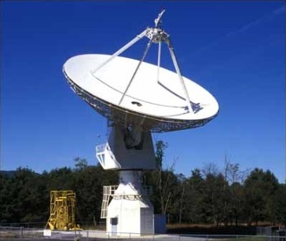
SARA Global Conference 2024 H1 Observations (“Off the Beaten Path”)

Slide 2
Agenda
20 Meter Dish Demo
H1 Introduction (Rotation Curves and Doppler)
Red Shifts H1
Lockman Hole H1
Globular Cluster H1
Galactic Worm H1
Extra-Galactic H1
Colliding Galaxies H1
Quasars H1
Cas A H1 (H1 Absorption Line-of-Sight)
H1 and the ISM
Summary and Open Forum

Slide 3
20 Meter Dish Demo
This 20m Demo and SARA Section Update are posted on SARA Analytical Section page
Also Posted:
2019 demo presentation posted (Cas A Flux Density Calculation)
2020 demo presentation posted (Pulsars)
2021 demo presentation posted (Masers)
2022 demo presentation posted (Raster Scans)
2023 demo presentation posted (Inter-Stellar Matter [ISM])
Green Bank Conference Account - Explore!
Demo Example – Watch the dish move outside!
See Green Bank and McGill University scientist Ryan S. Lynch’s “Searching for and Identifying Pulsars” guide posted on the internet.
http://www.gb.nrao.edu/20m/psr20m_advice.html
https://www.physics.mcgill.ca/~rlynch/Outreach/PSC_search_guide.pdf
https://astronomy.swin.edu.au/cosmos/p/pulsar+dispersion+measure

Slide 4
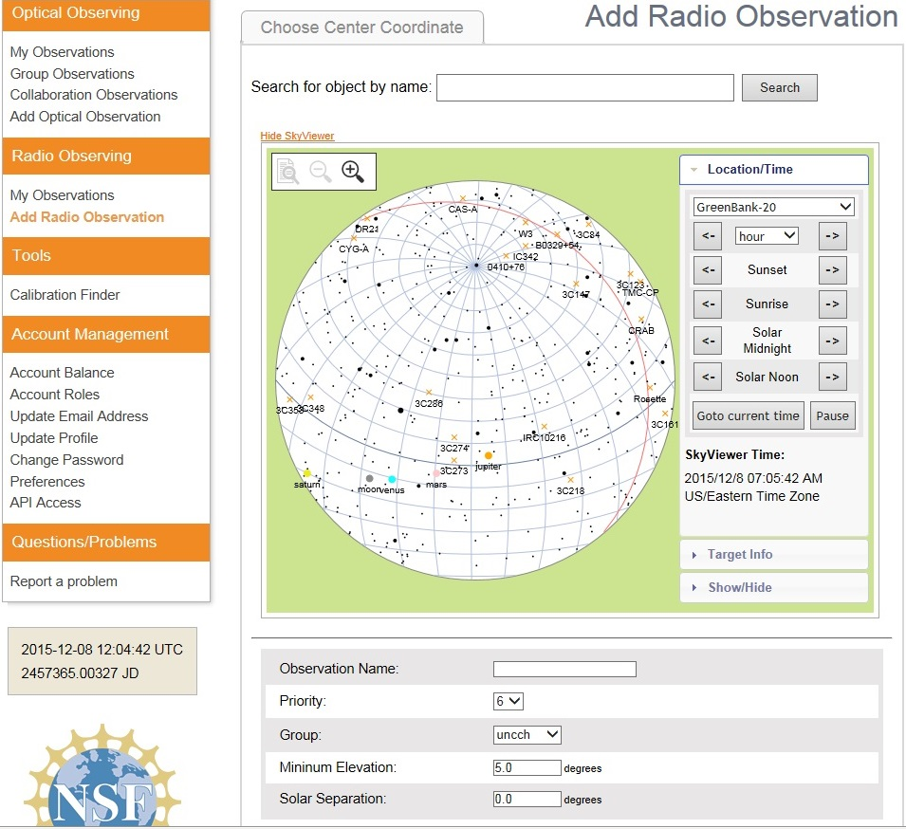
20 Meter Dish Demo
Add a Radio Observation
-Select an Object
(Database or RA/Dec)
-Minimum Elevation
(Used for mapping)
-Solar Separation
(to prevent solar side lobe
interference)

Slide 5
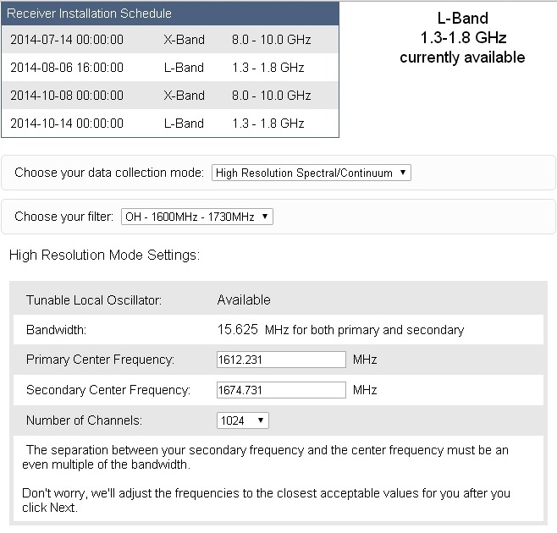
20 Meter Dish Demo
Configure Receiver
Low Resolution: continuum mapping/pulsars
High Resolution: Spectral Lines
No Filter Full Band (with interference)
H1 Filter (continuum maps, 1355-1455 MHz)
OH Filter (Iridium sat. interference, 1.6-1.73 GHz)
Data Collected in Bins: Time bins (data collected in a small chunk of time) or frequency bins (data collected in a small chunk of observing frequency).
X-Band: Aug. 28- Nov. 27, 2017

Slide 6
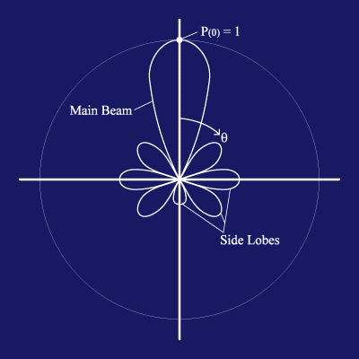
20 Meter Dish Demo
https://www.gb.nrao.edu/20m/map20m_advice.html
Credit: http://www.ras.ucalgary.ca › radiotel › calibration
Beam and Beamwidth (Visualization Basics)
The beam is the area on the sky in which radiation will be detected by the radio telescope. In terms of the telescope as a receiver of radiation, it will respond to the radiation coming in along that same beam as if it were a transmitter. In general, a smaller telescope has a wider beam. The reflecting dish of the radio telescope gives the antenna considerable directionality by focusing radio waves from a particular direction onto the horn. It is still sensitive to radiation from directions other than the pointing direction. The largest lobe is called the main beam and the smaller lobes are called side lobes.
The beamwidth of the full width half maximum (FWHM) of the main beam: This defines the resolution of the telescope. When a point source is in the most sensitive part of the main beam, the measured signal will be highest. As the point source is moved away from the center of the main beam, the measured signal will decrease. Therefore, by moving the point source through the main beam, the shape of the main beam is mapped out. Only structures on angular scales larger than the telescope's beam can be revealed. The angular resolution of a given antenna system is limited by the beamwidth. The 20-meter telescope is like a camera with one pixel, or beam. To make an image, one must scan the telescope back and forth across the object and build up an image, pixel by pixel.
Beamwidth (BW) = 70λ / D. It’s related to resolution. λ is the observing wavelength, and D is the telescope diameter. λ = 0.3 / frequency
For the 20m radio telescope:
The 8-10 GHz receiver has a beam size of about 7 arcmin.
The 1.4 GHz receiver has a beam size of about 44 arcmin.
(Some calculate a 0.6 degrees full width half maximum power response)
The antenna 3dB beamwidth is the angle between the half-power of an antenna pattern or beam over which the relative power is at or above 50% of the peak power. Example : An antenna has a diameter of 2m and frequency 16GHz. Calculate the 3 DB beamwidth for the antenna. To find 3 dB Beamwidth, first calculate the value of λ, Substitute the values in the λ formula, λ = 0.3 / frequency λ = 0.3 / 16 λ = 0.01875. Substitute the values in the beamwidth formula: Beamwidth = ( 70 * 0.01875 ) / 2 = = 1.3125 / 2 degrees = = 0.656 degrees
The sensitivity of a telescope is not uniform across the beam. In most cases, the telescope is most sensitive to radiation entering the telescope straight-on, and the sensitivity fades off towards larger angles. Radiation that enters in the beam but off-center might produce a response in the receiver 80% of that when it enters in the very center.
The Radio telescope system temperature is the amount of noise that will appear in a measurement and which the signal from the source (measured as antenna temperature) needs to stand out from to be detected.
The angular resolution is given by: θ ~ λ/D
See https://www.omnicalculator.com/physics/angular-resolution
(Allows use of multiple units)
BW = 1.2λ/D (in radians)
BW = 62/Fghz (in arcminutes); Fghz = GHz (instead of λ)
(for a 20-meter telescope)

Slide 7
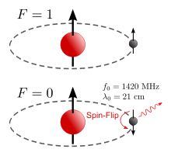
H1 Introduction
There are a few observations that can be made for H1 besides the usual galactic plane mapping and calculations for the galaxy’s rotation. Mapping H1 emissions can be used to determine the spiral structure of spiral galaxies. But first, lets explore what H1 is.
A hydrogen atom with proton and electron spins aligned (top) undergoes a flip of the electron spin, resulting in emission of a photon with a 21 cm wavelength (bottom). [https://en.wikipedia.org/wiki/Hydrogen_line]
An H1 region is a cloud in the interstellar medium composed of neutral hydrogen (H1). H1 regions are most stable at temperatures below 100K or above several thousand K. Gas between these temperatures heats or cools very quickly to reach one of these stable temperature regimes.
https://en.wikipedia.org/wiki/Hydrogen_line
So, what H1 observations are possible and not possible with the 20m GBO radio telescope?

Slide 8
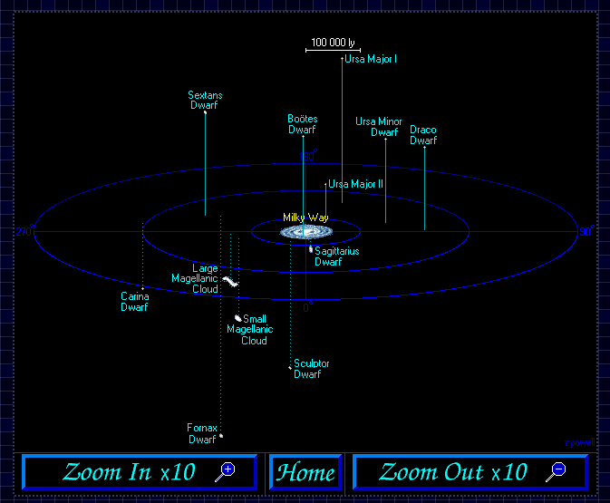
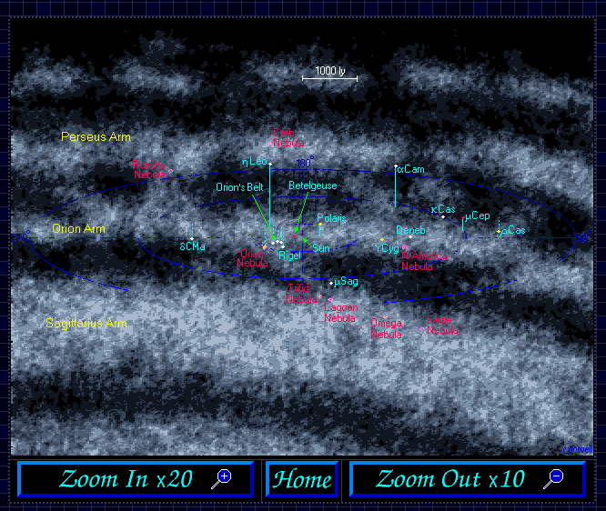
H1 Introduction
H1 emissions are everywhere in the celestial sky. Mapping H1 can be used to determine the spiral structure of spiral galaxies, and well as determine the rotation velocity.
https://www.icc.dur.ac.uk/~tt/Lectures/Galaxies/LocalGroup/Back/sattelit.html
https://www.icc.dur.ac.uk/~tt/Lectures/Galaxies/LocalGroup/Back/galaxy.html
https://www.icc.dur.ac.uk/~tt/Lectures/Galaxies/LocalGroup/Back/5000lys.html

Slide 9
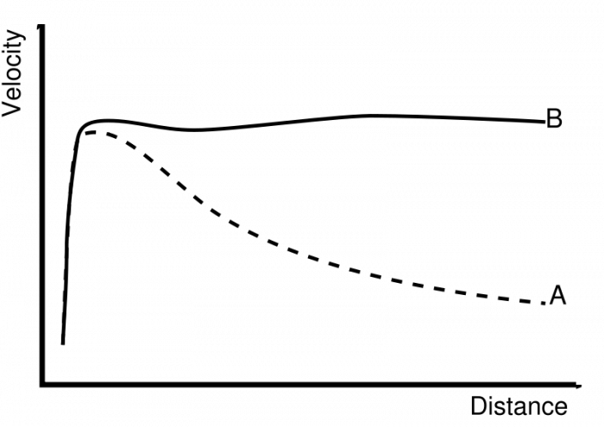
H1 Introduction
Rotation Curves: The rotation curve of the Milky Way Galaxy provides strong evidence for dark matter in the Milky Way. The matter we can see is half of the mass that Kepler's law finds.
Below: Rotation curve of a typical spiral galaxy: predicted (A) and observed (B). The discrepancy between the curves is attributed to dark matter. Credit: Wikipedia
Main Problems of the Theoretical Physics and Artefacts of Local Physics
January 2021, Journal of Modern Physics 12(07):1048-1108

Slide 10
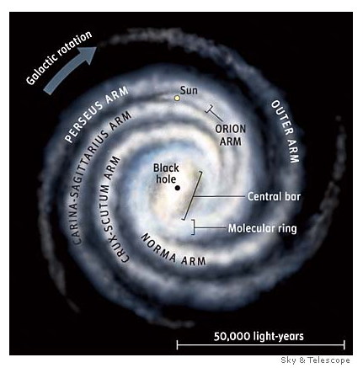
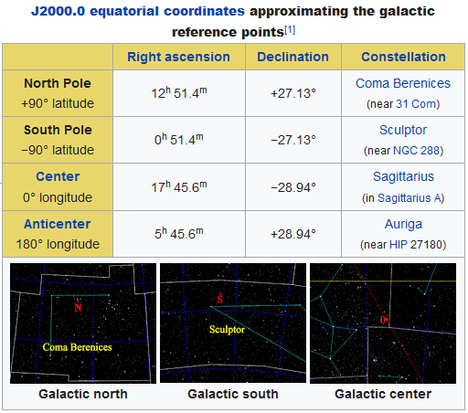
H1 Introduction
Get Your Bearings: Know the observing direction and direction of galactic motion. For the most part, observe blueshifts for galactic longitudes of 45-100 degrees and redshifts for 160-245 degrees.
Reference: https://en.wikipedia.org/wiki/Galactic_coordinate_system
See: Mapping the Milky Way: A Radio Astronomy-Directed Investigation for Lecture-Based Astro 101 Courses, Kathryn Williamson, Dan Reichart, Colin Wallace, Edward E. Prather, and Seth Hornstein

Slide 11
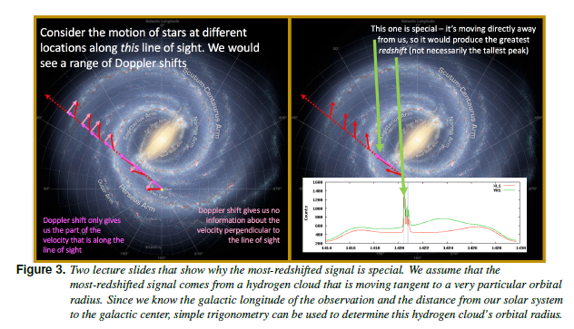
H1 Introduction
Spirals Arm Observations
Reference. Mapping the Milky Way: A Radio Astronomy Directed Investigation For Lecture-Based Astro 101 courses
https://rtsre.org/index.php/rtsre/article/view/18

Slide 12
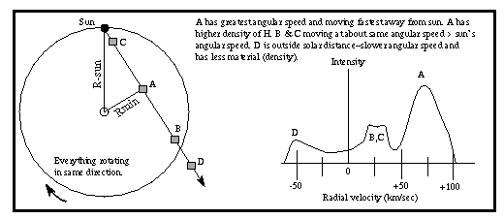
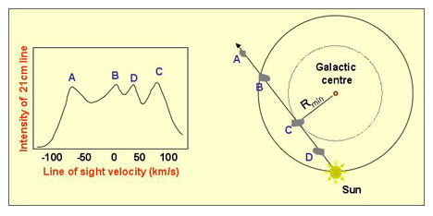
H1 Introduction
The Doppler Effect One can use the Doppler effect equation to calculate the radial velocity of an object if the original (unshifted) wavelength of the light emitted, and the difference between the wavelength of the emitted light and the original wavelength, are known. For a given absorption or emission line, The exact wavelength the line is known from laboratory observations, where the source of light is not moving. One can measure the new wavelength with instruments at the telescope, determining the difference in wavelength due to Doppler shifting. Since the speed of light is constant, one can then calculate the radial velocity of an object.
For example, a particular emission line of hydrogen is originally emitted with a wavelength of 656.3 nm from a gas cloud. At the telescope, the observed wavelength of the emission line is 656.6 nm. Because the light is shifted to a longer wavelength (redshifted), this gas cloud is moving away. The speed can be calculated using the Doppler shift formula:
https://pressbooks.online.ucf.edu/astronomybc/chapter/5-6-the-doppler-effect/

Slide 13
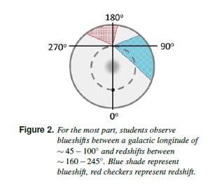
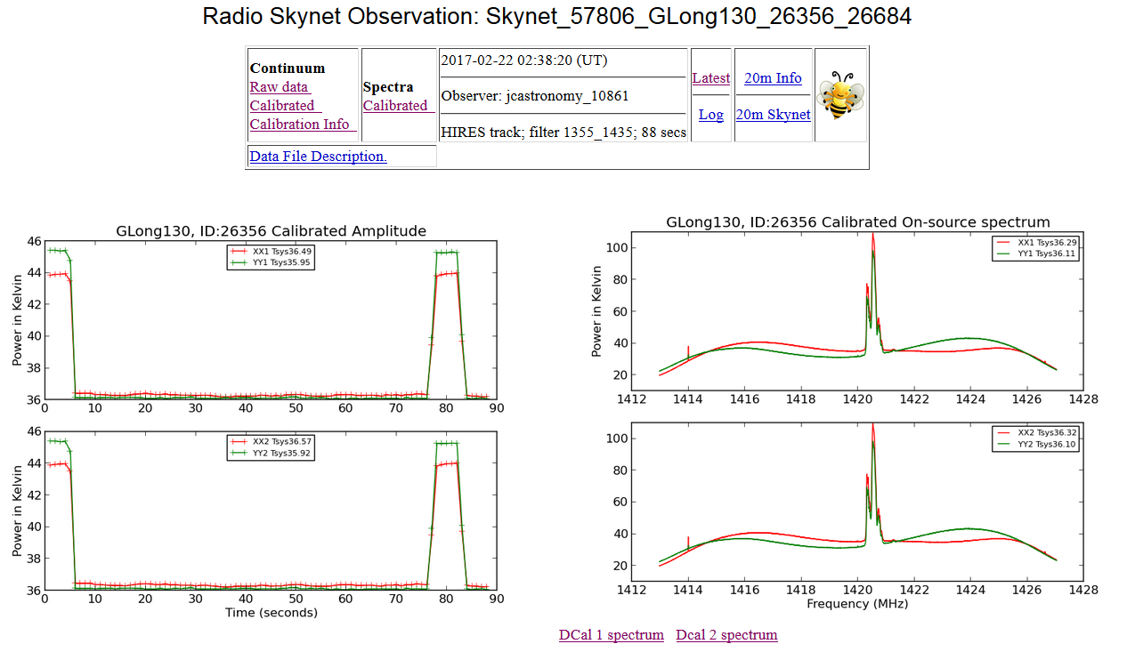
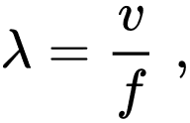
H1 Introduction
20m Example: Galactic Long. 130
A redshift is an increase in the wavelength, and corresponding decrease in the frequency and photon energy, of electromagnetic radiation.
20m Tip: Skynet observational logs with “GL” in their titles refer to galactic longitude observations, and not “Gliese” or other types of astronomical targets. Check data headers to confirm.
Notes:
20 Meter Quick Look Data. To zoom in on these spectral lines, import the ascii data into excel.

Slide 14
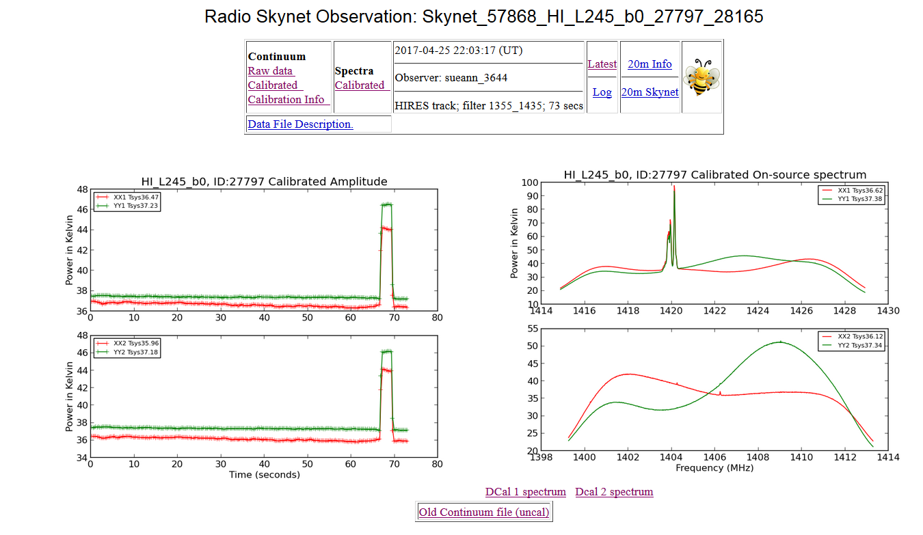
H1 Introduction
20m Example: Galactic Long. 245

Slide 15
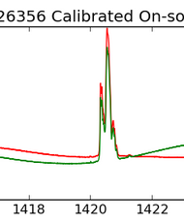
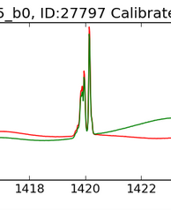
H1 Introduction
20m Doppler Comparisons: Superimposing the last two charts over the H1 rest line
L=245
L=130
Ref: Mapping the Milky Way: A Radio Astronomy-Directed Investigation for Lecture-Based Astro 101
Courses. Kathryn Williamson, Dan Reichart, Colin Wallace, Edward E. Prather, and Seth Hornstein.
(Note abscissa is frequency and not wavelength)
1420.4 MHz

Slide 16
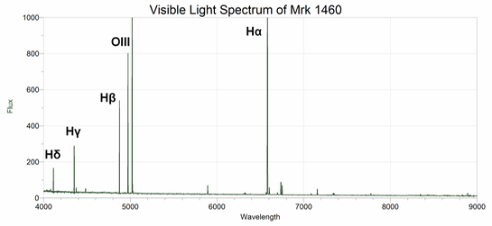
Red Shift Calculations
Optical Redshifts: Doppler shifts arise from the relative motion of source and observer through space, whereas astronomical redshifts are due to the expansion of space itself. The emission spectra of most galaxies (including quasars) are dominated in the optical by hydrogen lines (the Balmer series) and oxygen lines. In the spectra of quasars, a pair of strong lines caused by oxygen molecules that have been doubly ionized (OIII) can be found at 500.7 nm and 495.9 nm. A second pair of strong lines (OII, singly ionized) can be found at 372.7 nm and 373.0 nm.
Concept Example: See spectrum of the galaxy Mrk 1460 shown below. (Mrk 1460 is very close to the Milky Way and therefore does not have a detectable redshift: it is of the order z = 10⁻⁴). The x-axis of the plot is in Angstroms. The ordering and relative spacing of these emission lines will not change. Hα will always be at a longer wavelength than Hβ, and Hγ will be at a longer wavelength than both Hδ and Hε.
Optical Example before Attempting Radio Example
(Note abscissa is wavelength and not frequency)
https://itu.physics.uiowa.edu/labs/advanced/astronomical-redshift/part-2-measuring-redshifted-wavelengths

Slide 17
Red Shift Calculations
Measuring an Optical redshift/blueshift:
1) Find the spectrum of a target that shows spectral lines 2) Identify which line was created by which atom, ion, or molecule 3) Measure the shift of any line with respect to its expected wavelength 4) Use a formula that relates the observed shift to the object's velocity.
Rest Wavelengths of Hydrogen - Balmer Series
Name | Color | Wavelength (Angstroms)
Alpha (a) | Red | 6562.8
Beta (b) | Blue-green | 4861.3
Gamma (g) | Violet | 4340.5
Delta (d) | Deep Violet | 4101.7
https://skyserver.sdss.org/dr1/en/proj/basic/universe/redshifts.asp

Slide 18
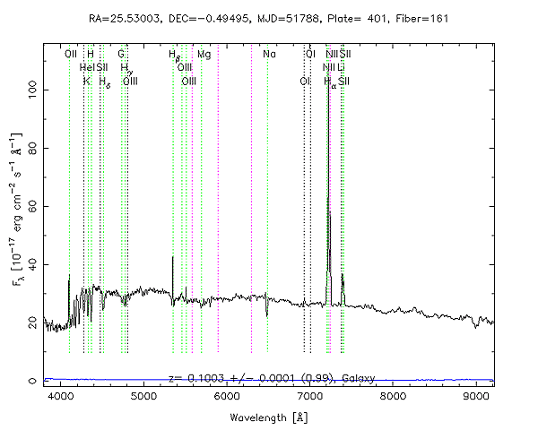
Red Shift Calculations
Optical Example: Check out the spectrum to the right: This spectrum comes from a galaxy and shows strong spectral lines. The hydrogen lines are identified: the tallest peak is the line (marked Ha), the second tallest is the b line. The g and d lines are valleys instead of peaks.
Wavelengths of Hydrogen - Balmer Series for Object ID # 587731512071880746
Name | Color | Wavelength (Angstroms)
Alpha (α) | Red | 7220
Beta (β) | Blue-green | 5360
Gamma (γ) | Violet | 4780
Delta (δ) | Deep Violet | 4500
https://skyserver.sdss.org/dr1/en/proj/basic/universe/redshifts.asp
Read off the wavelengths of the Balmer lines on the x-axis of the spectrum to verify the entries in this table:

Slide 19
Red Shift Calculations
Calculation Example
The redshift is symbolized by z. The definition of z is 1 + z = l _{observed} / l _{rest}.
For example, taking the Balmer gamma line of galaxy 587731512071880746,
1 + z = 4780 / 4340.5 = 1.1, so z = 0.1.
If the observed wavelength were less than the rest wavelength, z would be negative - that would tell us that we have a blueshift, and the galaxy is approaching us.
Choosing the alpha, beta, or delta lines would also give approximately z = 0.1, regardless of which line you choose.
Interpreting Redshifts
To convert from redshift z to velocity v measured in kilometers per second, the formula is v = c z, where c is the speed of light, c = 300,000 km/sec.
In this example, the galaxy appears to be moving away from us at about 30,000 km/sec.
The formula v = c z is accurate only when z is small compared to 1.0 (0.1 would be OK in this sense).
The galaxies are not moving through space, but just being carried along by space as it expands.
The redshift indicates the size of the universe at the time the light left the galaxy. Because the universe is billions of light-years across, it takes billions of years for light from distant galaxies to reach us. Suppose the distance to galaxy 587731512071880746 was d(z) at the time the light left it that we are now observing (for z = 0.1, this time was roughly a billion years ago). In those billion years, the space in the universe has expanded, so that now the distance between our galaxy and it is d(0). Then 1 + z = d(0) / d(z).
It is interpreted that at the time corresponding to redshift z = 0.1, all galaxies in the universe were 10% closer together. A measured value of z = 0.2 corresponds to a time when galaxies were 20% closer together than they are now, and so on.
But these are optical observations, not radio observations!
Next slide begins radio observations
https://skyserver.sdss.org/dr1/en/proj/basic/universe/redshifts.asp

Slide 20
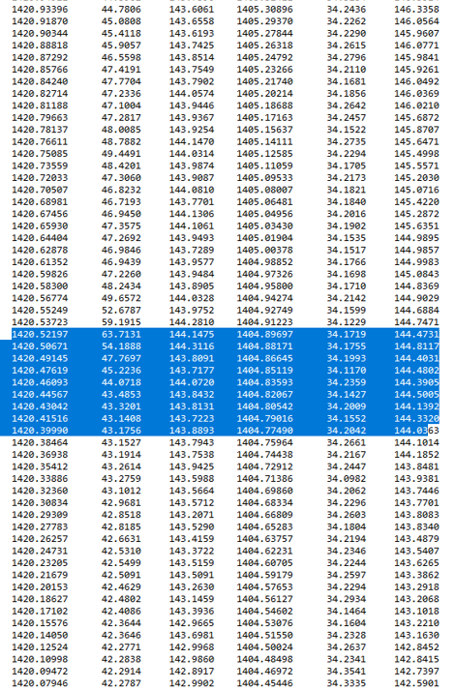
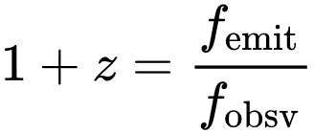
Red Shift Calculations
20m Radio Example: Andromeda Galaxy M31 Extra-Galactic H1
Using less than the recommended detection time.
https://www.gb.nrao.edu/20m/peak/ANDROMEDA1_TL/Skynet_59802_ANDROMEDA1_TL_82610_31374.A.spect.cal.txt
Duration: For observing hydrogen in nearby galaxies, 200 to 300 seconds is a good choice. This example uses 60 seconds.
1 + z = l _{observed} / l _{rest or}
H1 rest =1420.40575
Peak at 63.7131 with 1420.52197
1420.40575/ 1420.52197 = 0.999918185
Z = 0.999918185-1 = -0.000082815
Result is negative. This is likely to be M31.
The blueshift of the Andromeda galaxy is z = -0.00042
The galactic coordinates of Andromeda are longitude 121.2°, latitude -21.6°
Our Galaxy and Andromeda are pulling towards each other via gravity at 125 km/s (Given by v = c * Δλ/λ)

Slide 21
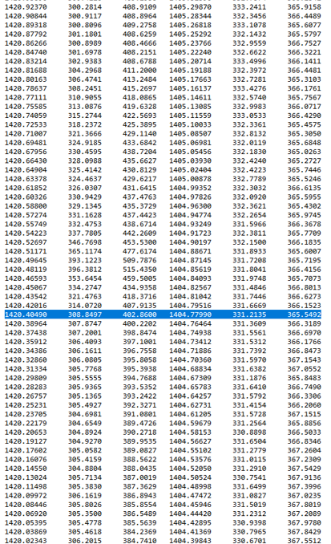
Red Shift Calculations
https://www.gb.nrao.edu/20m/peak/MESSIER_31-ST/Skynet_60085_Messier_31-ST_99590_48477.spect.cyb.txt
20m Radio Example: Andromeda Galaxy M31 Extra-Galactic H1
Using the recommended detection time
Duration: For observing hydrogen in nearby galaxies, 200 to 300 seconds is a good choice. My example uses 300 seconds as recommended.
1 + z = l _{observed} / l _{rest or}
H1 rest =1420.40575
Peak at 396.3812 with 1420.48119
1420.40575/ 1420.48119 =
0.999946891
Z= 0.999946891 -1 = -0.000053
Result about the same: this is likely M31. (Also see slide 32 for chart)
The blueshift of the Andromeda galaxy is z = -0.00042
Our Galaxy and Andromeda are pulling towards each other via gravity at 125 km/s
The galactic coordinates of Andromeda are longitude 121.2°, latitude -21.6°
Blueshifts for galactic longitudes of 45-100 and redshifts for 160-245.
Conclusion: Adjustments to duration, coordinates (actual real time epoch), actual peak power/counts between measurements, and other parameters can have effects.

Slide 22
Lockman Hole H1
Observing the Absence of H1
The Lockman Hole is an area of the sky in which minimal amounts of neutral hydrogen gas are observed. The Lockman Hole is a relatively clear window on distant objects, which makes it an attractive area of the sky for observational astronomy surveys. It is located near the pointer stars of the Big Dipper in the constellation Ursa Major and is ~15 square degrees in size. The Lockman Hole is named after its discoverer, astronomer F. Jay Lockman. The Lockman Hole is located at about RA 10h 45m, Dec. +58° and is defined by a region of low neutral hydrogen gas and dust column density.
https://en.wikipedia.org/wiki/Lockman_Hole

Slide 23
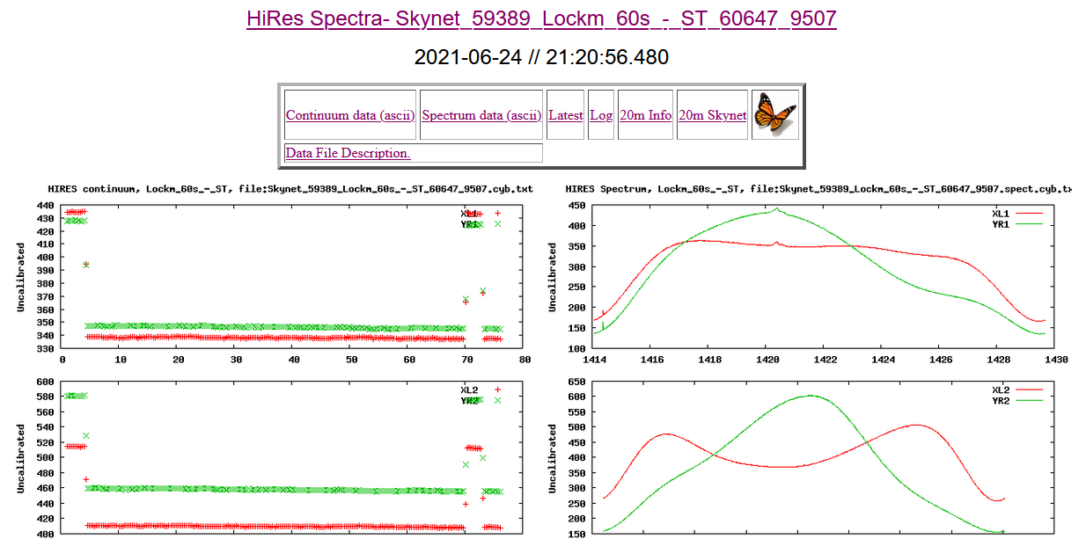
Lockman Hole H1
20m Observation of the Lockman Hole - Northern Hemisphere
(Chandra Deep Field South for Southern Hemisphere)
Considerations:
A rare nothing! Compare to slides 13 and 14.

Slide 24
Globular Cluster H1
Globular clusters: These are large packed clusters of stars that are in a somewhat symmetrical spherical shape. They are the oldest objects in the Galaxy, and are composed of Population II objects, about 11 billion to 13 billion years. They tend to have much smaller amounts of heavy elements than do the stars in the plane of the Galaxy. Globular clusters are found at high latitude and were formed before the material of the Galaxy flattened into a thin disk. The ISM in the solar neighborhood contains elements heavier than helium (i.e., metallicity), at a level of about 2% by mass, while the globular clusters contain as little as 0.02% of the same elements. Their considerable gravitational attraction makes them very stable and long-lived. The youngers stars have died, and the older ones remain, while stars in open clusters might disperse before they can become very old. The abundance of metals is higher for clusters near the galactic center than for those in the halo. The hydrogen in cluster stars is thought to amount to 70–75 percent by mass, helium 25–30 percent, and the heavier elements 0.01–0.1 percent.
Radio astronomical studies have set a low upper limit on the amount of neutral hydrogen in globular clusters.
https://www.britannica.com/science/globular-cluster

Slide 25
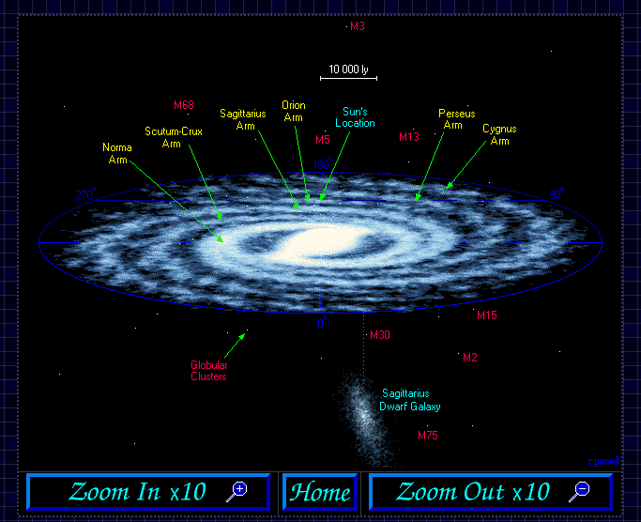
Globular Cluster H1
Examples: M13 is
in the galactic halo with very old stars.
Globular cluster M13 is visible to the unaided eye as a hazy patch of light
https://www.icc.dur.ac.uk/~tt/Lectures/Galaxies/LocalGroup/Back/galaxy.html

Slide 26
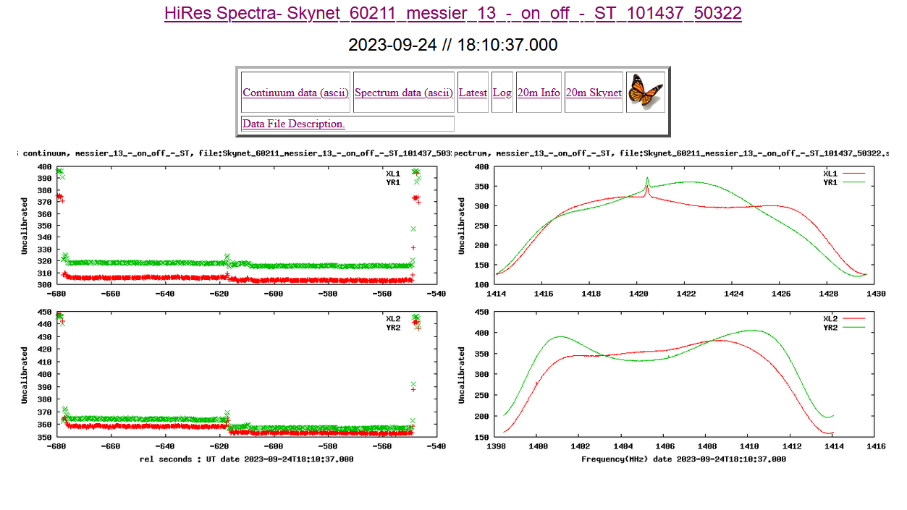
Globular Cluster H1
20m Example: M13
Radio astronomical studies have set a low upper limit on the amount of neutral hydrogen in globular clusters. Compare to slides 13 and 14, and 23.

Slide 27
Galactic Worm H1
Galactic Worm 123.4-1.5 (GW 123.4-1.5) is an H1 region with a mass of approximately 10⁵ M_{Sun}. It has an unusual mushroom-shaped structure that may be the result of having been formed by an infalling cloud slamming through the disc of the Milky Way from the other side. The high-velocity cloud in question is theorized as having hit at around 100 km/s, 5×10⁷ years ago.
The terms galactic worm (GW) and H1 worm have been used for apparent streaks of H1 (e.g., detected through 21-cm line surveys) perpendicular to the galactic plane that have been interpreted as candidates for the intersection of H1 supershells with the gas of the Milky Way galactic disk. They constitute a sign of the presence of the supershell.
Interstellar cloud
H I region
Observation data: J2000 epoch
Right ascension | 00^{h} 55^{m}
Declination | +61° 24′
Distance | 12,400 ± 3,900 ly (3800±1200 pc)
Constellation | Cassiopeia
https://en.wikipedia.org/wiki/GW_123.4-1.5
http://astro.vaporia.com/start/galacticworm.html

Slide 28
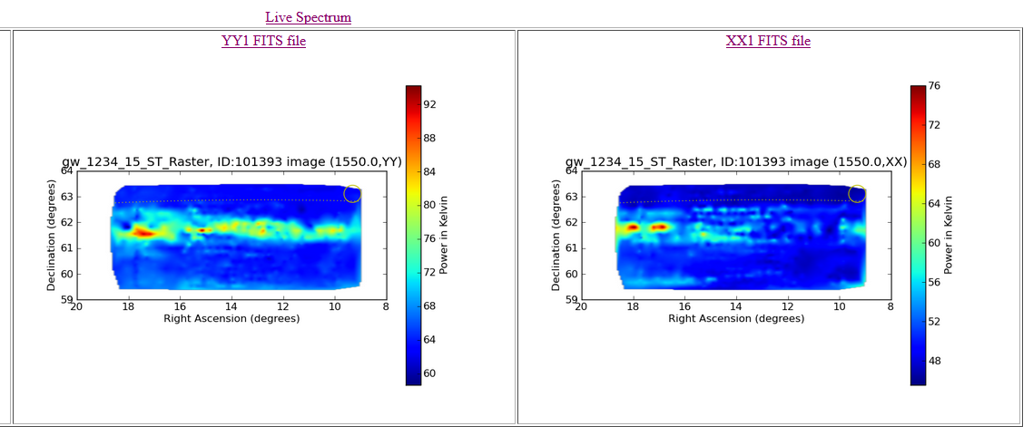
Galactic Worm H1
20m Target Resolution: The 20m Radio Telescope cannot resolve everything
Heiles (1984) identified H1 gas filaments “crawling” away from the plane of the inner Galaxy. These so-called “worms” were proposed to be parts of larger H1 shells blown by the energetic stellar winds or supernovae in stellar associations. Koo et al. (1992) later produced a catalogue of 118 Galactic worm candidates, defining as a worm any dusty, H I structure perpendicular to the Galactic Plane
Galactic Worm 123.4-1.5: A Mushroom-shaped HI Cloud
Jayanne English, A.R. Taylor, S.Y. Mashchenko, Judith A. Irwin, Shantanu Basu, Doug Johnstone
Conclusion: Galactic Worm H1 cannot be resolved with the 20m dish.

Slide 29
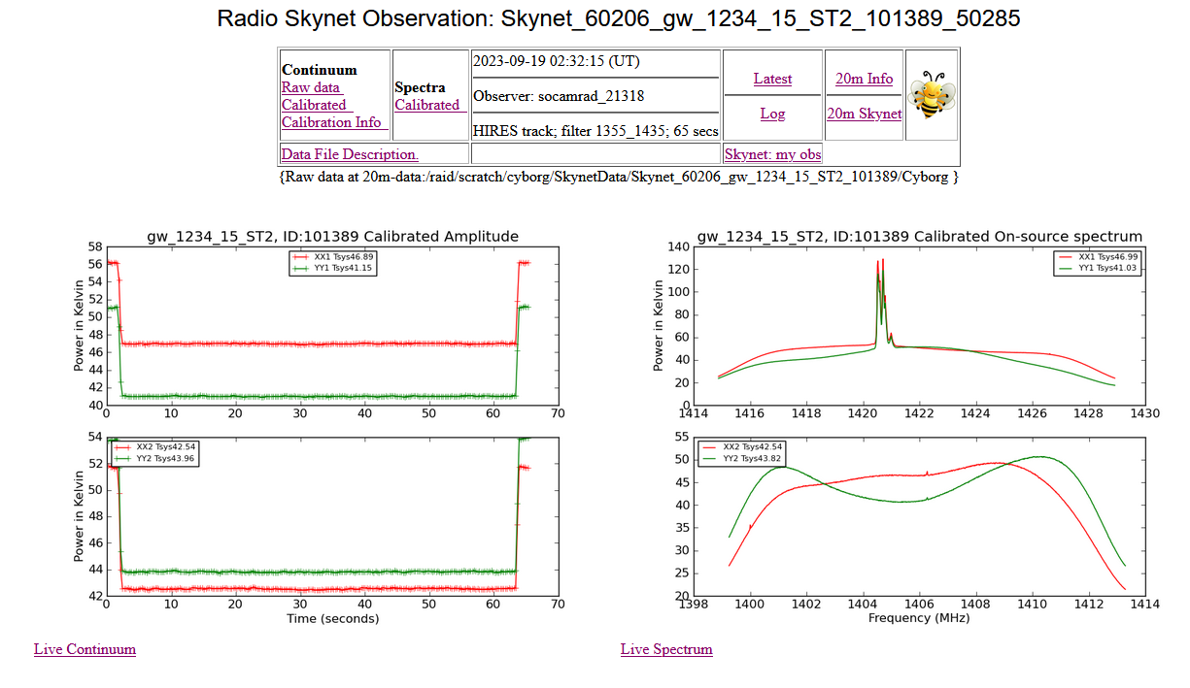
Galactic Worm H1
20m Example: This view of the Galactic Worm probably is observing the spiral arms of the Mily way.

Slide 30
Extra-Galactic H1
Path Type: On/Off Observe the object and a reference position some distance away. If doing continuum observations, this is good for measuring the strength (or flux density) of an object. For spectral line observations, it is good for observing fainter objects such as nearby galaxies.
Duration: time in seconds for each phase. 30 to 60 seconds is usually good for most cases. For observing hydrogen in nearby galaxies, 200 to 300 seconds is a good choice.
Offset: set this to a few beamwidths, so that the "off" or "reference" position is well separated from the "On" or "Source" position. 3 - 4 degrees is usually a good choice.
The total time this procedure will take is the Duration x 2.
Ref: https://www.gb.nrao.edu/20m/obsadvice.html
In the local universe, the H1 mass of galaxies has been measured via emission studies in the H1 21 cm emission line. It has not been possible to detect H1 21 cm emission from individual galaxies beyond fairly low redshifts, z ≳ 0.4, with the highest-redshift detection to date at z = 0.376 (e.g., Fernández et al. 2016).
Ref: https://iopscience.iop.org/article/10.3847/2041-8213/abfcc7

Slide 31
Extra-Galactic H1
20m Example: M31
Mapping H1 emissions can be used to determine the spiral structure of spiral galaxies. It is also used to map gravitational disruptions between galaxies. When two galaxies collide, the material is pulled out in strands, allowing astronomers to determine which way the galaxies are moving.
The original observation data is gone! Not so unexpected, and sometimes common, especially if something was observed that perhaps should not have been (i.e., the blue oval).

Slide 32
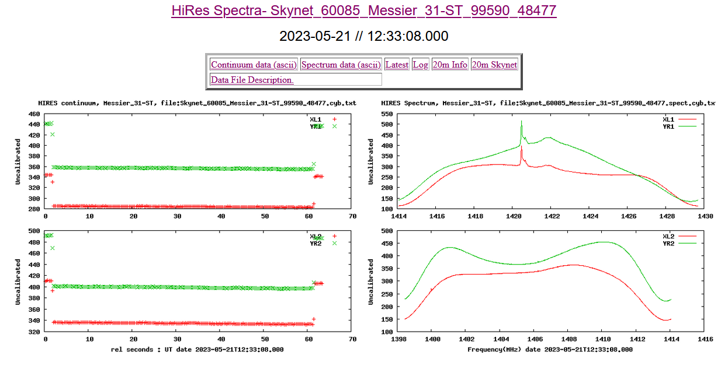
Extra-Galactic H1
20m Example: M31
https://www.gb.nrao.edu/20m/peak/MESSIER_31-ST/Skynet_60085_Messier_31-ST_99590_48477.spect.cyb.txt
See slide 21 Calculation:

Slide 33
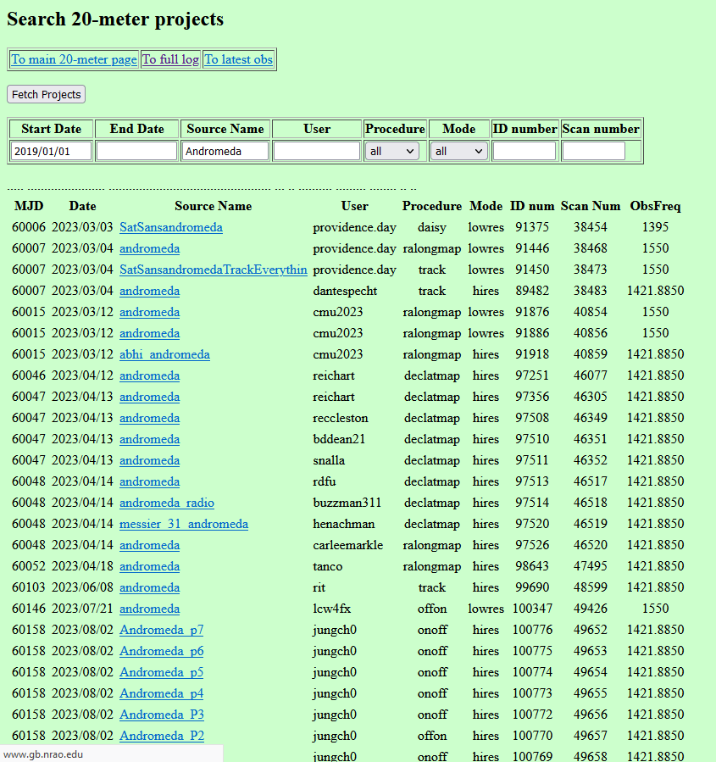
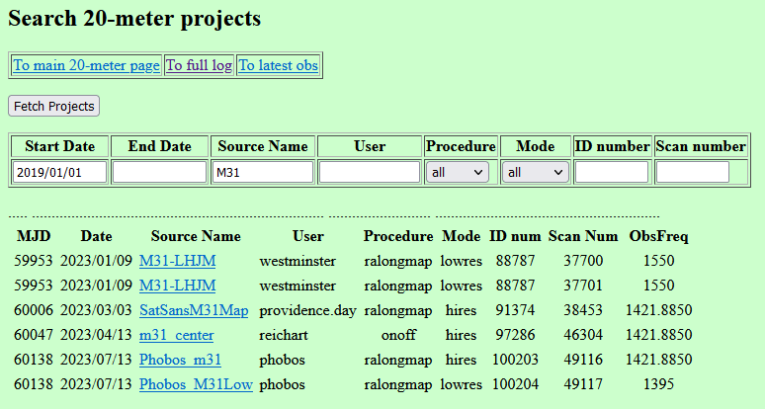
Extra-Galactic H1
Searching existing data for Andromeda Galaxy/ M31

Slide 34
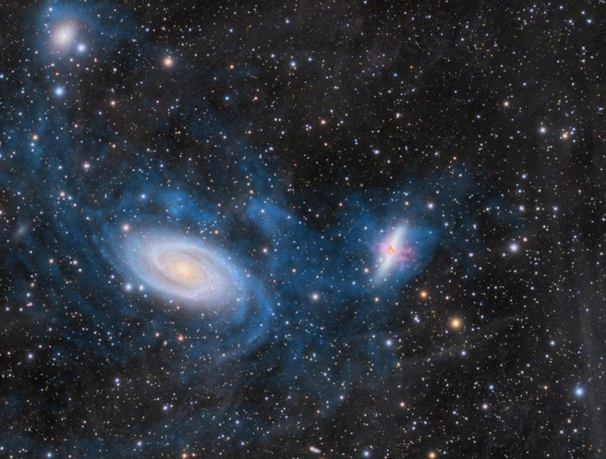
Colliding Galaxies H1
M81 and M82 are a pair of galaxies in the constellation Ursa Major. The apparent separation of the galaxies is 31 arc-minutes. They are 12 million light-years distance. Their actual distances from each other is 150,000 light years. Between full moons, the Moon's angular diameter can vary from 29.43 arcminutes at apogee to 33.5 arcminutes at perigee. For the 20m radio telescope The 1.4 GHz receiver has a beam size of about 44 arcmin. (See slide 6)
https://earthsky.org/todays-image/m81-and-m82-hii-emission-photos/

Slide 35
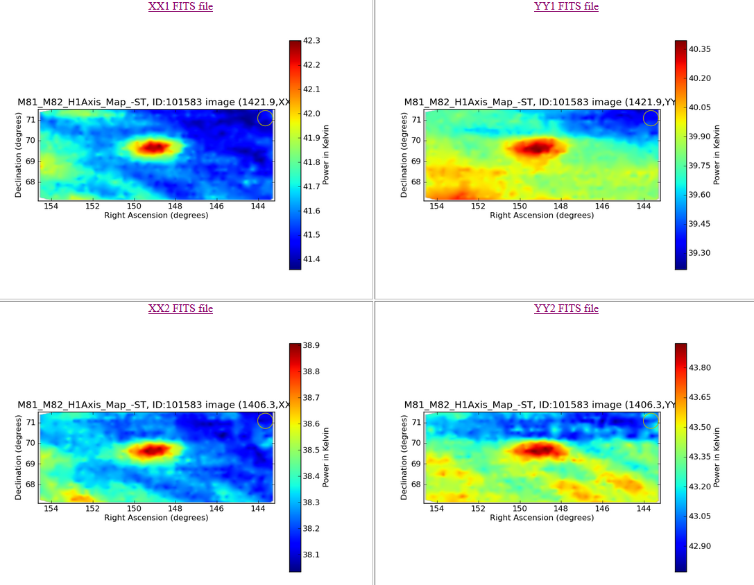
Colliding Galaxies H1
20m Example: Target coordinates at center axis between the M81/M82 galaxies

Slide 36
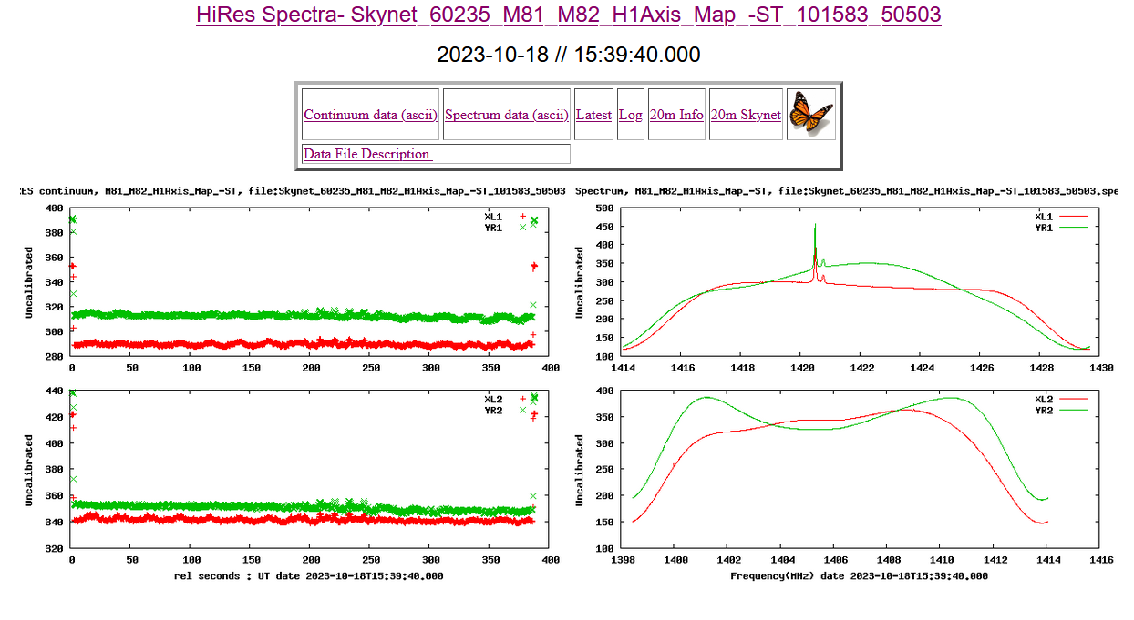
Colliding Galaxies H1
20m Example: Target coordinates at center axis between the M81/M82 galaxies.
Compare this to the M31 observation .

Slide 37
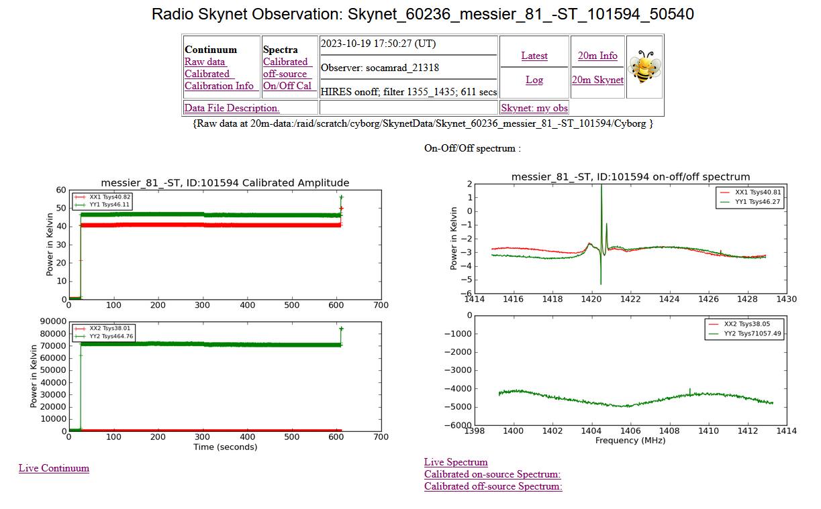
Colliding Galaxies H1
“Bee” Mode
20m Example: Centered on M81:
“Bee” Mode: On/Off

Slide 38
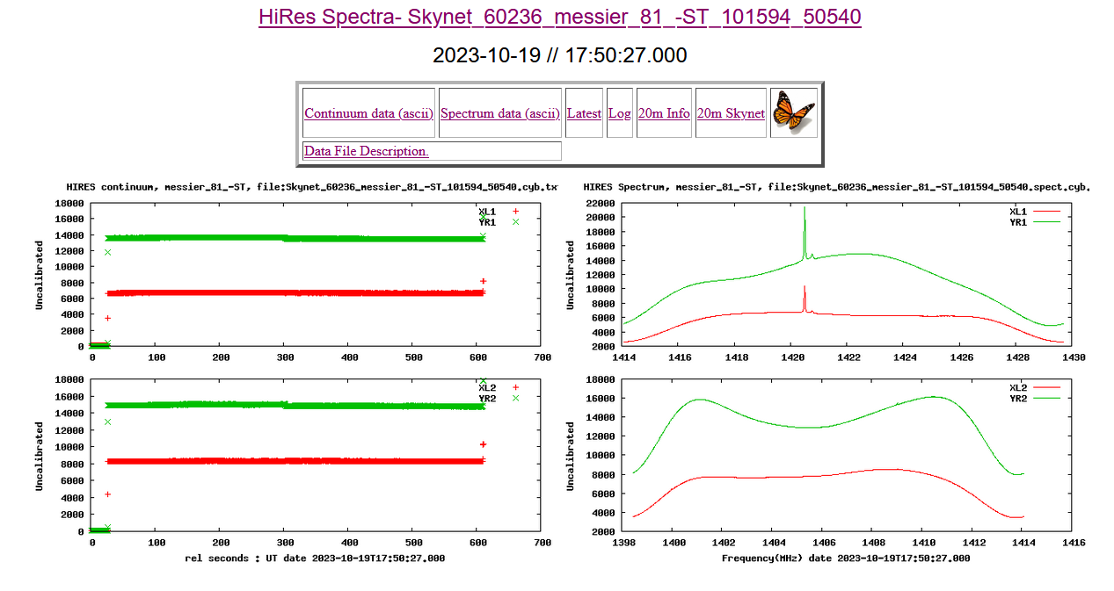
Colliding Galaxies H1
20m Example: Centered on M81:
Same example in “Butterfly” mode: not “On/Off”
“Butterfly” Mode

Slide 39
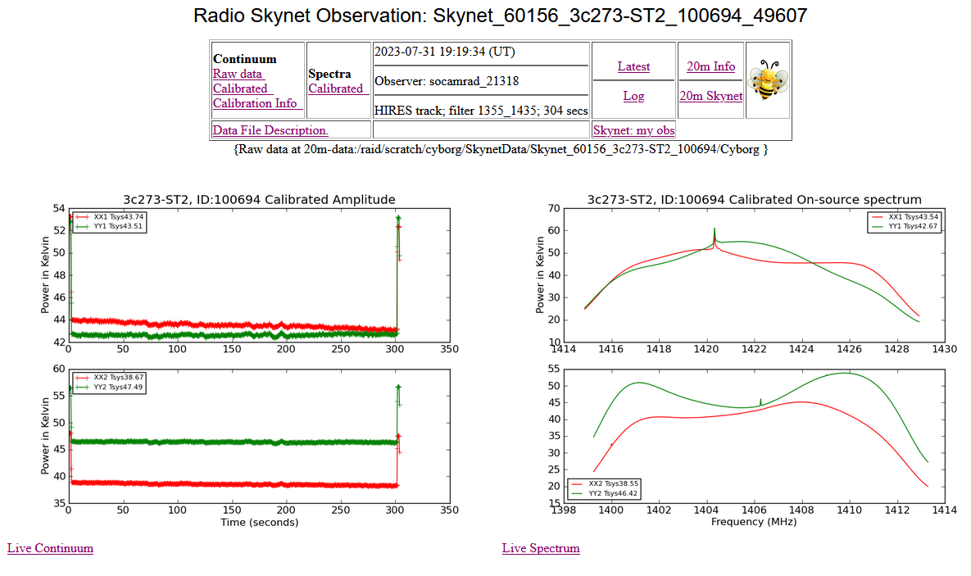
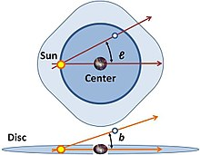
Quasars H1
20m Quasar Example:
The galactic coordinate of the quasar are l = 289.95 and b = +64.36. The V magnitude (average) is 12.9.
3C 273 is therefore a high galactic latitude object, a clear advantage to minimize the effects of gas and dust along the line of sight. The redshift of 3C 273 is z = 0.158 (Veron-Cetty & Veron 1995).
The galactic coordinates use the Sun as the origin. Galactic longitude (l) is measured with primary direction from the Sun to the center of the galaxy in the galactic plane, while the galactic latitude (b) measures the angle of the object above the galactic plane.
Ref: https://en.wikipedia.org/wiki/Galactic_coordinate_system
Note: Red shifts of Quasars cannot be measured with the 20m dish. Quasars are bright in the continuum and not the H1 line.

Slide 40
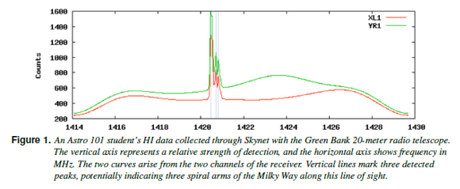
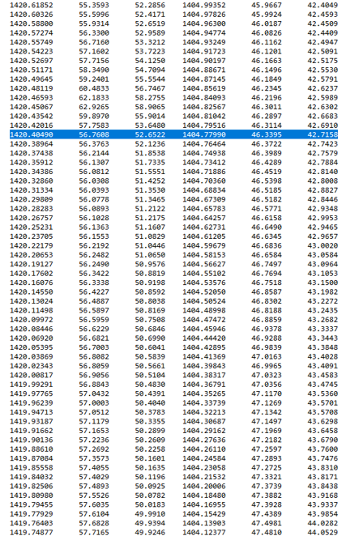
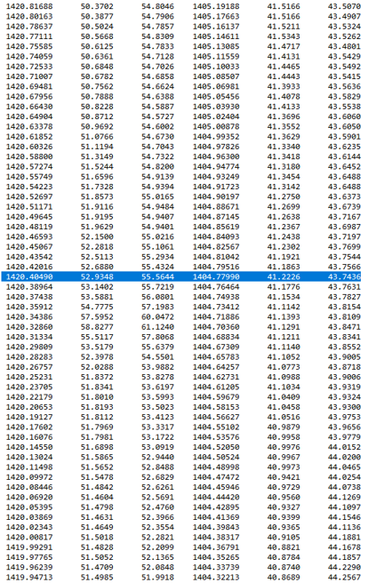
Quasar H1
https://www.gb.nrao.edu/20m/peak/3C273_ON_OFF_-_ST/Skynet_60223_3c273_on_off_-_ST_101450_50424.A.spectoff.cal.txt
The galactic coordinate of the quasar are l = 289.95 and b = +64.36. The V magnitude (average) is 12.9. 3C 273 is therefore a high galactic latitude object, a clear advantage to minimize the effects of gas and dust along the line of sight. The redshift of 3C 273 is z = 0.158 (Veron-Cetty & Veron 1995).
https://www.gb.nrao.edu/20m/peak/3C273-ST2/Skynet_60156_3c273-ST2_100694_49607.A.spect.cal.txt

Slide 41
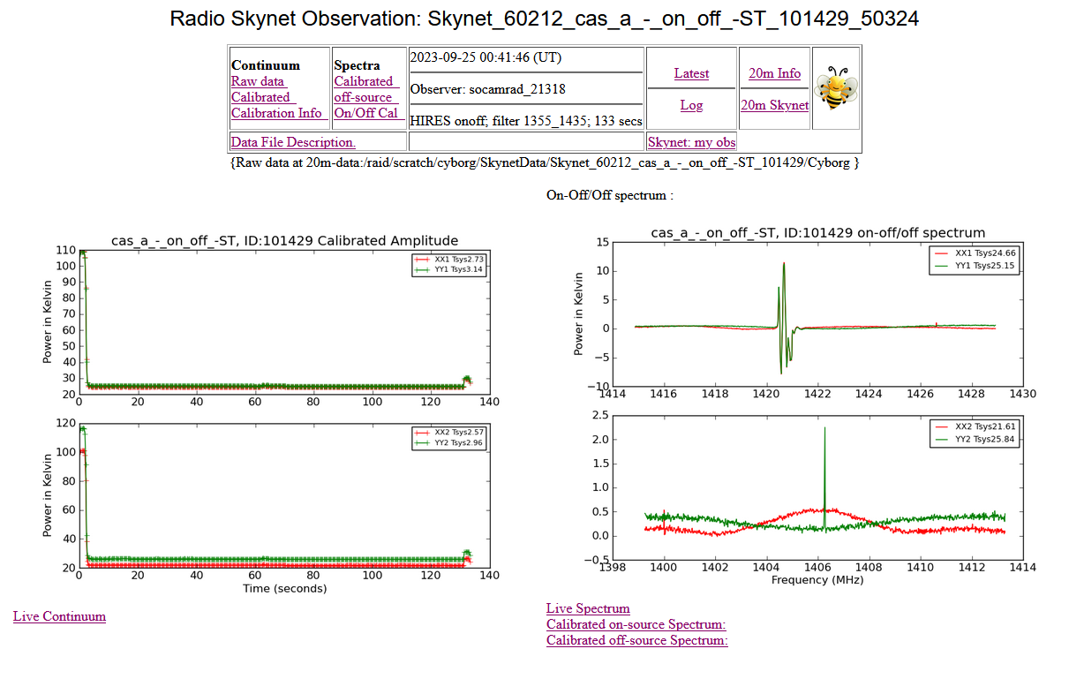
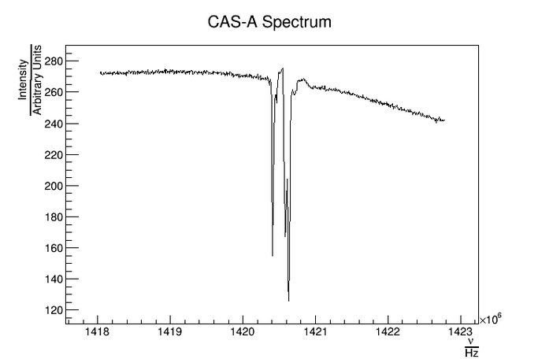
Cas A H1 (H1 Absorption Line-of-Sight)
20m Cas A Example: Cas A is about 11K light years away. For in on-source and off-source spectra, one finds sharp absorption and emission lines in the spectrum for the 21 cm line.
There are 3 possibilities:
The absorption lines come from the exploding shell and are more redshifted for the part of the cloud moving away from us relative to the part moving to us. This is not likely. Cas A is a Type IIb supernova remnant, which has virtually no hydrogen in the shells. The star that exploded, had a helium core and almost no hydrogen envelope. Hence, the spectral features of the hydrogen must be due to the interstellar gas.
The absorption lines come from hydrogen clouds between Cas A and us and the remaining emission lines are those from the exploding shell which don't correspond to any hydrogen cloud in between. This issue with this is that the difference of on- and off-source measurements should cancel out the hydrogen clouds in between.
Galactic coordinates | 111.734745°, −02.129570°
https://physics.stackexchange.com/questions/95075/absorption-and-emission-lines-in-cassiopeia-a-hydrogen-spectrum

Slide 42
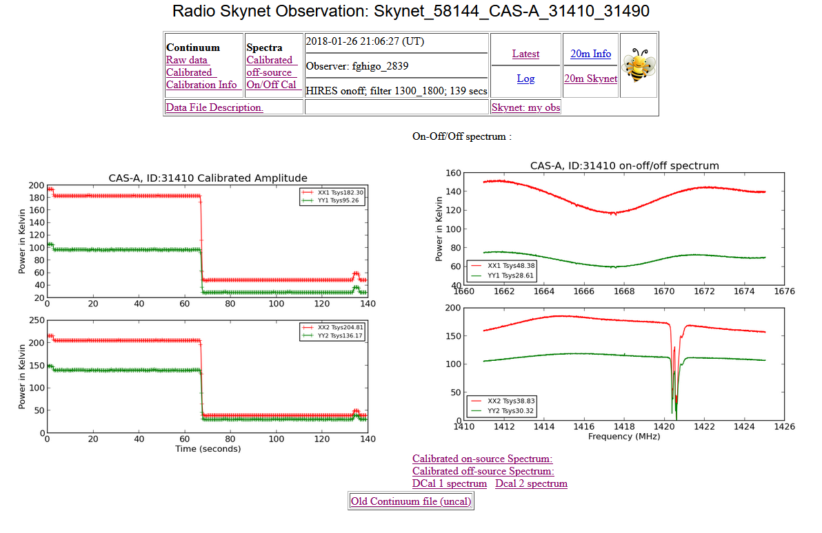
Cas A H1 (H1 Absorption Line-of-Sight)
20m Cas A Example (3rd possibility): The 21cm spectral line may appear both as emission and as absorption. One sees emission lines from the interstellar gas if there is no source behind the interstellar gas. One may also see absorption lines if there is a source of all frequencies behind the interstellar gas. In the latter case, the interstellar gas' absorption exceeds its emission. This is the dominant process in the case of the Cas-A spectrum. The spectrum graph mostly shows absorption. Emission dominates when the interstellar gas is "warmer" at the given frequency than the environment behind it; absorption dominates when the source behind the interstellar gas is "warmer" at the frequency.
More 20m Examples
Also See (By Richard Russel): Detecting a Galactic Hydrogen Absorption Cloud using Cassiopeia A as a Broadband Emitter
https://www.youtube.com/watch?v=qkBu2RgLZoo
This one uses the 20-m radio telescope to observe the HI absorption cloud while observing Cas-A, which is acting as a broadband emitter.

Slide 43
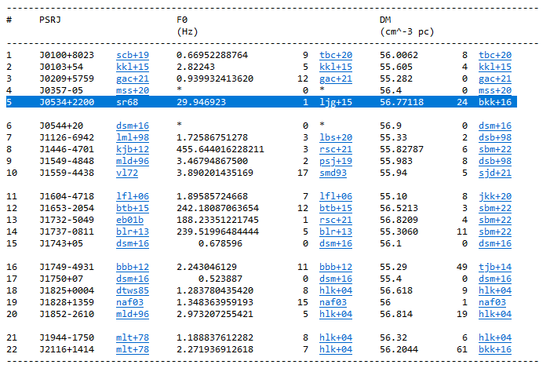
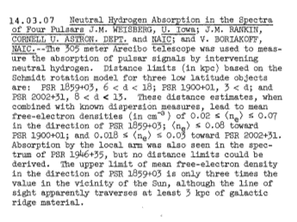
H1 and the ISM
Neutral atomic hydrogen (H1) traces the interstellar medium (ISM) over a broad range of physical conditions. Can the Dispersion Measure of Pulsars tell us anything about H1?
Examples
Gordon, K J, and Gordon, C P. Measurement of neutral-hydrogen absorption in the spectra of eight pulsars. Country unknown/Code not available: N. p., 1974. Web.
Then Press Table
The Crab Pulsar (PSR B0531+21, also known by the J2000 name PSR J0534+2200) was discovered in 1968. It is the remnant of its progenitor supernova SN 1054.
ATNF Pulsar Catalogue
https://www.atnf.csiro.au/research/pulsar/psrcat/
Paper: Manchester, R. N., Hobbs, G.B., Teoh, A. & Hobbs, M., AJ, 129, 1993-2006 (2005)
AAS Abstracts

Slide 44
H1 and the ISM
ATNF Pulsar Catalogue v1.68: Documentation
G. Hobbs, R. N. Manchester and L. Toomey CSIRO Astronomy and Space Science, Australia Telescope National Facility, PO Box 76, Epping, NSW 1710, Australia
The ATNF Pulsar Catalogue
Includes all published rotation-powered pulsars, including those detected only at high energies, and Anomalous X-ray Pulsars (AXPs) and Soft Gamma-ray Repeaters (SGRs) for which coherent pulsations have been detected. However, it excludes accretion-powered pulsars such as Her X-1 and the X-ray millisecond pulsars. To access, use the web interface ( http://www.atnf.csiro.au/research/pulsar/psrcat ). Appendix A: The Pulsar Parameters, lists the commonly used pulsar parameters.
A Few More Examples
To produce a list of the names and Galactic coordinates of all the known pulsars with periods greater than two seconds and distances greater than 3 kpc:
Click on the box to the left of 'Name', 'GL' and 'GB' under the 'Predefined Variables' heading at the top of the web interface
In the 'Condition' box, type: p0 > 2 && dist > 3
Move to the bottom of the page and click on TABLE (BOX)
To plot a period-period derivative diagram for all the known pulsars:
Move to the bottom of the web interface and enter 'p0' in the 'X-Axis' box underneath the heading 'Plotted Output'. Change 'linear' to 'log' to plot the graph with logarithmic axes.
Enter 'p1' in the 'Y-Axis' box and change 'linear' to 'log'.
Click on PLOT (BOX)
To list all known pulsars with declinations greater than -30 degrees and with measured flux densities at 400 MHz
Under the 'Predefined Variables' heading, select 'Name', 'RAJ', 'DECJ' and 'S400'.
In the 'Condition' box type: decjd > -30 && exist(s400) Click on the TABLE (BOX) icon at the bottom of the page.
https://www.atnf.csiro.au/people/pulsar/psrcat/psrcat_help.html

Slide 45
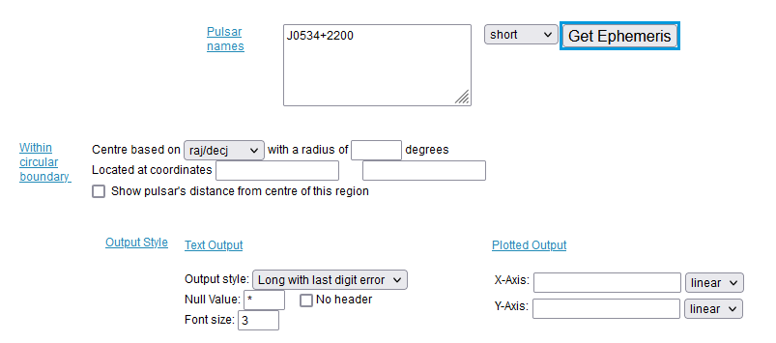
H1 and the ISM
Crab Pulsar Example
P0 0.0333924123 1.200e-09
See Appendix A for Parameter definitions. https://www.atnf.csiro.au/research/pulsar/psrcat/psrcat_help.html
For example, F0 is Barycentric rotation frequency (Hz); PO is Pulse Period.
NOTE: For 20m search on the crab pulsar (a pulsar) and not the crab nebula (a SNR)
Crab pulsar is PSR J0534+2200, a.k.a. PSR B0531+22 and also CM Tau
From Catalog DM = 56.77, PO pulse period (s) [Select “long” then Get Ephemeris.
Because frequency is time-dependent, movement toward or away from a radio wave will affect the frequency at which it is detected, i.e., the Doppler effect. One way to control for this movement is to measure barycentric frequency instead of raw frequency. Calculations of barycentric frequency control for the rotation of the Earth and its orbit around the sun.
https://www.atnf.csiro.au/research/pulsar/psrcat/

Slide 46
Summary and Open Forum
Questions are easier than answers in radio astronomy: When observing H1, or any radio objects, consider the effects of the parameters on the results of the observation:
The characteristics of your target (how it differs from the expected galactic H1 of the wider region).
The number of spiral arms through field of view of the radio telescope.
The direction of the object from the position of the Milky Way galaxy and the Sun.
The radio telescope beam size.
The similar observations by experienced scientists (Reichart and fghigo)
The relative strength of continuum vs spectral in raster scans, and potential satellite interference.
The field of view of a raster map, and the sweep pattern chosen.
The receiver settings chosen (band width, center frequency, high/low resolution). Ensure proper data selected per polarization and frequency. i.e., xx1, yy1, xx2, or yy2, raw vs calibrated.
The distances to the target.
The H1 clouds absorbing or emitting in this vicinity.
The ISM besides H1.
Key Objectives of this PowerPoint: An understanding and confirmation of what the 20m can and can’t do with H1 observations.

Slide 47
Summary and Open Forum
Questions? Other items of interest:
April 8, 2024 Solar Eclipse – What did the 20m dish observe?
Contour Maps.
SARA Journal March-April 2024 issue: Observational Report on OH masers observed with the 25m Dwingeloo radio telescope, by Eduard Mol, et. al.. Several circumstellar OH masers were discussed with red and blue shifted peaks at 1612 MHz.

Slide 48
Contact
Email SARA Section Analytical Section Coordinator
Tzikas@alum.rpi.edu
stephentzikas@gmail.com

