Slide 1
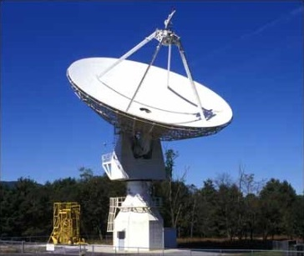

SARA Global Conference 2025
Pulsar Profiles

Slide 2
Agenda
20 Meter Dish Demo
Introduction
Variation of Observation Parameters
Types of Pulsar Profiles
  Inter-Pulse Pulsars
  Double Pulsars
  Mode Switching Pulsars
  Polarization in Pulsars
  Radio Stars
  Scintillation in Pulsars
  Other Classifications
Pulsar Databases
Summary and Open Forum

Slide 3
20 Meter Dish Demo
This 20m Demo and SARA Section Update are posted on SARA Analytical Section page
Also Posted:
  2019 demo presentation posted (Cas A Flux Density Calculation)
  2020 demo presentation posted (Pulsars)
  2021 demo presentation posted (Masers)
  2022 demo presentation posted (Raster Scans)
  2023 demo presentation posted (Inter-Stellar Medium [ISM])
  2024 demo presentation posted (H1 “Off the Beaten Path”)
Green Bank Conference Account - Explore!
Demo Example – Watch the dish move outside!
See Green Bank and McGill University scientist Ryan S. Lynch’s “Searching for and Identifying Pulsars” guide posted on the internet.
http://www.gb.nrao.edu/20m/psr20m_advice.html
https://www.physics.mcgill.ca/~rlynch/Outreach/PSC_search_guide.pdf
https://astronomy.swin.edu.au/cosmos/p/pulsar+dispersion+measure

Slide 4
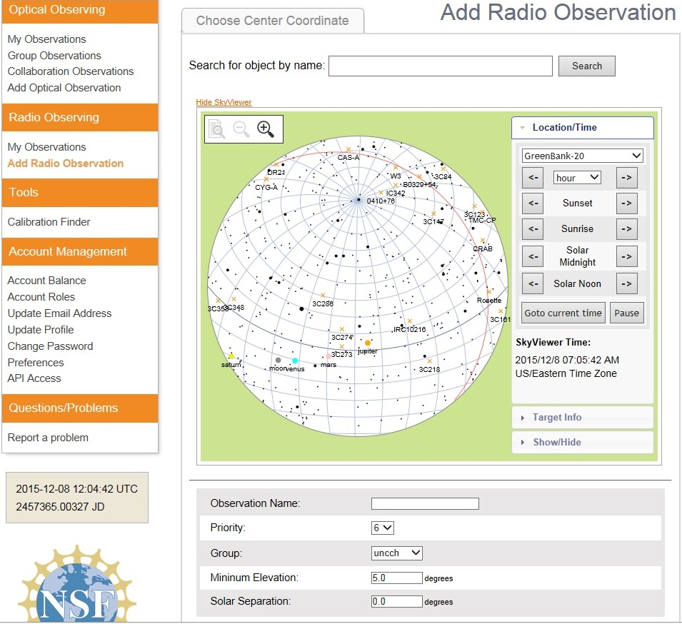
20 Meter Dish Demo
Add a Radio Observation
-Select an Object
(Database or RA/Dec)
-Minimum Elevation
(Used for mapping)
-Solar Separation
(to prevent solar side lobe
interference)

Slide 5
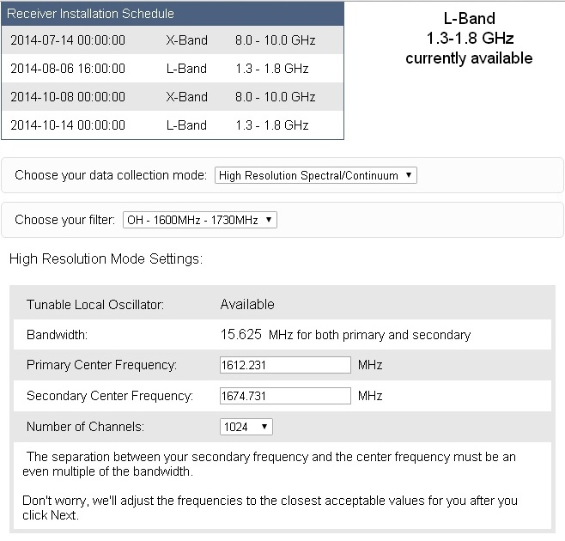
20 Meter Dish Demo
Configure Receiver
Low Resolution: continuum mapping/pulsars
High Resolution: Spectral Lines
No Filter Full Band (with interference)
H1 Filter (continuum maps, 1355-1455 MHz)
OH Filter (Iridium sat. interference, 1.6-1.73 GHz)
Data Collected in Bins: Time bins (data collected in a small chunk of time) or frequency bins (data collected in a small chunk of observing frequency).
X-Band: Aug. 28- Nov. 27, 2017

Slide 6
20 Meter Dish Demo
Input Your Pulsar Observation
Name the object with a recognizable pulsar name, for example, "B0329+54".
Personalize by appending to the name, e.g. "B0329+54_mypulsar".
Select "Low Resolution Spectral/Continuum" and check the "Pulsar Mode" box.
Select "Track"
Bright pulsars can be detected with 60 s durations. Longer for weaker pulsars.
Set the integration time to a fraction (e.g., 1/30th of the pulsar period).
Possible range of integration times: 0.1 to 0.0001. The data acquisition system is unable to keep up with the data rate if the integration time is less than 0.0001 second. It will collect data, but what it collects will be mostly nonsense.
Remember the 3 P’s: Freq. range, Integration time, Observing time Parameters
http://www.gb.nrao.edu/20m/psr20m_advice.html

Slide 7
20 Meter Dish Demo
PRESTO Prepfold Plots: These are the results of a pulsar observed through the 20m radio telescope.
There are many diﬀerent packages of software designed for observing pulsars. One is called PRESTO. PRESTO takes the Fourier transform of a data set and uses algorithms to search for pulsars. When PRESTO ﬁnds a promising candidate, it can go back to the time domain data and use a program called prepfold to fold the data at the period of a candidate. What comes out is a plot like the following figure.
See 2020 Demo Presentation on Pulsars

Slide 8
20 Meter Dish Demo
Pulse Profile Panel
Shows the strength of the pulse as a function of phase. This is the result of the full folding process. To make it, we add up, or integrate, the results of all the sub-folds. The peak corresponds to when the pulsar is “on”, and the random lines that you see when we are “oﬀ-pulse” is the background noise.
See 2020 Demo Presentation on Pulsars

Slide 9
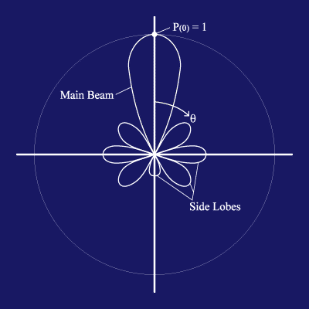
20 Meter Dish Demo
https://www.gb.nrao.edu/20m/map20m_advice.html
Credit: http://www.ras.ucalgary.ca › radiotel › calibration
Beam and Beamwidth (Visualization Basics)
The beam is the area on the sky in which radiation will be detected by the radio telescope. In terms of the telescope as a receiver of radiation, it will respond to the radiation coming in along that same beam as if it were a transmitter. In general, a smaller telescope has a wider beam. The reflecting dish of the radio telescope gives the antenna considerable directionality by focusing radio waves from a particular direction onto the horn. It is still sensitive to radiation from directions other than the pointing direction. The largest lobe is called the main beam and the smaller lobes are called side lobes.
The beamwidth is the full width half maximum (FWHM) of the main beam. This defines the resolution of the telescope. When a point source is in the most sensitive part of the main beam, the measured signal will be highest. As the point source is moved away from the center of the main beam, the measured signal will decrease. Therefore, by moving the point source through the main beam, the shape of the main beam is mapped out. Only structures on angular scales larger than the telescope's beam can be revealed. The angular resolution of a given antenna system is limited by the beamwidth. The 20-meter telescope is like a camera with one pixel, or beam. To make an image, one must scan the telescope back and forth across the object and build up an image, pixel by pixel.
Beamwidth (BW) = 70λ / D. It’s related to resolution. λ is the observing wavelength, and D is the telescope diameter. λ = 0.3 / frequency
For the 20m radio telescope:
The 8-10 GHz receiver has a beam size of about 7 arcmin.
The 1.4 GHz receiver has a beam size of about 44 arcmin.
(Some calculate a 0.6 degrees full width half maximum power response)
The antenna 3dB beamwidth is the angle between the half-power of an antenna pattern or beam over which the relative power is at or above 50% of the peak power. Example : An antenna has a diameter of 2m and frequency 16GHz. Calculate the 3 DB beamwidth for the antenna. To find 3 dB Beamwidth, first calculate the value of λ, Substitute the values in the λ formula, λ = 0.3 / frequency λ = 0.3 / 16 λ = 0.01875. Substitute the values in the beamwidth formula: Beamwidth = ( 70 * 0.01875 ) / 2 = = 1.3125 / 2 degrees = = 0.656 degrees
The sensitivity of a telescope is not uniform across the beam. In most cases, the telescope is most sensitive to radiation entering the telescope straight-on, and the sensitivity fades off towards larger angles. Radiation that enters in the beam but off-center might produce a response in the receiver 80% of that when it enters in the very center.
The Radio telescope system temperature is the amount of noise that will appear in a measurement and which the signal from the source (measured as antenna temperature) needs to stand out from to be detected.
The angular resolution is given by: θ ~ λ/D
See https://www.omnicalculator.com/physics/angular-resolution
(Allows use of multiple units)
BW = 1.2λ/D (in radians)
BW = 62/Fghz (in arcminutes); Fghz = GHz (instead of λ)
(for a 20-meter telescope)

Slide 10
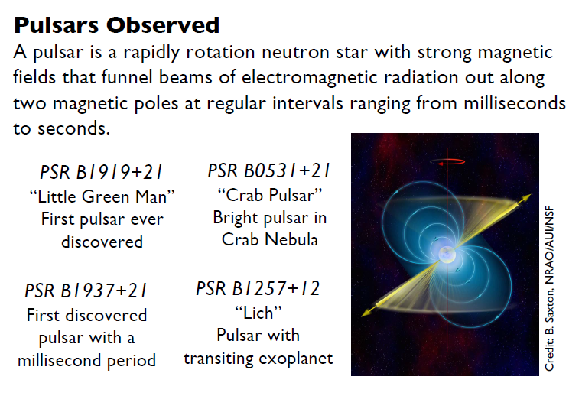
Introducton
20m data shows this pulsar profile to be fairly standard
Student Poster: Operating Green Bank Observatory’s 20 Meter Telescope with Ham Radio Students
Mia Bridges¹, Alia Wofford², Xander Whittington-Speck³, Danielle Rowland⁴
1 The College of William & Mary, 2 George Mason University, 3 Northwest Vista College, 4 National Radio Astronomy Observatory

Slide 11
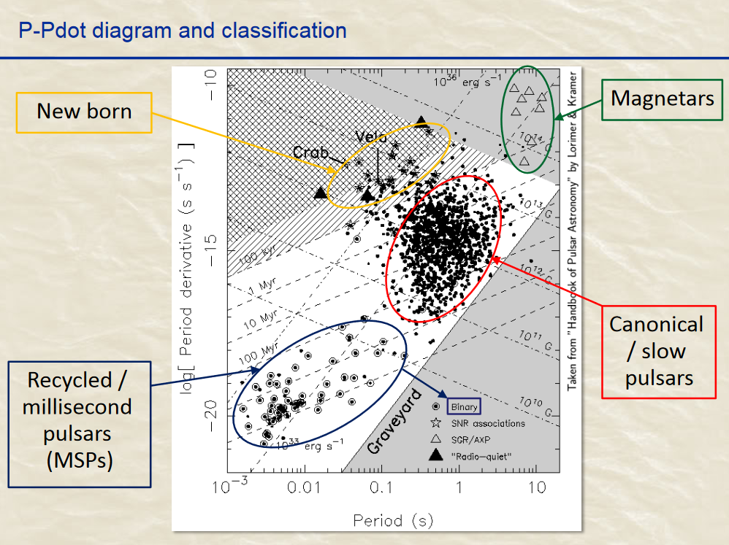
Introduction
There are 3,400+ pulsars
http://ipta.phys.wvu.edu/files/student-week-2017/IPTA2017_KuoLiu_pulsartiming.pdf

Slide 12
Introduction
It is possible to observe interpulses with the 20m GBO radio telescope. The profiles of some pulsars include a component called an interpulse (IP), which is separated from the main pulse (MP) by approximately a half of the pulsar period. The IPs may be as weak as a few percent of the MP. In general, the IP is located not exactly midway between the successive MPs but may be shifted by up to a few tens of degrees toward earlier or later pulse phases. Pulse profiles may contain a few such components at once. For example, the Crab pulsar has a total of six components outside of the MP. The emission components outside of the MP are characteristic of the short-period pulsars, s, and the millisecond pulsars. The IPs are met in ∼2% of the normal pulsars and ∼40% of the millisecond ones.
Physics of Interpulse Emission in Radio Pulsars, S. A. Petrova
Institute of Radio Astronomy, 4, Chervonopraporna Street, 61002 Kharkov, Ukraine
Received 2007 July 16; accepted 2007 September 14; published 2008 January 20
One proposed mechanism of radiation emission in the polar gap of the Crab pulsar may be an explanation for the interpulse shift. It is the curvature radiation which is emitted by returning positrons moving toward the surface of the neutron star along field lines of the inclined magnetic field and reflects from the surface. Such radiation interferes with transition radiation emitted from the neutron star when positrons hit the surface.
[Submitted on 5 Jul 2017 (v1), last revised 22 Aug 2017 (this version, v3)]
On the mystery of the interpulse shift in the Crab pulsar
Victor M. Kontorovich, Sergii V. Trofymenko
arXiv:1707.01584 [astro-ph.HE]

Slide 13
Introduction
All the pulsars have the angle between their magnetic and rotation axes close to 90°. The simplest interpretation of the results is that we see ‘main pulse’ emission from one pole and ‘interpulse’ emission from the opposite pole. The emission region in pulsars is complex, even when the profile appears simple.
Polarization measurements of five pulsars with interpulses
M.J. Keith, S. Johnston, M. Kramer, P. Weltevrede
Monthly Notices of the Royal Astronomical Society, Volume 402, Issue 2, February 2010, Pages 745–752, https://doi.org/10.1111/j.1365-2966.2009.15926.x
Published: 02 February 2010
The difference between double-pole and single-pole pulsars lies in the origin of radiation beams: double-pole pulsars emit radiation from both magnetic poles, while single-pole pulsars emit from a single pole. Hence, the interpulse appears when we observe either two opposite poles (a double-pole or DP pulsar) or the same pole twice (a single-pole or SP pulsar); in the latter case, the two peaks correspond to the double intersection of the hollow-cone directivity pattern: In the hollow-cone model, radio beams are not solid cones, but rather have a hollow, donut-like shape, with the emission being concentrated along the edges of the cone. For the DP case, the inclination angle χ (between the rotational axis and its magnetic axis) is close to 90◦, while for a SP pulsar, this angle is close to 0◦.
Monthly Notices of the Royal Astronomical Society
MNRAS 466, 2325–2336 (2017)
Statistics of interpulse radio pulsars: the key to solving the alignment/counter-alignment problem
L. I. Arzamasskiy, V. S. Beskin, and K. K. Pirov

Slide 14
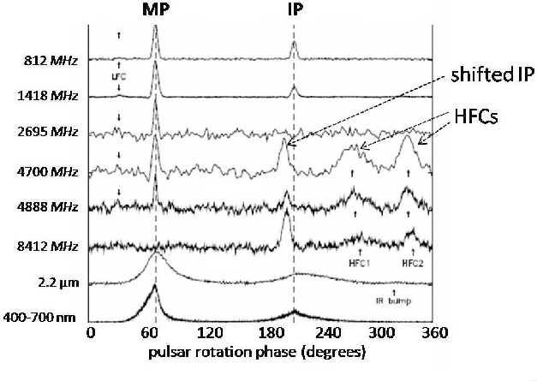
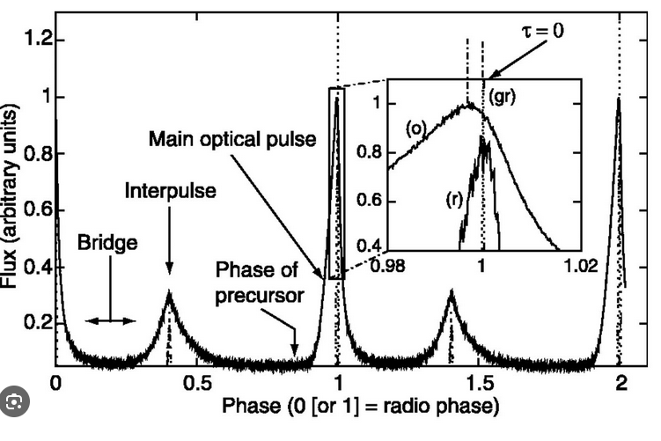
Introduction
High Frequency Components (HFCs)
Enhanced Optical Emission From crab Pulsar
Photon Counting for Studying Faint Astronomical Variable Signals in Optical Band
March 2018
DOI:10.5772/intechopen.71072
In book: Photon Counting - Fundamentals and Applications
Filippo Ambrosino and Franco Meddi
Pulsar profiles over many frequencies
Source: Semantic Scholar, On the mystery of the interpulse shift in the crab pulsar

Slide 15
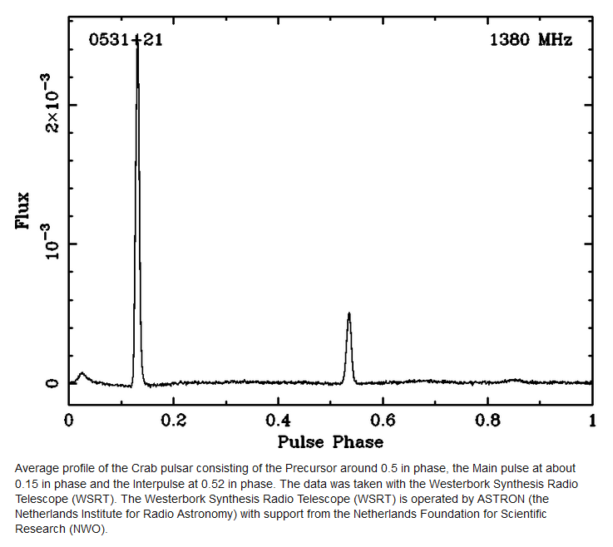
Introduction
The Pulsar In The Crab Nebula: A short review
May 2016
DOI:10.22323/1.237.0015
Conference: Frontier Research in Astrophysics
Author: N. Lewandowska, State University of New York

Slide 16
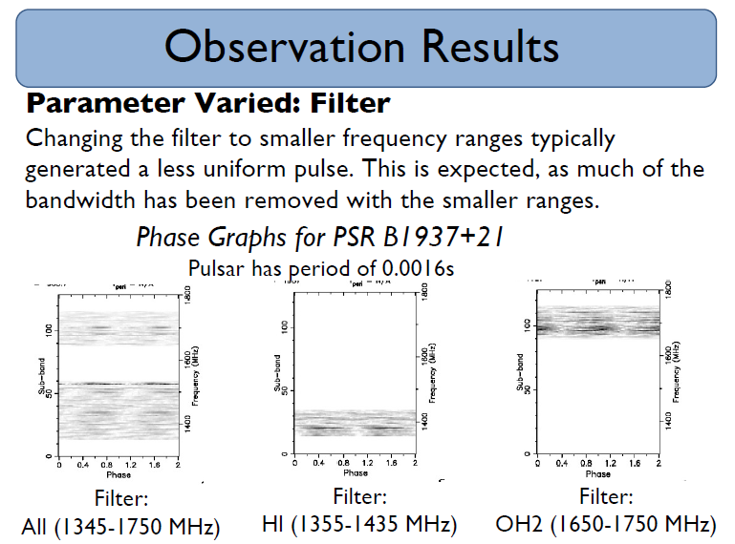
Variation of Observation Parameters
Remember the 3 P’s (Parameters)
Student Poster: Operating Green Bank Observatory’s 20 Meter Telescope with Ham Radio Students
Mia Bridges1, Alia Wofford2, Xander Whittington-Speck3, Danielle Rowland4
1The College of William & Mary, 2George Mason University, 3Northwest Vista College, 4National Radio Astronomy Observatory

Slide 17
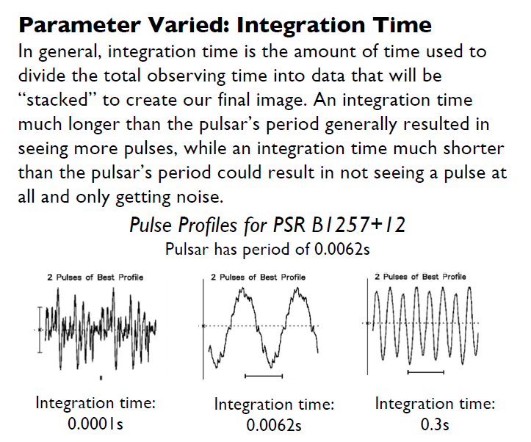
Variation of Observation Parameters
Compare to Slide 6:
0.0062/30 = 0.00021s suggested integration time. It’s OK to vary!
Remember the 3 P’s (Parameters)
Student Poster: Operating Green Bank Observatory’s 20 Meter Telescope with Ham Radio Students
Mia Bridges1, Alia Wofford2, Xander Whittington-Speck3, Danielle Rowland4
1The College of William & Mary, 2George Mason University, 3Northwest Vista College, 4National Radio Astronomy Observatory

Slide 18
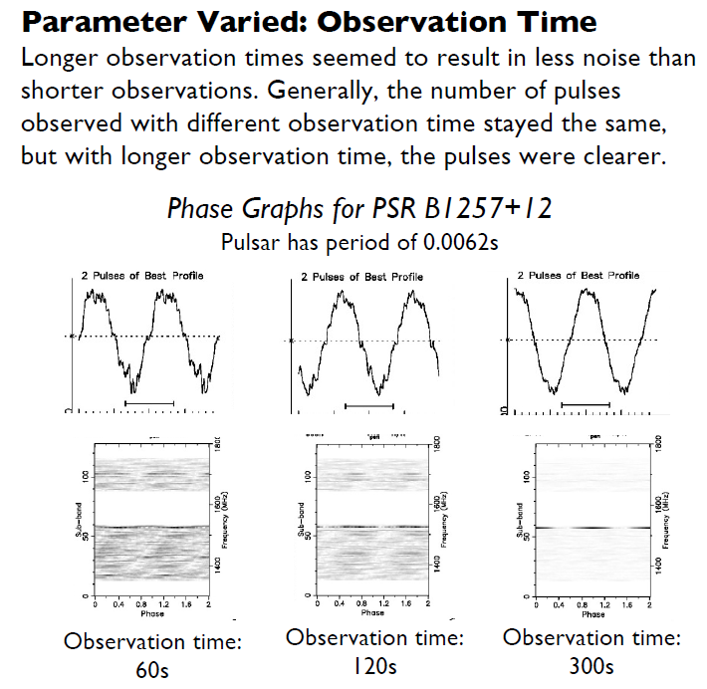
Variation of Observation Parameters
Remember the 3 P’s (Parameters)
Student Poster: Operating Green Bank Observatory’s 20 Meter Telescope with Ham Radio Students
Mia Bridges1, Alia Wofford2, Xander Whittington-Speck3, Danielle Rowland4
1The College of William & Mary, 2George Mason University, 3Northwest Vista College, 4National Radio Astronomy Observatory

Slide 19
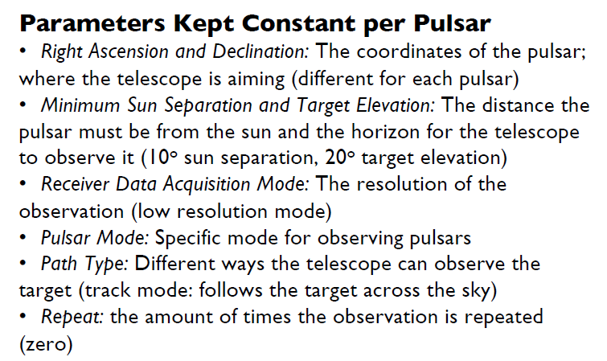
Variation of Observation Parameters
Student Poster: Operating Green Bank Observatory’s 20 Meter Telescope with Ham Radio Students
Mia Bridges¹, Alia Wofford², Xander Whittington-Speck³, Danielle Rowland⁴
1 The College of William & Mary, 2 George Mason University, 3 Northwest Vista College, 4 National Radio Astronomy Observatory

Slide 20
Types of Pulsar Profiles
Inter-Pulse Pulsars
Double Pulsars
Mode Switching Pulsars
Polarization in Pulsars
Radio Stars
Scintillation in Pulsars
Other Classifications

Slide 21
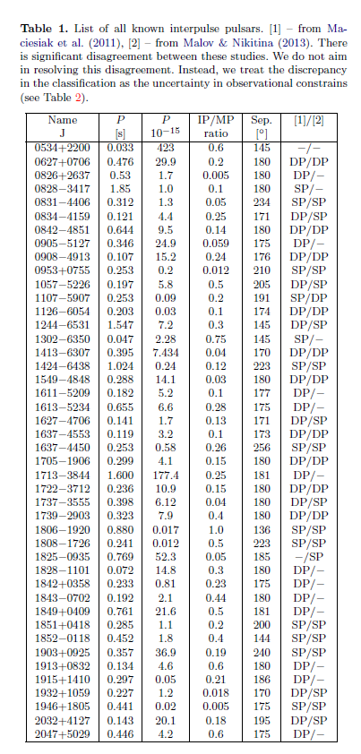
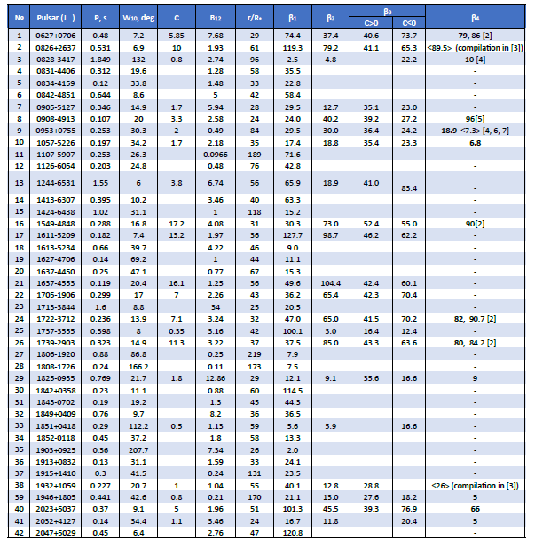
Inter-Pulse Pulsars
B0950+08
MNRAS 466, 2325–2336 (2017)
Statistics of interpulse radio pulsars: the key to solving the alignment/counter-alignment problem
L. I. Arzamasskiy, V. S. Beskin, and K. K. Pirov
Accepted 2016 November 29. Received 2016 November 28; in original form 2016 October 11
The structure of radio pulsars with interpulses
malov@prao.ru, maggika@mail.ru
I.F. Malov, E.B. Nikitina
Pushchino Radio Astronomy Observatory, Physical Institute of the Russian Academy of Sciences

Slide 22
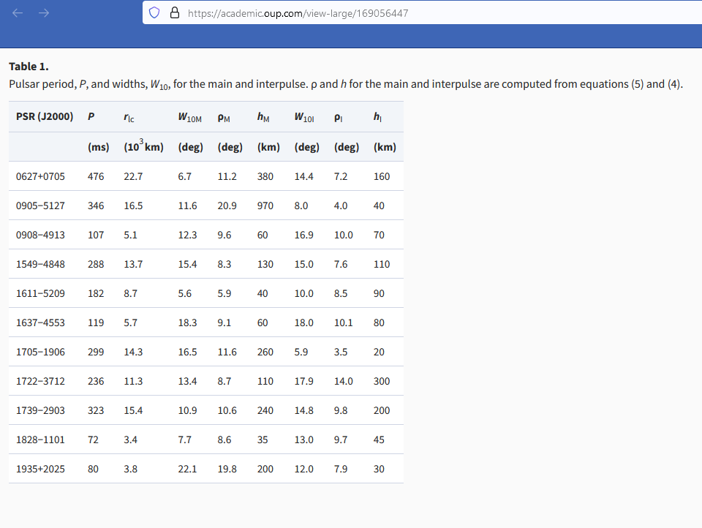
Inter-Pulse Pulsars

Slide 23
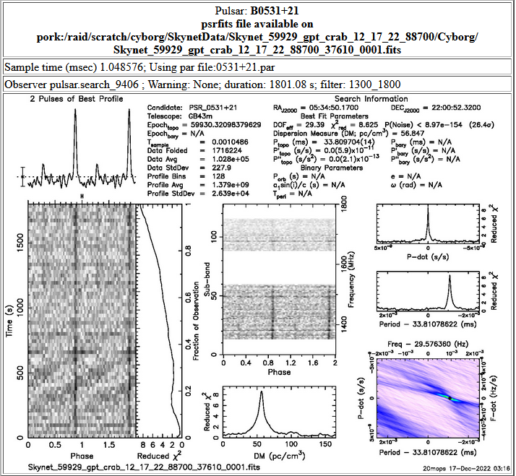
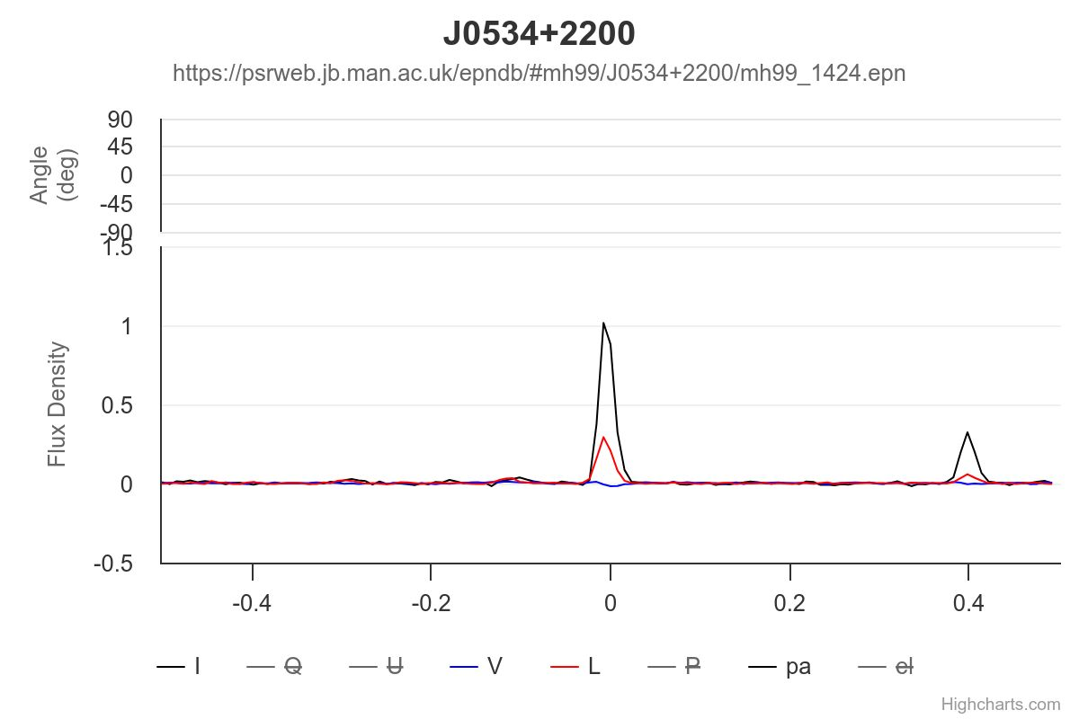
Inter-Pulse Pulsars
0534
RA Component
Compare to European Pulsar Network
The EPN Database of Pulsar Profiles
1424 MHz
Notice the coordinates for the next 4 Crab Pulsar Examples
The Period is a consideration in selecting the Integration Time
https://psrweb.jb.man.ac.uk/epndb/#mh99/J0534+2200/mh99_1424.epn
The total intensity, linear polarization and circular polarization, their fractions, as well as position angle of linear polarization, all are plotted from the bottom to the top sub-panels for each profile. For each pulsar, the total intensity, linear and circular polarization are represented by black solid, red dashed and blue doted lines in the bottom sub-panel. The left-hand circular polarization is defined to be positive.
Crab Pulsar B0531 = J0534
The 3 P’s:
Freq. Range: 1300-1800
T sample: 0.001
T observation: 1801 s

Slide 24
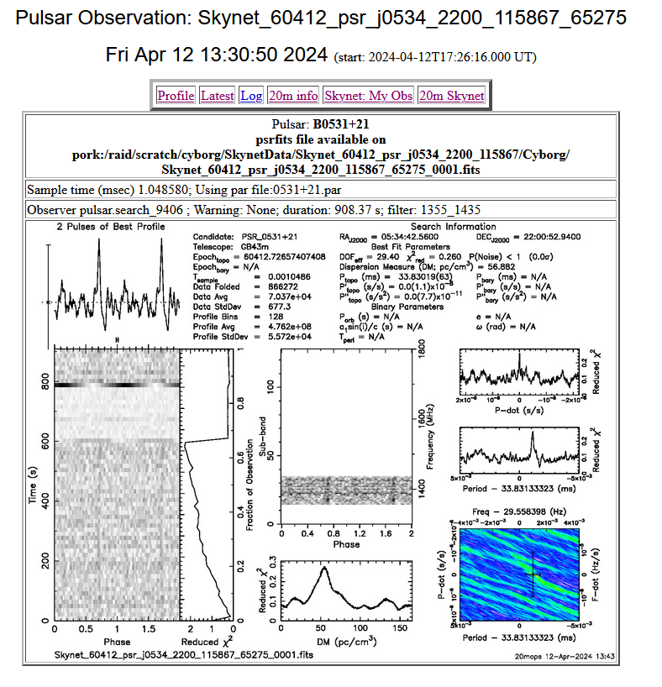
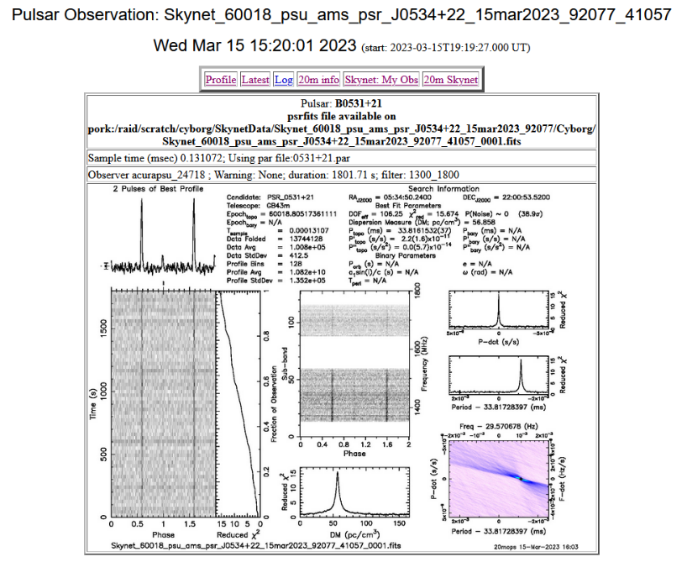
Inter-Pulse Pulsars
0534
The 3 P’s:
Freq. Range: 1355-1435
T sample: 0.001
T observation: 908 s
The 3 P’s:
Freq. Range: 1300-1800
T sample: 0.0001
T observation: 1802 s

Slide 25
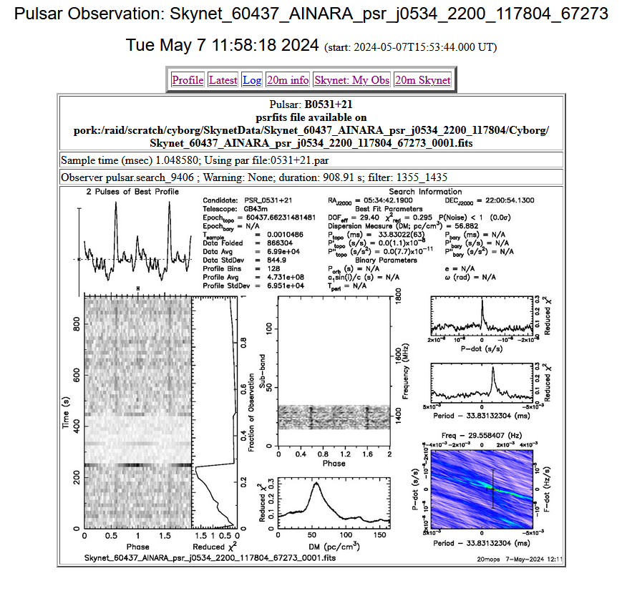
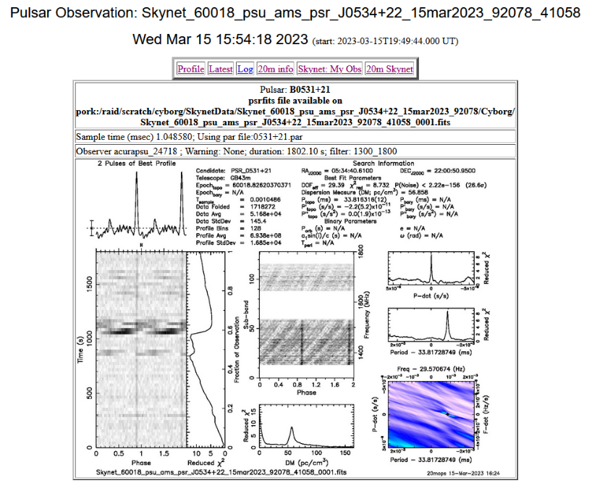
Inter-Pulse Pulsars
0534
The 3 P’s:
Freq. Range: 1355-1435
T sample: 0.001
T observation: 909 s
The 3 P’s:
Freq. Range: 1300-1800
T sample: 0.001
T observation: 1802 s

Slide 26
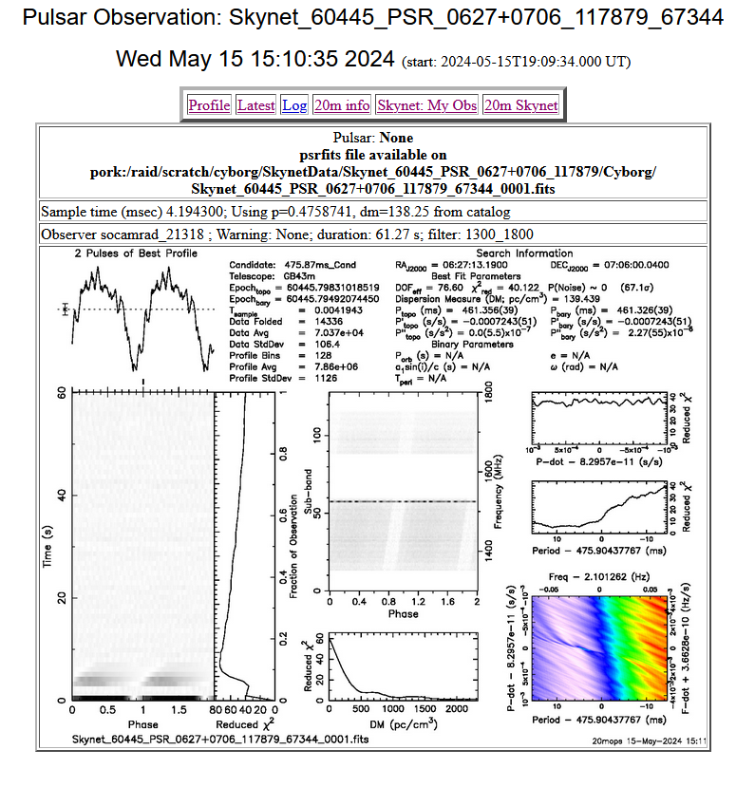
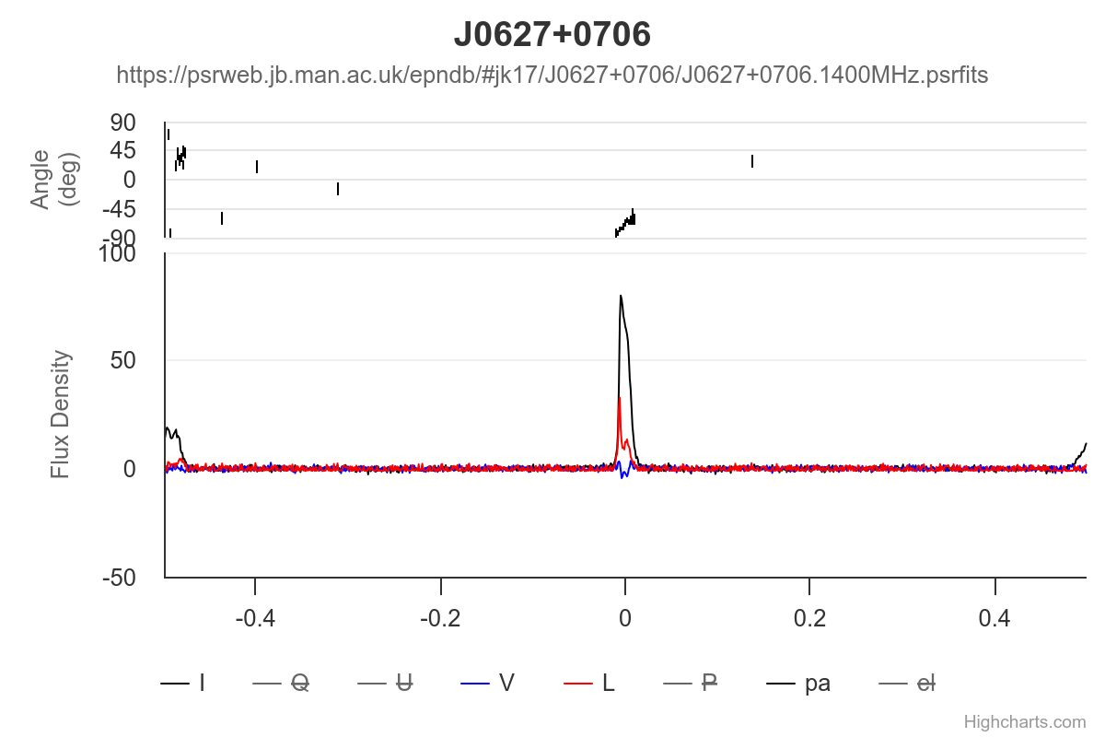
Inter-Pulse Pulsars
0627
The EPN Database of Pulsar Profiles
1369 MHz
Sometimes the Inter-Pulse is not always obvious
https://psrweb.jb.man.ac.uk/epndb/#jk17/J0627+0706/J0627+0706.1400MHz.psrfits
The total intensity, linear polarization and circular polarization, their fractions, as well as position angle of linear polarization, all are plotted from the bottom to the top sub-panels for each profile. For each pulsar, the total intensity, linear and circular polarization are represented by black solid, red dashed and blue doted lines in the bottom sub-panel. The left-hand circular polarization is defined to be positive.
The 3 P’s:
Freq. Range: 1300-1800
T sample: 0.004
T observation: 61 s

Slide 27
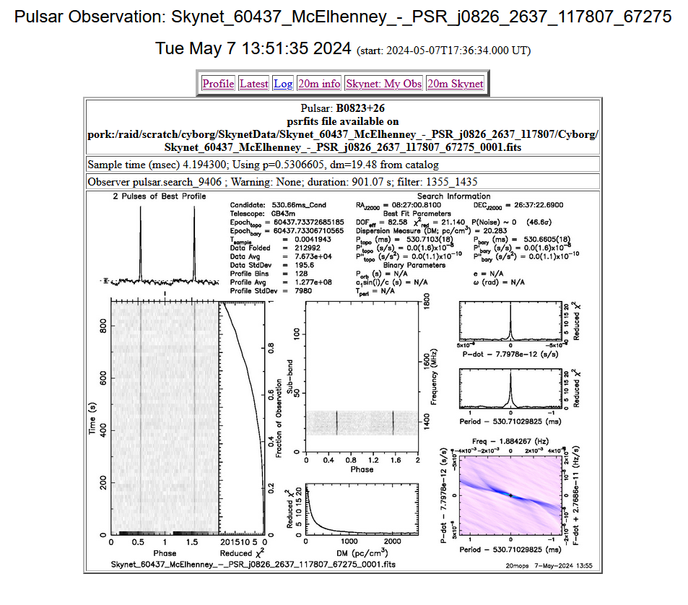
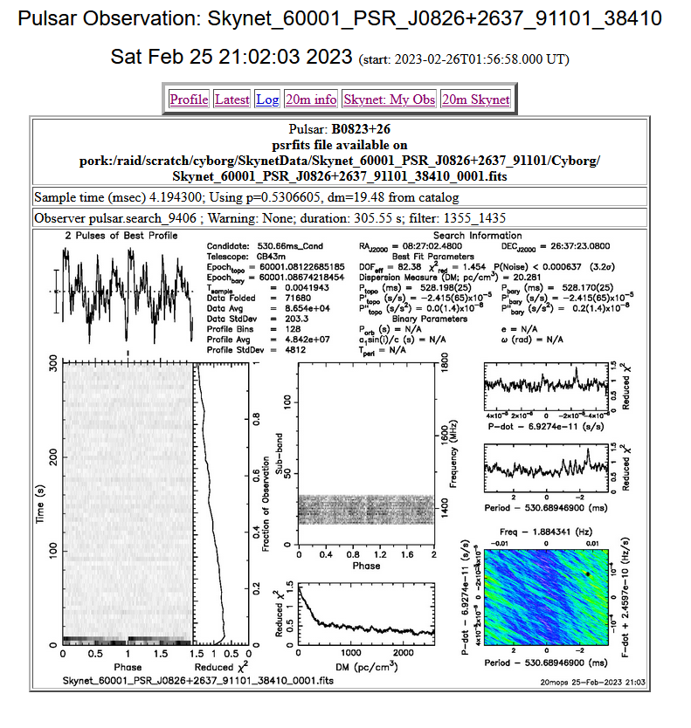
Inter-Pulse Pulsars
0826
The 3 P’s:
Freq. Range: 1355-1435
T sample: 0.004
T observation: 901 s
The 3 P’s:
Freq. Range: 1355-1435
T sample: 0.004
T observation: 306 s

Slide 28
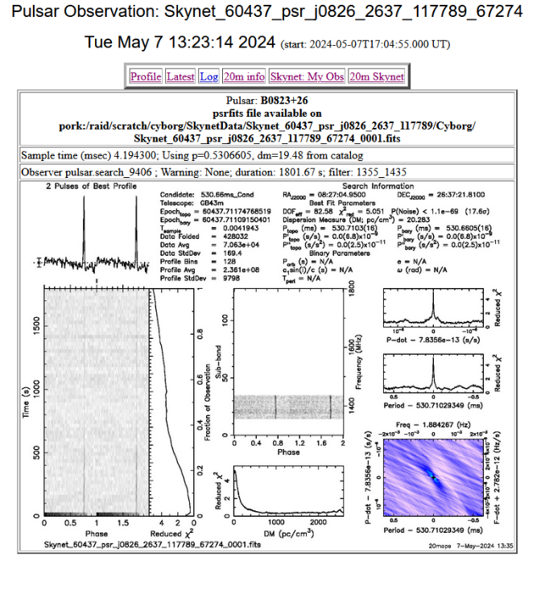
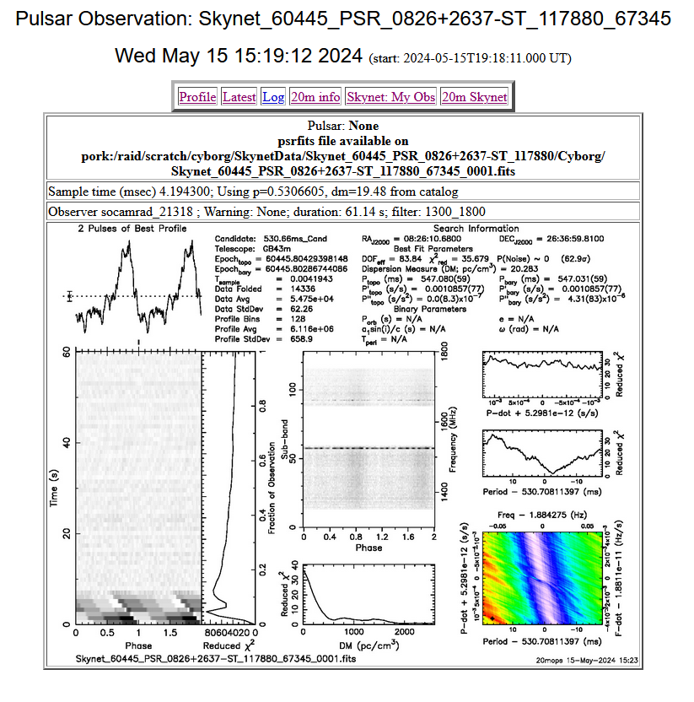
Inter-Pulse Pulsars
0826
The 3 P’s:
Freq. Range: 1355-1435
T sample: 0.004
T observation: 1802 s
The 3 P’s:
Freq. Range: 1300-1800
T sample: 0.004
T observation: 61 s

Slide 29
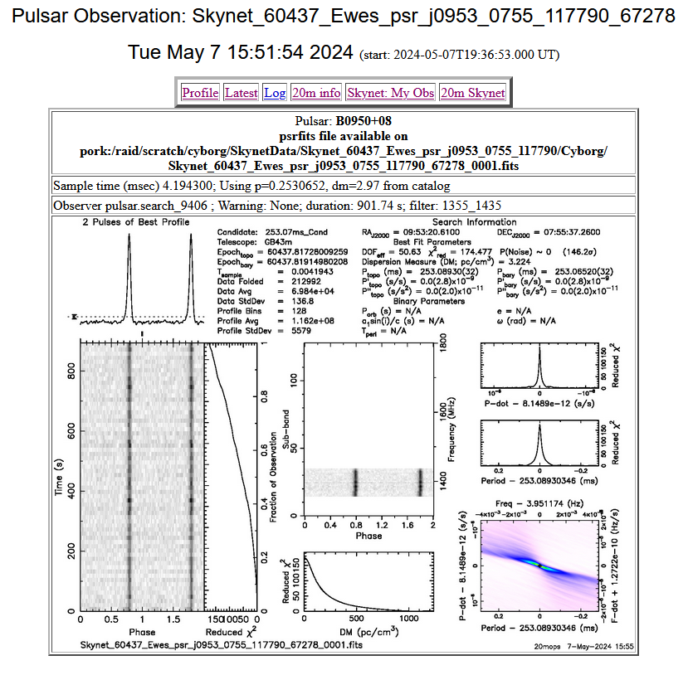
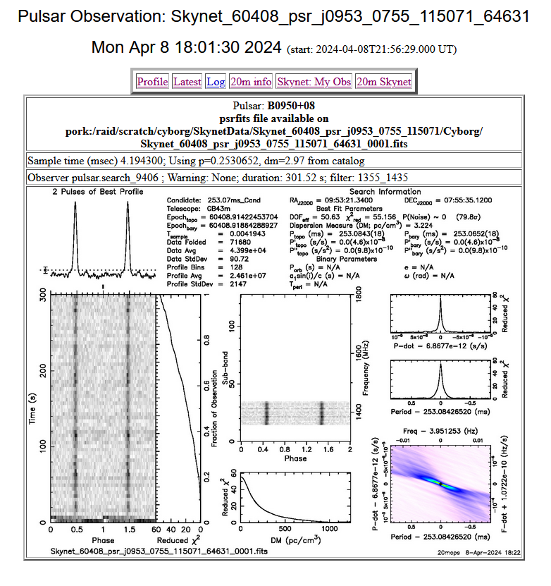
Inter-Pulse Pulsars
0953
The 3 P’s:
Freq. Range: 1355-1435
T sample: 0.004
T observation: 902 s
The 3 P’s:
Freq. Range: 1355-1435
T sample: 0.004
T observation: 302 s

Slide 30
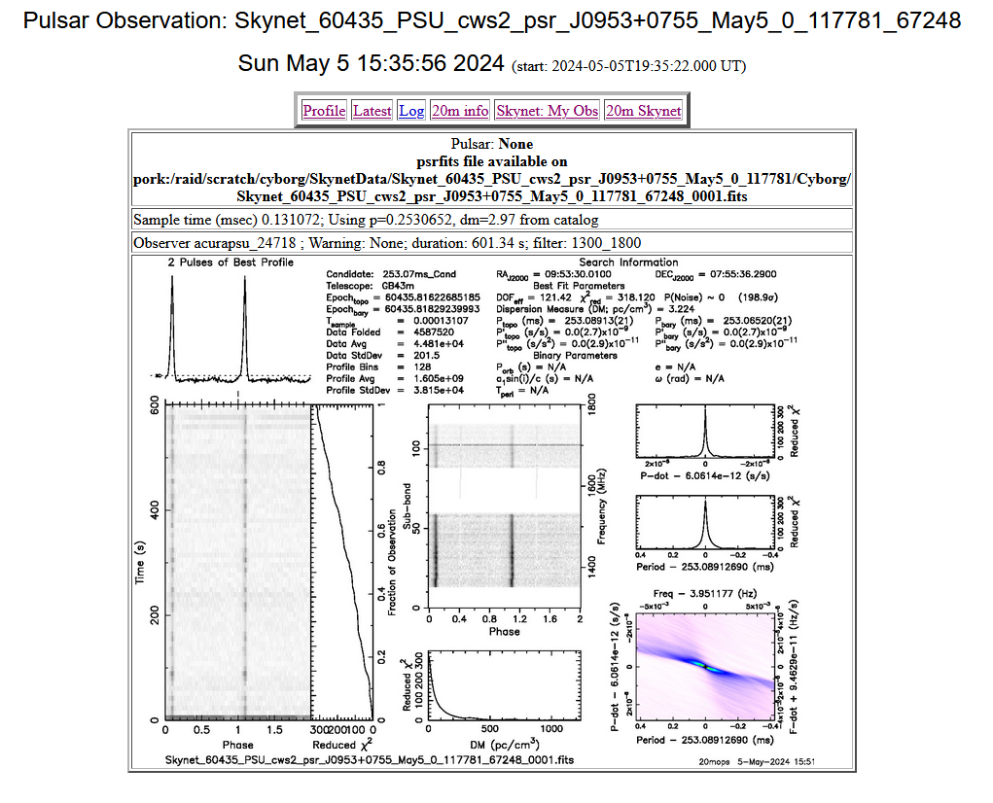
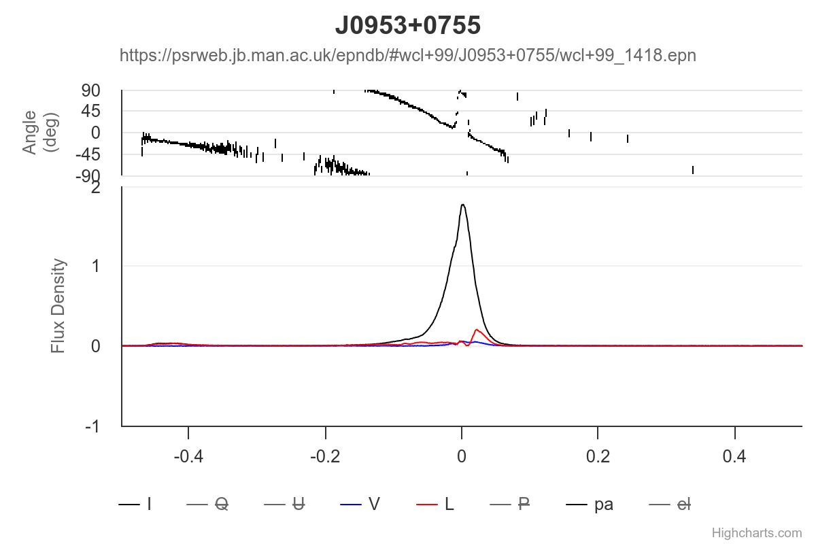
Inter-Pulse Pulsars
0953
The EPN Database of Pulsar Profiles
1418 MHz
https://psrweb.jb.man.ac.uk/epndb/#wcl+99/J0953+0755/wcl+99_1418.epn
The total intensity, linear polarization and circular polarization, their fractions, as well as position angle of linear polarization, all are plotted from the bottom to the top sub-panels for each profile. For each pulsar, the total intensity, linear and circular polarization are represented by black solid, red dashed and blue doted lines in the bottom sub-panel. The left-hand circular polarization is defined to be positive.
The 3 P’s:
Freq. Range: 1300-1800
T sample: 0.0001
T observation: 601 s

Slide 31
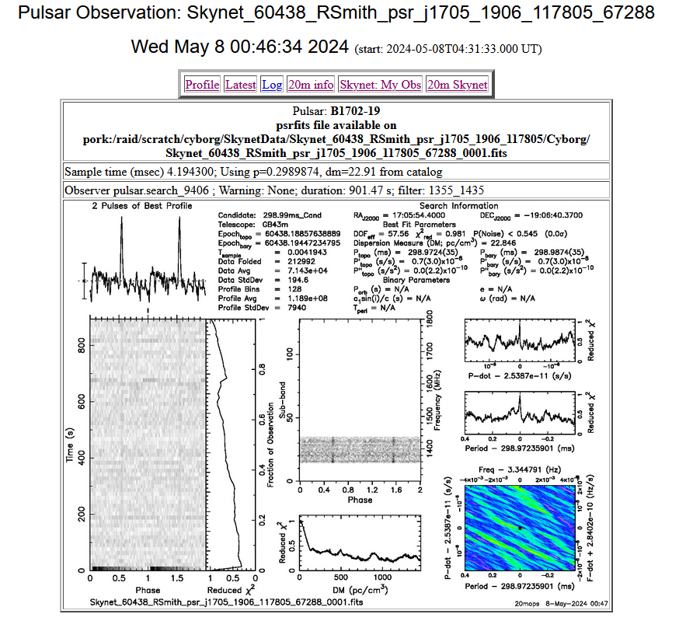
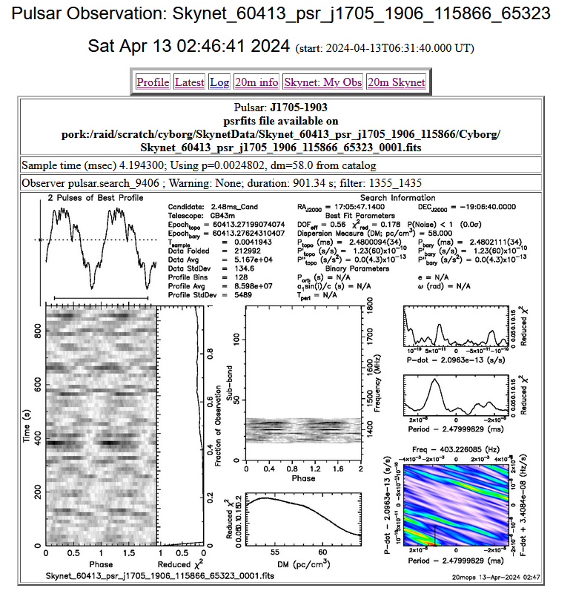
Inter-Pulse Pulsars
1705
Both have the same 3P’s!
What’s Wrong?
Not the same pulsar location despite B and J system coordinates that look similar. Confirmed by the very different pulsar periods.
The 3 P’s:
Freq. Range: 1355-1435
T sample: 0.004
T observation: 901 s
The 3 P’s:
Freq. Range: 1355-1435
T sample: 0.004
T observation: 901 s

Slide 32
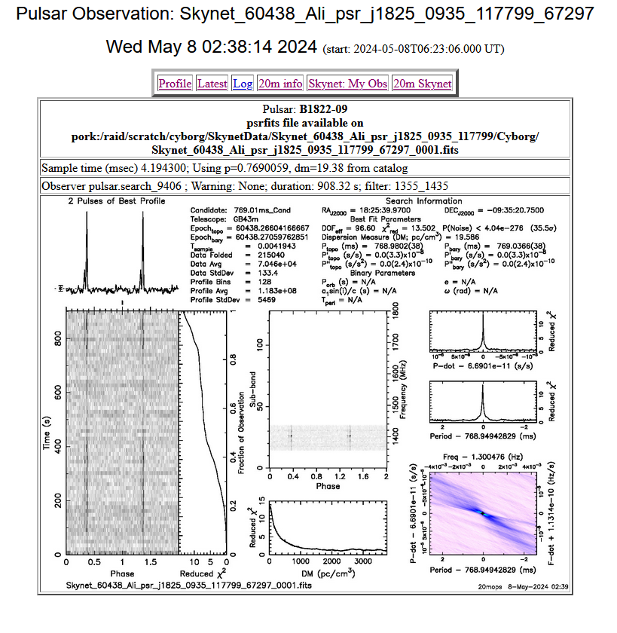
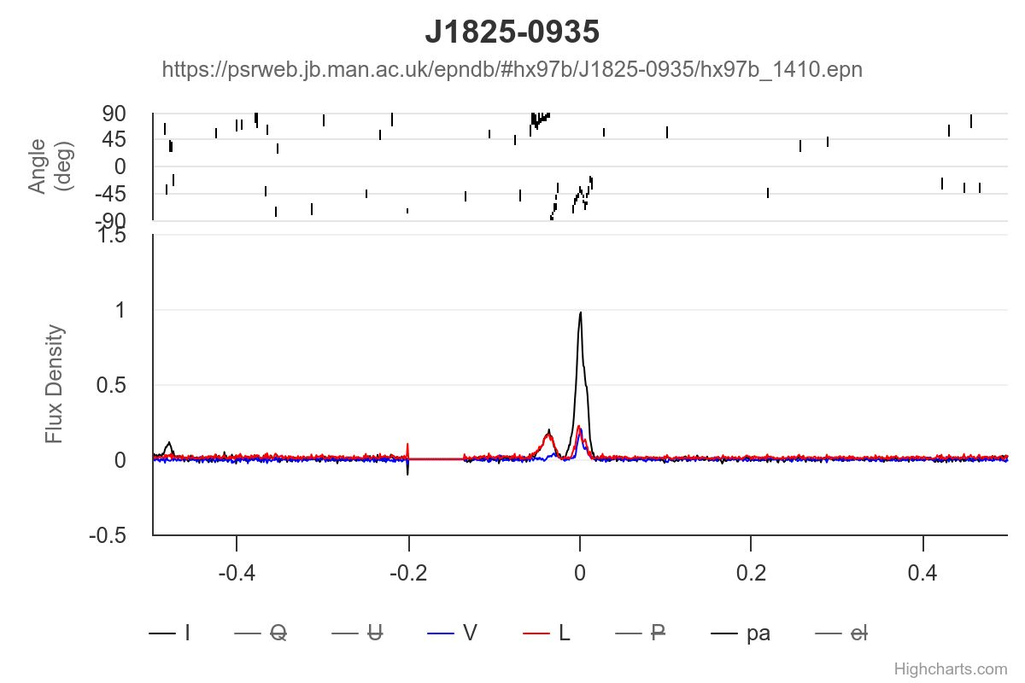
Inter-Pulse Pulsars
1825
The EPN Database of Pulsar Profiles
1410 MHz
The 3 P’s:
Freq. Range: 1355-1435
T sample: 0.004
T observation: 908 s
https://psrweb.jb.man.ac.uk/epndb/#hx97b/J1825-0935/hx97b_1410.epn
The total intensity, linear polarization and circular polarization, their fractions, as well as position angle of linear polarization, all are plotted from the bottom to the top sub-panels for each profile. For each pulsar, the total intensity, linear and circular polarization are represented by black solid, red dashed and blue doted lines in the bottom sub-panel. The left-hand circular polarization is defined to be positive.

Slide 33
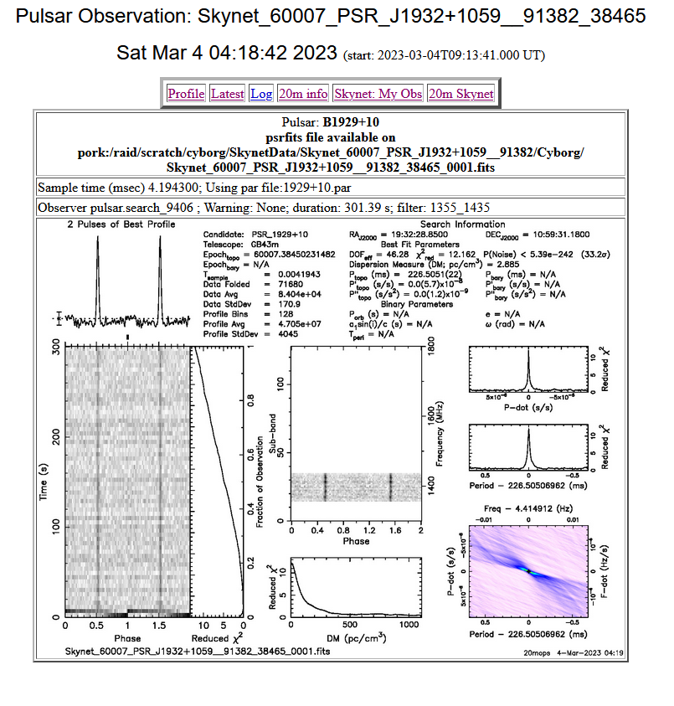
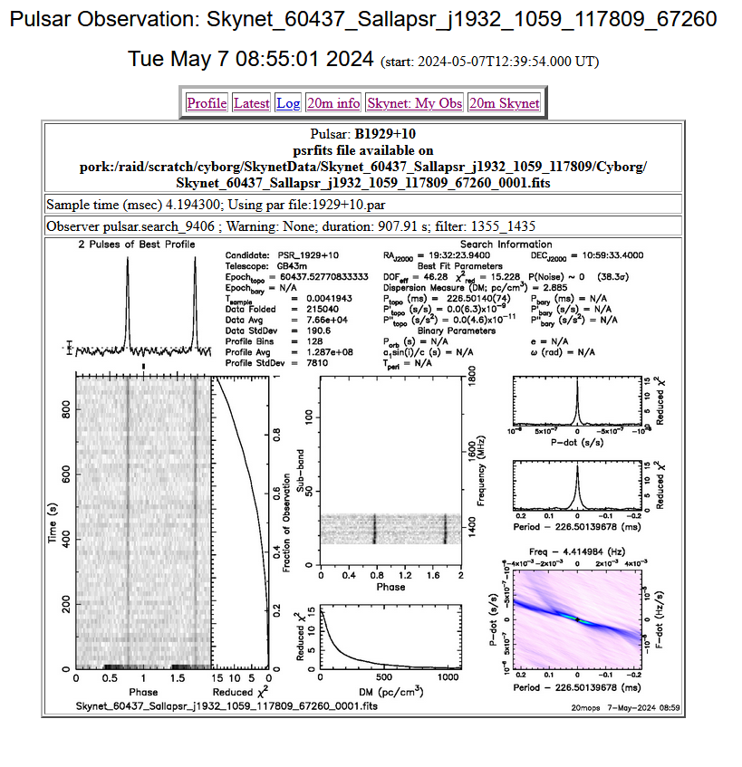
Inter-Pulse Pulsars
1932
The 3 P’s:
Freq. Range: 1355-1435
T sample: 0.004
T observation: 301 s
The 3 P’s:
Freq. Range: 1355-1435
T sample: 0.004
T observation: 908 s

Slide 34
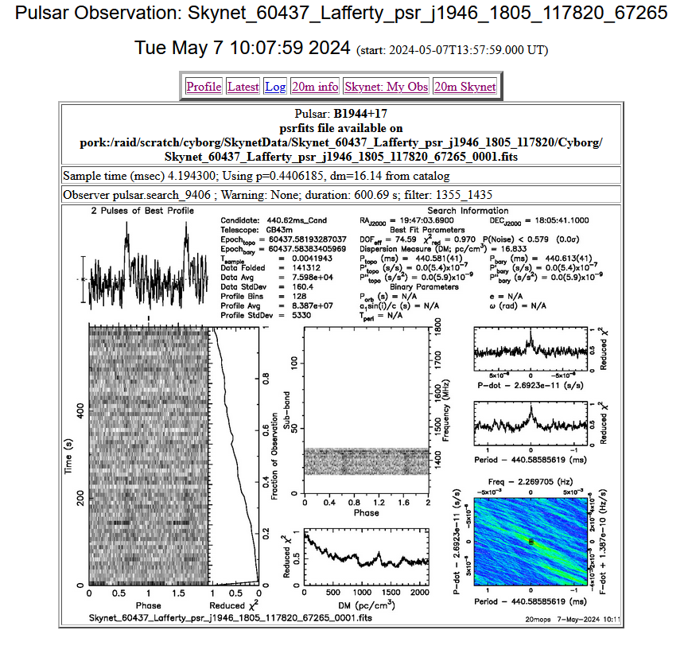
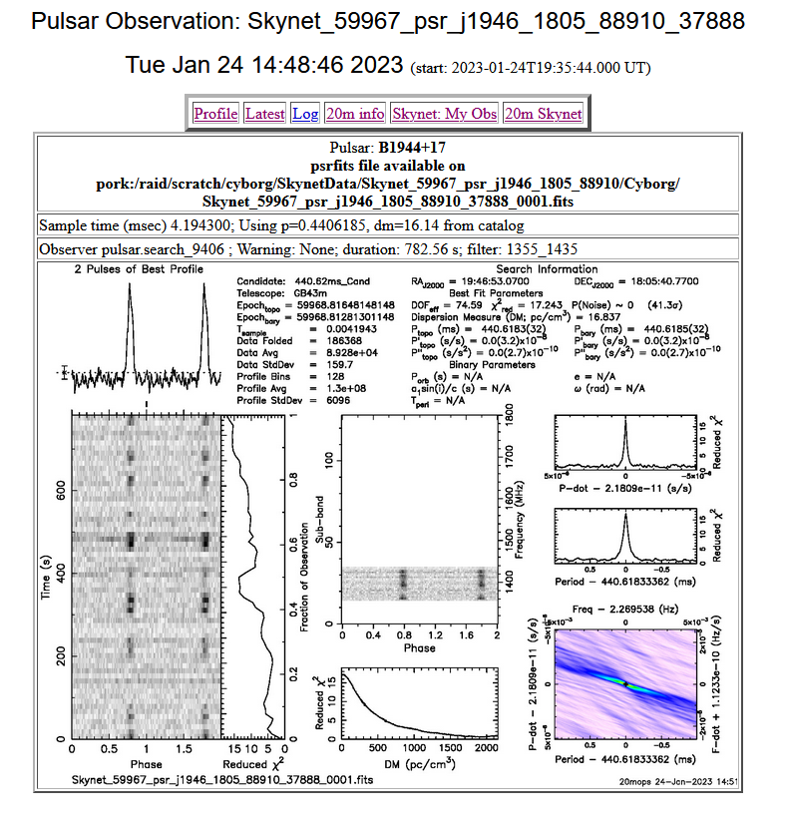
Inter-Pulse Pulsars
1946
The 3 P’s:
Freq. Range: 1355-1435
T sample: 0.004
T observation: 601 s
The 3 P’s:
Freq. Range: 1355-1435
T sample: 0.004
T observation: 783 s

Slide 35
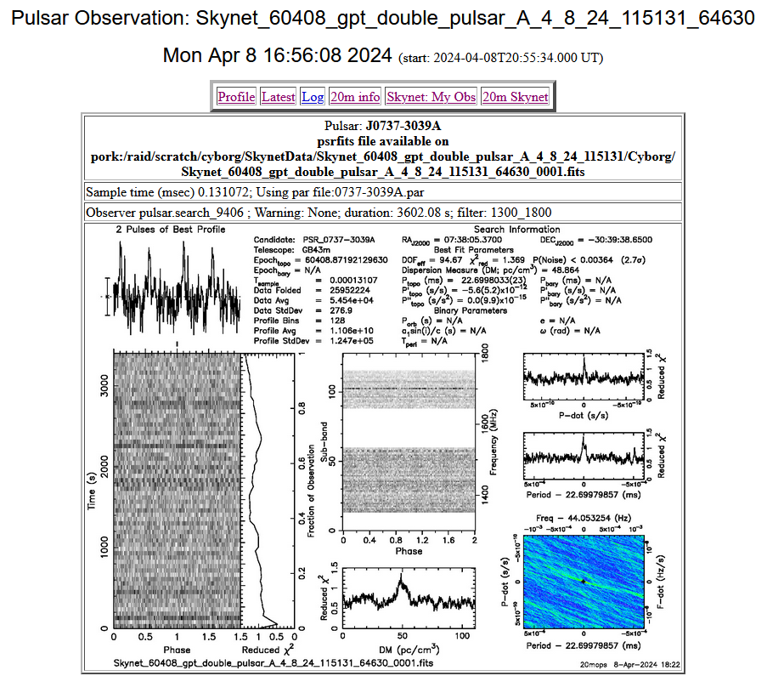
Double Pulsars
Using a 20 m Radio Telescope to Test a Simple Method for Estimating the Orbital Period of Binary Millisecond Pulsars
Preiser, A. ; Chen, X. ; Zuckerman, A.
This paper developed a method for estimating the orbital period of binary millisecond pulsars. Using the ATNF catalog the authors selected four binary millisecond pulsars that could be observable with the 20 m telescope at the Green Bank Observatory. They observed each pulsar two times a day over the time-period of at least two orbital periods. From the observations, they recorded the barycentric time and the barycentric pulsar spin period and looked for periodic behavior in the pulsar period variations to determine if the periodic behavior observed matched the orbital period. This simple method uses many short observations to estimate the orbital period.
The 3 P’s:
Freq. Range: 1300-1800
T sample: 0.0001
T observation: 3602 s
https://ui.adsabs.harvard.edu/abs/2020AAS...23510221P/abstract
American Astronomical Society meeting #235, id. 102.21. Bulletin of the American Astronomical Society, Vol. 52, No. 1
January 2020

Slide 36
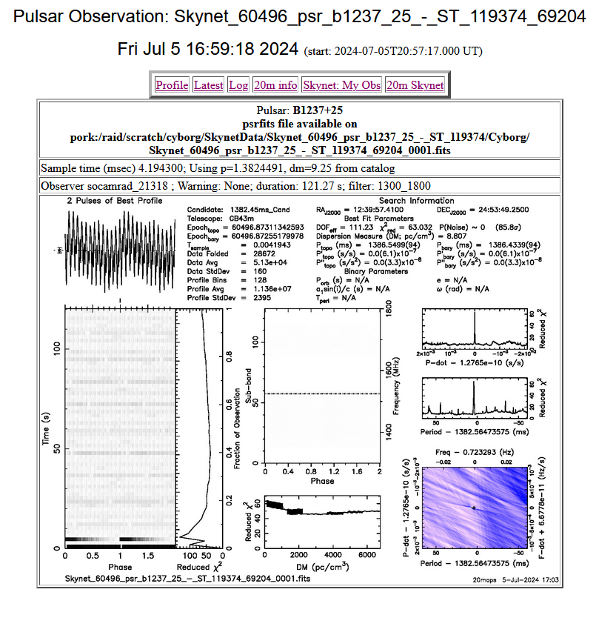
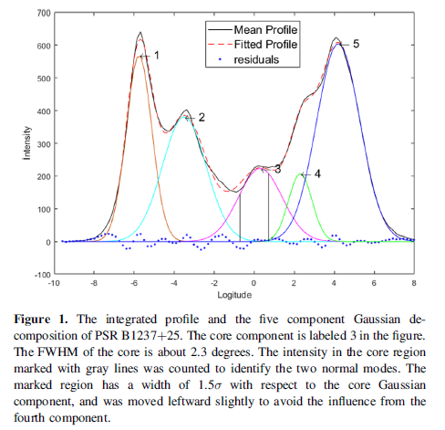
0329, 1133, 1237, 1822, 2321
Mode Switching Pulsars
A Detailed Study of Mode Changing and Modulation of PSR B1237+25 with FAST
Wang, Zheng-Wu ; Yuan, Mao ; Wang, Lin ; Zhang, Cheng-Min ; Peng, Bo
PSR B1237+25, whose mean pulse profile has five components, is a well-known star to study pulsar emission geometries. The paper’s authors conducted mode changing and modulation analysis on this pulsar using FAST data at 1.25 GHz with a bandwidth of 400 MHz. They observed and identified three emission modes of this pulsar: a quiet normal mode that has little or no core activity with distinctive 2.8-period subpulse modulation on its outer cone; a flare normal mode in which the core is highly active; and an abnormal mode in which the core is active and the last component is weak.
A Detailed Study of Mode Changing and Modulation of PSR B1237+25 with FAST
To cite this article: Zheng-Wu Wang et al 2022
Res. Astron. Astrophys. 22 07500
The 3 P’s:
Freq. Range: 1300-1800
T sample: 0.004
T observation: 121 s

Slide 37
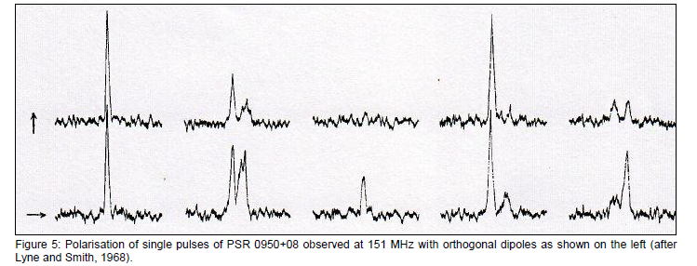
Polarization in Pulsars
Polarization studies of pulsars can help identify them in radio continuum surveys, understand their polarization properties, and determine how their polarization evolves
0950
Journal of Astronomical History and Heritage, 15(2), 76-95 (2012). Page 76 TS
Richard Wielebinski
Max-Planck-Institut für Radioastronomie, Auf dem Hügel 69, 53121 Bonn, Germany.
E-mail: rwielebinski@mpifr-bonn.mpg.de

Slide 38
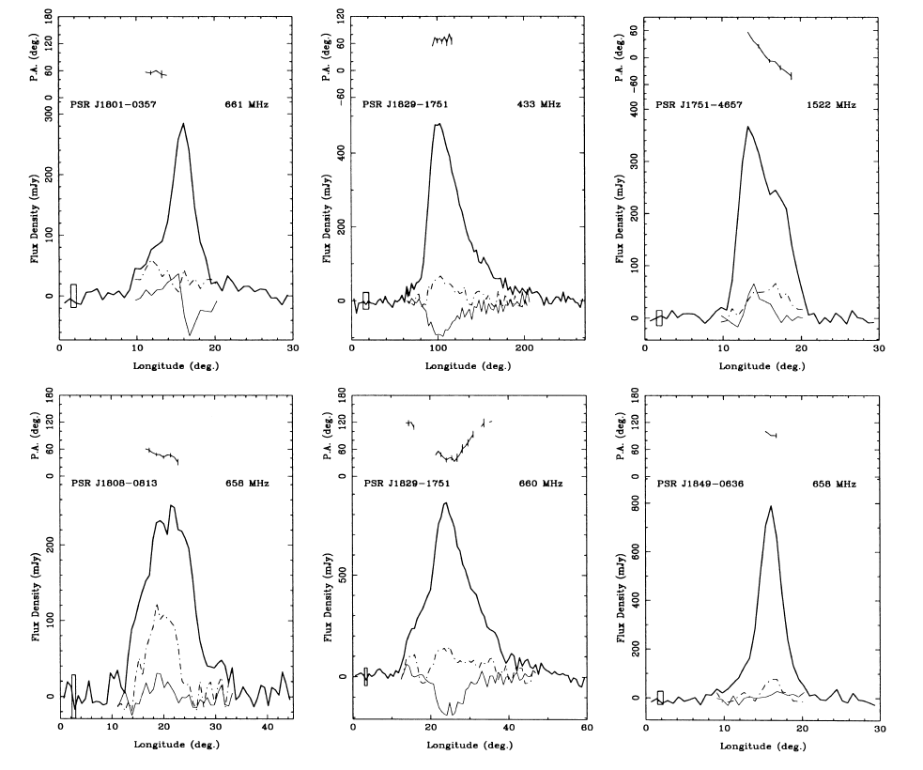
Polarization in Pulsars
1829
Structure of Pulsar Beams: Conal versus Patchy
This paper’s authors observed the mean pulse profiles and polarization properties of 66 pulsars at 435, 660 or 1500 MHz. Observed profiles are interpreted in the context of the circular beam, rotating-vector model to give impact parameters and inclination angles for the beam or dipole magnetic axis. In general, research papers might find evidence to support different models of pulsar beams. This paper’s observations gave support to the patchy cone model for pulsar emission.
[Note: there are many theories/models on the shape of pulsar radio emission beams, of which the patchy cone model is one.]
Mon. Not. R. Astron. Soc. 295, 280–298 (1998)
Polarization observations of 66 southern pulsars
R. N. Manchester, J. L. Han and G. J. Qiao
Accepted September 15. Received 1997 September 9; in original form 1997 June 9

Slide 39
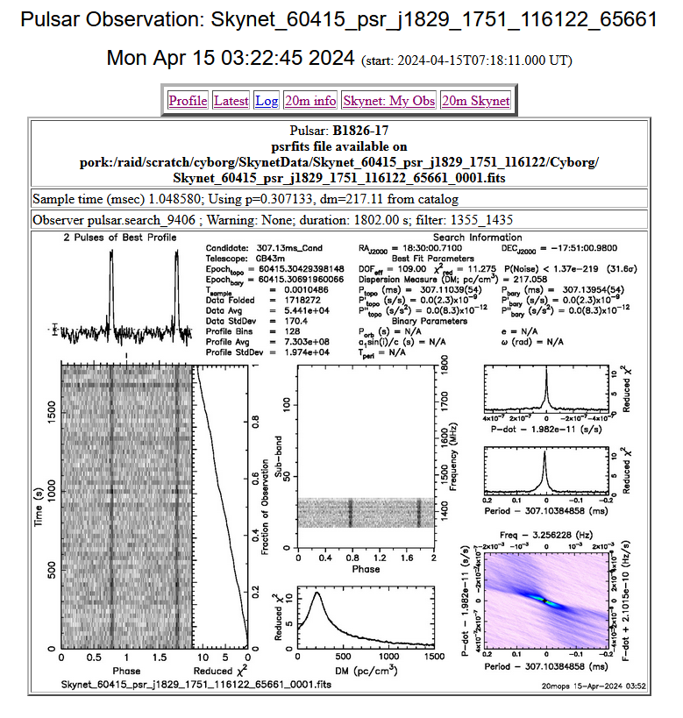
Polarization in Pulsars
1829, Continued
“PSR J1829—1751 (PSR B1826-17): This pulsar has a triple morphology with the central component dominating at frequencies below about 1 GHz and disappearing at higher frequencies. At 433 MHz, the profile is wide with an approximately exponential tail. The pulsar DM is high (—218 cm-3 pc, and so this tail almost certainly results from scattering. The observed scattering time (—50 ms) is, however, much greater than the value of 9 ms predicted by the Taylor & Cordes (1993) model. Strong right-circular polarization is observed near the center of the (unscattered) profile at both 433 and 660 MHz. Significant linear polarization is also seen at both frequencies, with a very unusual PA variation at 660 MHz. There may be an orthognal-mode transition in the leading part of the pulse.”
Mon. Not. R. Astron. Soc. 295, 280-298 (1998)
Polarization observations of 66 southern pulsars
R. N. Manchester, J. L. Han, and G. J. Qiao
The 3 P’s:
Freq. Range: 1355-1435
T sample: 0.001
T observation: 1802 s

Slide 40
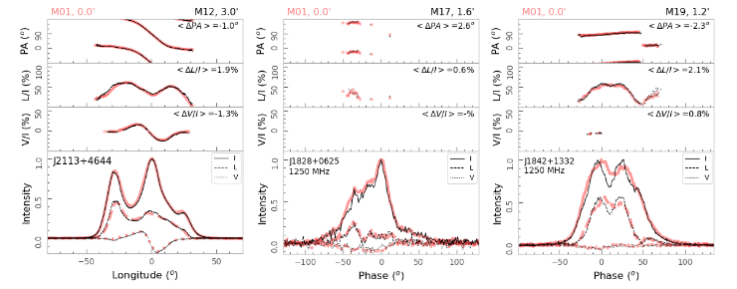
Polarization in Pulsars
Pulsar polarization profiles are a very basic database for understanding the emission processes in a pulsar magnetosphere. After careful polarization calibration of a 19-beam L-band receiver and verification of beam-offset observation results, the researchers of this paper obtain polarization profiles of 682 pulsars from observations by the Five-hundred-meter Aperture Spherical radio Telescope (FAST).
Comparisons for polarization profiles (thin lines) obtained from data recorded by the outer beams of the 19-beam
L-band receiver when a pulsar is very offset from the beam center with the results (thick background lines) observed by
the central beam M01 without offset. For each pulsar, in the bottom sub-panel are the total intensity, linear and circular
polarization represented by solid, dashed and doted lines; and other sub-panels are the fractional circular and linear
polarization and position angle curves of linear polarization with the linear polarized intensities exceeding 5σ, here σ is
obtained from the off pulse phase-bins. In general, results from the outer beams are very consistent with that from the
central beam M01 in the thick background line, with a small derivations for ⟨∆P A⟩, ⟨∆L/I⟩ and ⟨∆V /I⟩ as indicated in
each sub-panel.
RAA 2023 Vol. 23 No. 03, A02 © 2019 National Astronomical Observatories, CAS and IOP Publishing Ltd.
http://www.raa-journal.org http://iopscience.iop.org/raa
Research in Astronomy and Astrophysics
FAST pulsar database: I. Polarization profiles of 682 pulsars
P. F. Wang, et. al.

Slide 41
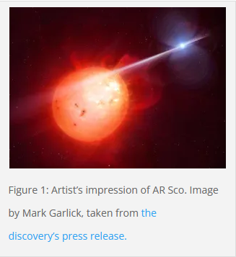
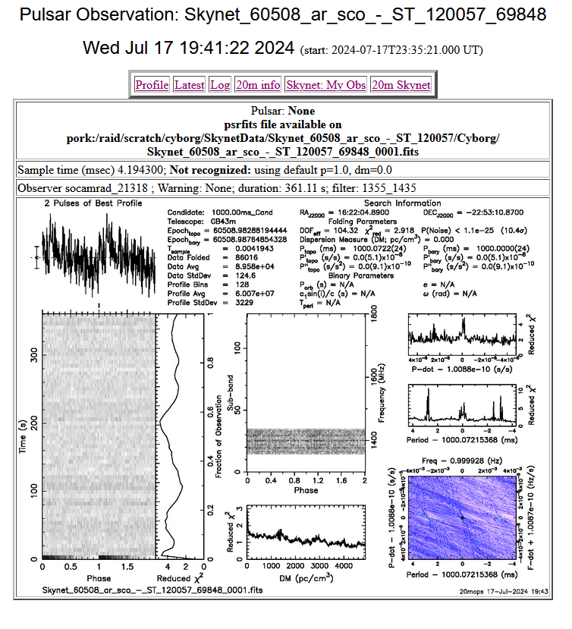
Radio Stars
AR Scorpii is a binary system containing a white dwarf and a main sequence star. It pulsates strongly and its brightness can increase or decrease by as much as a factor of four in as little as thirty seconds. These pulsations are seen across the electromagnetic spectrum, from radio all the way up to ultraviolet. There are three time periods. Two are the orbital period of the system (3.5 hours) and the rotation period of the white dwarf (2 minutes, which is much faster than a white dwarf normally spins). The third period, which is also around 2 minutes long, is a so-called ‘beat’ period that comes from interference between the orbital and rotation periods. The beat period implies some interaction between the white dwarf itself and the main sequence star, such as pulses from the white dwarf reflecting from the other star’s surface.
The 3 P’s:
Freq. Range: 1355-1435
T sample: 0.004
T observation: 361 s
https://astrobites.org/2016/12/23/ar-sco-the-first-white-dwarf-pulsar/

Slide 42
0358 = 0355
Scintillation in Pulsars
0452, 1752, 1822, 1900, 2022
2154 = 2157

Slide 43
Other Classifications
Ordinary
Gamma Pulsars (10%)
ToPP: Topology of Pulsar Profiles (Graph theory method and Classification of the EPN)
AXP: Anomalous X-ray Pulsar or Soft Gamma-ray Repeater with detected pulsations
Binary: Pulsar has one or more stellar companion(s)
HE: Spin-powered pulsar with pulsed emission from radio to infrared or higher frequencies
NRAD: Spin-powered pulsar with pulsed emission only at infrared or higher frequencies
RADIO: Pulsars with pulsed emission in the radio band
RRAT: Pulsars with intermittently pulsed radio emission
XINS: Isolated neutron stars with pulsed thermal X-ray emission but no detectable radio emission

Slide 44
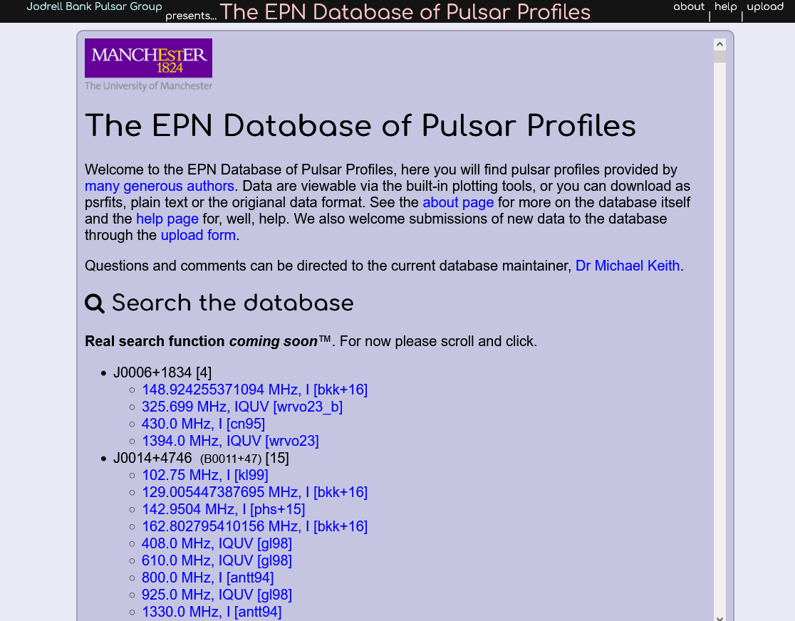
Pulsar Databases
European Pulsar Network (EPN)
Polarization profiles: The total intensity, linear polarization and circular polarization, their fractions, as well as position angle of linear polarization, all are plotted from the bottom to the top sub-panels for each profile. For each pulsar, the total intensity, linear and circular polarization are represented by black solid, red dashed and blue doted lines in the bottom sub-panel. The left-hand circular polarization is defined to be positive.
https://psrweb.jb.man.ac.uk/epndb/

Slide 45
Pulsar Databases
European Pulsar Network (EPN)
Found 5,108 profiles from 1,316 unique pulsars.
The data streams themselves may be outputs of different polarization channels, or individual channels (bands) of a filter bank or a combination thereof. In total, there may be a number of data streams of i.e. different frequencies for each polarization. Each data stream starts with a small, fixed length sub-header in front of the actual data values. The number of streams and their length may vary between different EPN files but is constant within each file. A character field and an ordinal number is provided for each stream for its identification.
Website does not define the letter codes
I: The total intensity (Black)
L: linear polarization (Red Dashed)
V: circular polarization (Blue Dotted)
Pa: position angle of linear polarization
The left-hand circular polarization is defined to be positive.
https://psrweb.jb.man.ac.uk/epndb/

Slide 46



Pulsar Databases
Australian
Neutral atomic hydrogen (H1) traces the interstellar medium (ISM) over a broad range of physical conditions. Can the Dispersion Measure of Pulsars tell us anything about H1?
Examples
Gordon, K J, and Gordon, C P. Measurement of neutral-hydrogen absorption in the spectra of eight pulsars. Country unknown/Code not available: N. p., 1974. Web.
Then Press Table
The Crab Pulsar (PSR B0531+21, also known by the J2000 name PSR J0534+2200) was discovered in 1968. It is the remnant of its progenitor supernova SN 1054.
ATNF Pulsar Catalogue
https://www.atnf.csiro.au/research/pulsar/psrcat/
Paper: Manchester, R. N., Hobbs, G.B., Teoh, A. & Hobbs, M., AJ, 129, 1993-2006 (2005)
AAS Abstracts

Slide 47


Pulsar Databases
ATNF Pulsar Catalogue v1.68: Documentation
G. Hobbs, R. N. Manchester and L. Toomey
CSIRO Astronomy and Space Science, Australia Telescope National Facility, PO Box 76, Epping, NSW 1710, Australia
The ATNF Pulsar Catalogue
Includes all published rotation-powered pulsars, including those detected only at high energies, and Anomalous X-ray Pulsars (AXPs) and Soft Gamma-ray Repeaters (SGRs) for which coherent pulsations have been detected. However, it excludes accretion-powered pulsars such as Her X-1 and the X-ray millisecond pulsars. To access, use the web interface ( http://www.atnf.csiro.au/research/pulsar/psrcat ). Appendix A: The Pulsar Parameters, lists the commonly used pulsar parameters.
A Few More Examples
To produce a list of the names and Galactic coordinates of all the known pulsars with periods greater than two seconds and distances greater than 3 kpc:
Click on the box to the left of 'Name', 'GL' and 'GB' under the 'Predefined Variables' heading at the top of the web interface
In the 'Condition' box, type: p0 > 2 && dist > 3
Move to the bottom of the page and click on TABLE (BOX)
To plot a period-period derivative diagram for all the known pulsars:
Move to the bottom of the web interface and enter 'p0' in the 'X-Axis' box underneath the heading 'Plotted Output'. Change 'linear' to 'log' to plot the graph with logarithmic axes.
Enter 'p1' in the 'Y-Axis' box and change 'linear' to 'log'.
Click on PLOT (BOX)
To list all known pulsars with declinations greater than -30 degrees and with measured flux densities at 400 MHz
Under the 'Predefined Variables' heading, select 'Name', 'RAJ', 'DECJ' and 'S400'.
In the 'Condition' box type: decjd > -30 && exist(s400)
Click on the TABLE (BOX) icon at the bottom of the page.
https://www.atnf.csiro.au/people/pulsar/psrcat/psrcat_help.html

Slide 48


Pulsar Databases
Crab Pulsar Example
P0 0.0333924123 1.200e-09
See Appendix A for Parameter definitions. https://www.atnf.csiro.au/research/pulsar/psrcat/psrcat_help.html
For example, F0 is Barycentric rotation frequency (Hz); PO is Pulse Period.
NOTE: For 20m search on the crab pulsar (a pulsar) and not the crab nebula (a SNR)
Crab pulsar is PSR J0534+2200, a.k.a. PSR B0531+22 and also CM Tau
From Catalog DM = 56.77, PO pulse period (s) [Select “long” then Get Ephemeris.
Because frequency is time-dependent, movement toward or away from a radio wave will affect the frequency at which it is detected, i.e., the Doppler effect. One way to control for this movement is to measure barycentric frequency instead of raw frequency. Calculations of barycentric frequency control for the rotation of the Earth and its orbit around the sun.
https://www.atnf.csiro.au/research/pulsar/psrcat/

Slide 49
Summary and Open Forum
Demo Objective: When observing pulsar profiles always remember the 3 P’s and how they affect outcomes:
A Parameter for Frequency Range.
A Parameter for Integration Time.
A Parameter for Observation Time.
Key Objectives of this PowerPoint: An understanding and confirmation of what the 20m can and can’t do with pulsar profile observations.
Questions?

Slide 50
Contact
Email SARA Section Analytical Section Coordinator
Tzikas@alum.rpi.edu
stephentzikas@gmail.com

