Slide 1
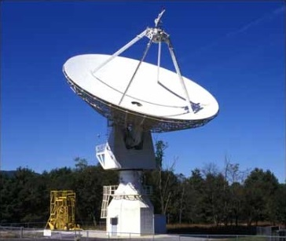

SARA Global Conference 2026
Solar Eclipses, Flares, and Occultations

Slide 2
Agenda
20 Meter Dish Demo
Solar Eclipses
  August 21, 2017
  April 8, 2024
  March 29, 2025
  August 12, 2026
  January 24, 2020 (vicinity pass)
Solar Flares
Occultations
Summary and Open Forum

Slide 3
20 Meter Dish Demo
This 20m Demo and SARA Section Update are posted on SARA Analytical Section page
Also Posted:
  2019 demo presentation posted (Cas A Flux Density Calculation)
  2020 demo presentation posted (Pulsars)
  2021 demo presentation posted (Masers)
  2022 demo presentation posted (Raster Scans)
  2023 demo presentation posted (Inter-Stellar Matter [ISM])
  2024 demo presentation posted (H1 Observations “Off the Beaten Path”)
  2025 demo presentation posted (Pulsar Profiles)
Green Bank Conference Account - Explore!
Demo Example – Watch the dish move outside!
See Green Bank and McGill University scientist Ryan S. Lynch’s “Searching for and Identifying Pulsars” guide posted on the internet.
http://www.gb.nrao.edu/20m/psr20m_advice.html
https://www.physics.mcgill.ca/~rlynch/Outreach/PSC_search_guide.pdf
https://astronomy.swin.edu.au/cosmos/p/pulsar+dispersion+measure

Slide 4
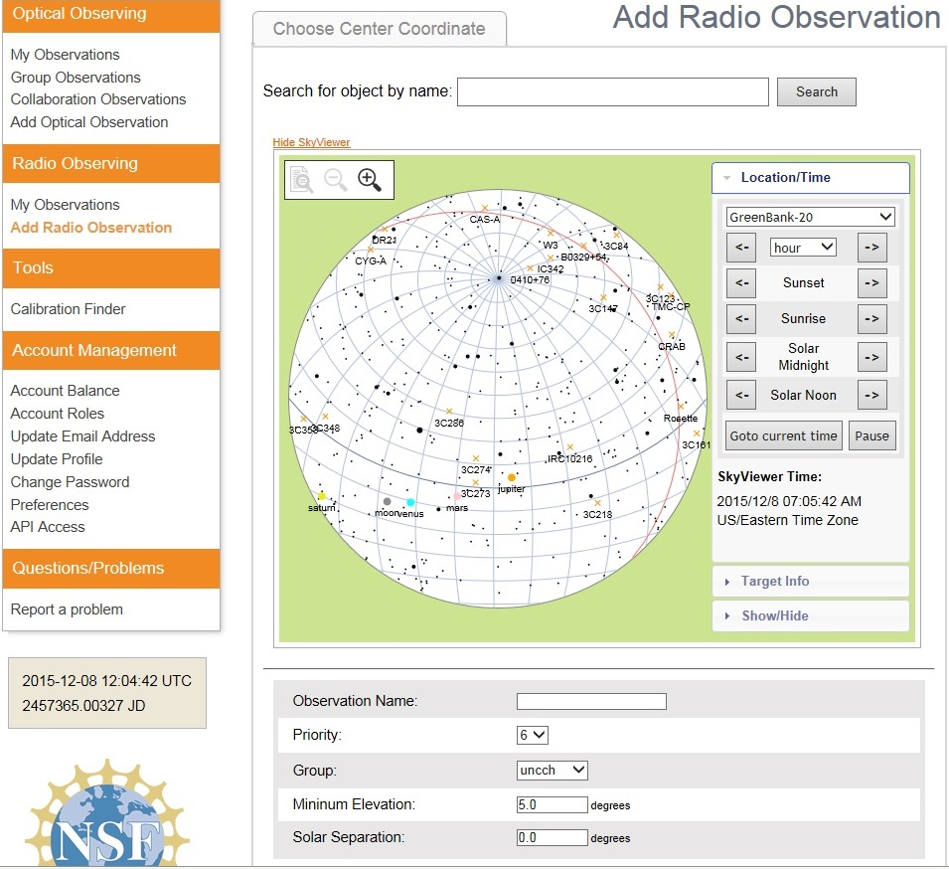
20 Meter Dish Demo
Add a Radio Observation
-Select an Object
(Database or RA/Dec)
-Minimum Elevation
(Used for mapping)
-Solar Separation
(to prevent solar side lobe
interference)

Slide 5
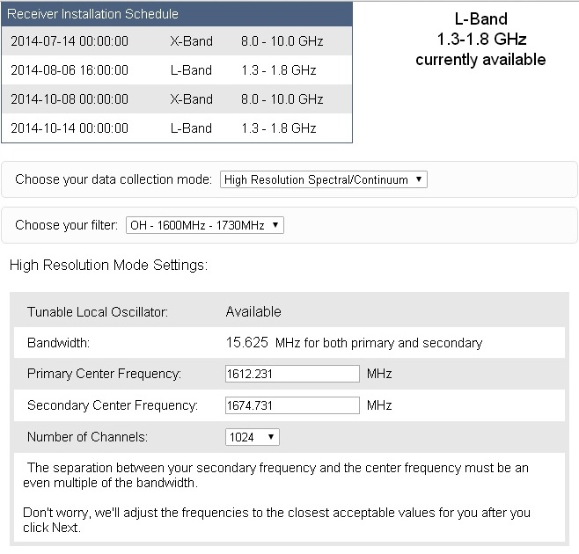
20 Meter Dish Demo
Configure Receiver
Low Resolution: continuum mapping/pulsars
High Resolution: Spectral Lines
No Filter Full Band (with interference)
H1 Filter (continuum maps, 1355-1455 MHz)
OH Filter (Iridium sat. interference, 1.6-1.73 GHz)
Data Collected in Bins: Time bins (data collected in a small chunk of time) or frequency bins (data collected in a small chunk of observing frequency).
X-Band: Aug. 28- Nov. 27, 2017

Slide 6
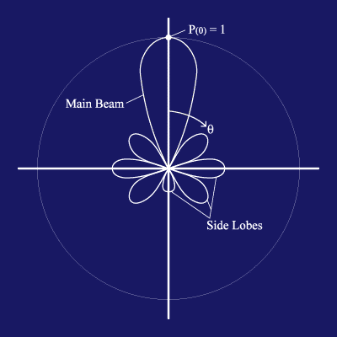
20 Meter Dish Demo
https://www.gb.nrao.edu/20m/map20m_advice.html
Credit: http://www.ras.ucalgary.ca › radiotel › calibration
Beam and Beamwidth (Visualization Basics)
The beam is the area on the sky in which radiation will be detected by the radio telescope. In terms of the telescope as a receiver of radiation, it will respond to the radiation coming in along that same beam as if it were a transmitter. In general, a smaller telescope has a wider beam. The reflecting dish of the radio telescope gives the antenna considerable directionality by focusing radio waves from a particular direction onto the horn. It is still sensitive to radiation from directions other than the pointing direction. The largest lobe is called the main beam and the smaller lobes are called side lobes.
The beamwidth of the full width half maximum (FWHM) of the main beam: This defines the resolution of the telescope. When a point source is in the most sensitive part of the main beam, the measured signal will be highest. As the point source is moved away from the center of the main beam, the measured signal will decrease. Therefore, by moving the point source through the main beam, the shape of the main beam is mapped out. Only structures on angular scales larger than the telescope's beam can be revealed. The angular resolution of a given antenna system is limited by the beamwidth. The 20-meter telescope is like a camera with one pixel, or beam. To make an image, one must scan the telescope back and forth across the object and build up an image, pixel by pixel.
Beamwidth (BW) = 70λ / D. It’s related to resolution. λ is the observing wavelength, and D is the telescope diameter. λ = 0.3 / frequency
For the 20m radio telescope:
The 8-10 GHz receiver has a beam size of about 7 arcmin.
The 1.4 GHz receiver has a beam size of about 44 arcmin.
(Some calculate a 0.6 degrees full width half maximum power response)
The antenna 3dB beamwidth is the angle between the half-power of an antenna pattern or beam over which the relative power is at or above 50% of the peak power. Example : An antenna has a diameter of 2m and frequency 16GHz. Calculate the 3 DB beamwidth for the antenna. To find 3 dB Beamwidth, first calculate the value of λ, Substitute the values in the λ formula, λ = 0.3 / frequency λ = 0.3 / 16 λ = 0.01875. Substitute the values in the beamwidth formula: Beamwidth = ( 70 * 0.01875 ) / 2 = = 1.3125 / 2 degrees = = 0.656 degrees
The sensitivity of a telescope is not uniform across the beam. In most cases, the telescope is most sensitive to radiation entering the telescope straight-on, and the sensitivity fades off towards larger angles. Radiation that enters in the beam but off-center might produce a response in the receiver 80% of that when it enters in the very center.
The Radio telescope system temperature is the amount of noise that will appear in a measurement and which the signal from the source (measured as antenna temperature) needs to stand out from to be detected.
The angular resolution is given by: θ ~ λ/D
See https://www.omnicalculator.com/physics/angular-resolution
(Allows use of multiple units)
BW = 1.2λ/D (in radians)
BW = 62/Fghz (in arcminutes); Fghz = GHz (instead of λ)
(for a 20-meter telescope)

Slide 7
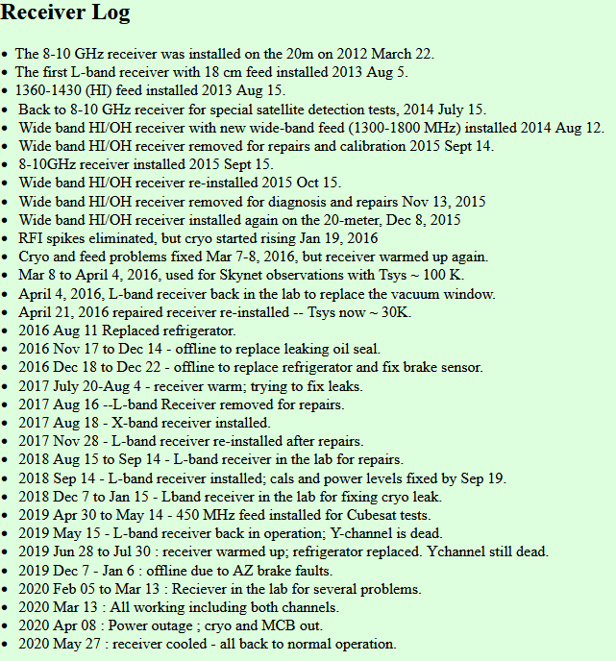
20 Meter Dish Demo
https://www.gb.nrao.edu/20m/

Slide 8
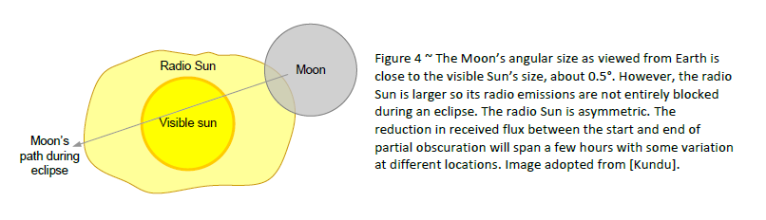
Solar Eclipses
Use a Sun-Moon position calculator for monthly eclipses of the sun’s corona.
Illustration: Planning for the 2023 and 2024 Solar Eclipses at VHF, UHF and Ku-band, Christian Monstein and Whitham D. Reeve

Slide 9
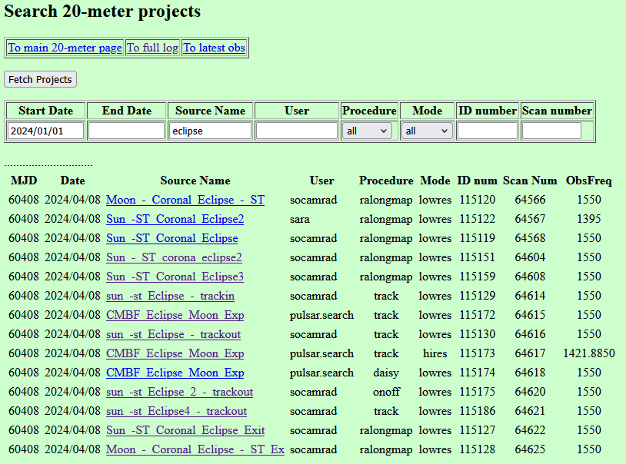
Solar Eclipses
Search existing data for eclipse events
https://www.gb.nrao.edu/20m/find20mproj.html

Slide 10
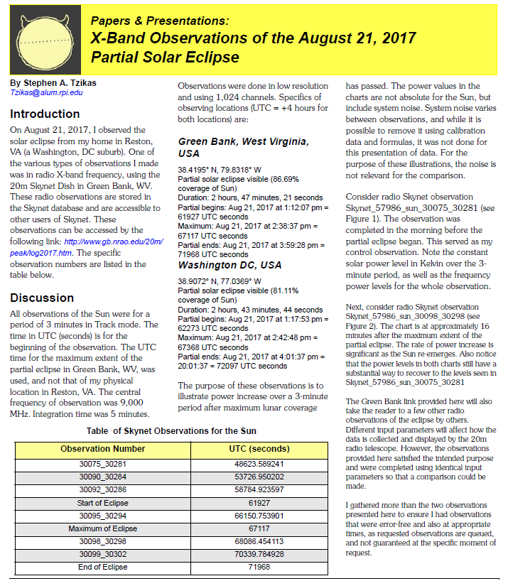
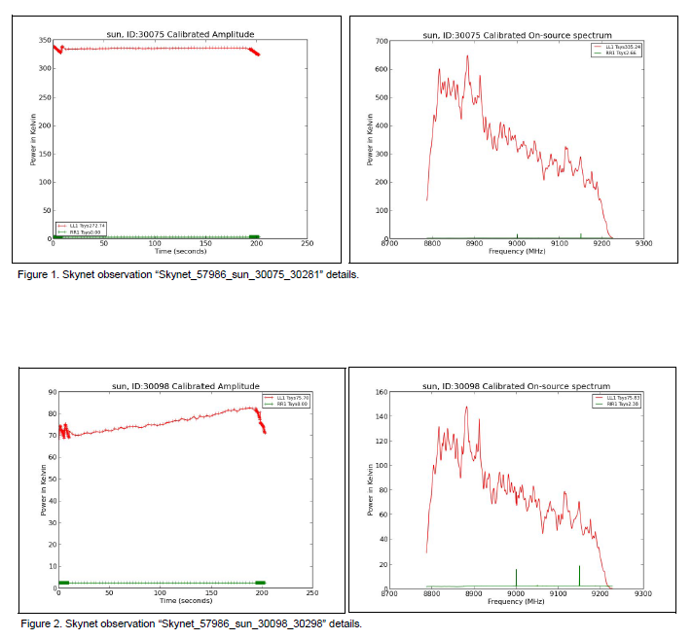
Solar Eclipses
2017 8 21 Partial Solar Eclipse
2017 Eclipse in X-Band, tracking mode
20m data used for an A.L.P.O. Article
Journal of the Association of Lunar & Planetary Observers, Volume 61, No. 1, Winter 2019

Slide 11
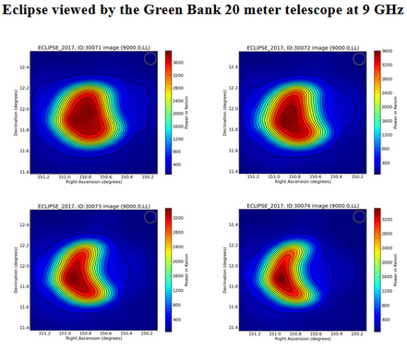
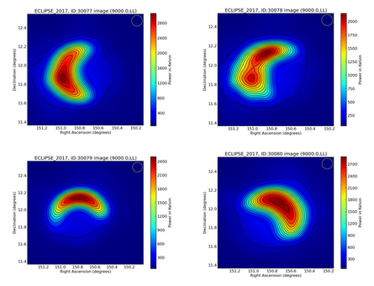
Solar Eclipses
2017 8 21 Partial Solar Eclipse
2017 Eclipse in X-Band, raster scan mode, www.gb.nrao.edu/20 m log

Slide 12
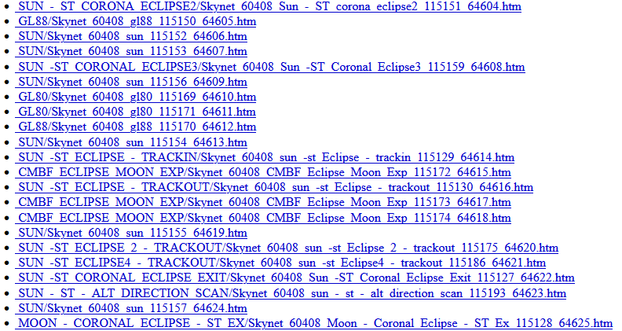
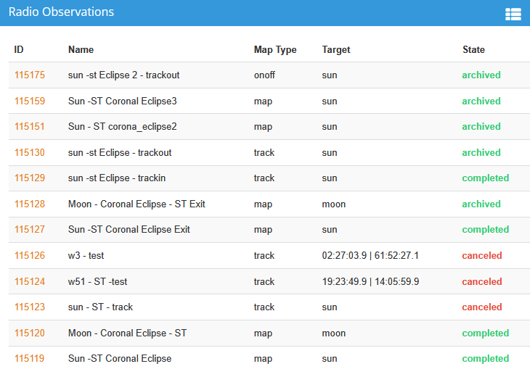
Solar Eclipses
2024 4 08 Partial Solar Eclipse
20m data include raster scan mode
www.gb.nrao.edu/20 m log
Observer 60408

Slide 13
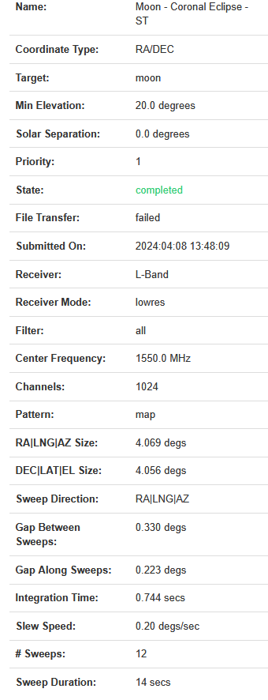
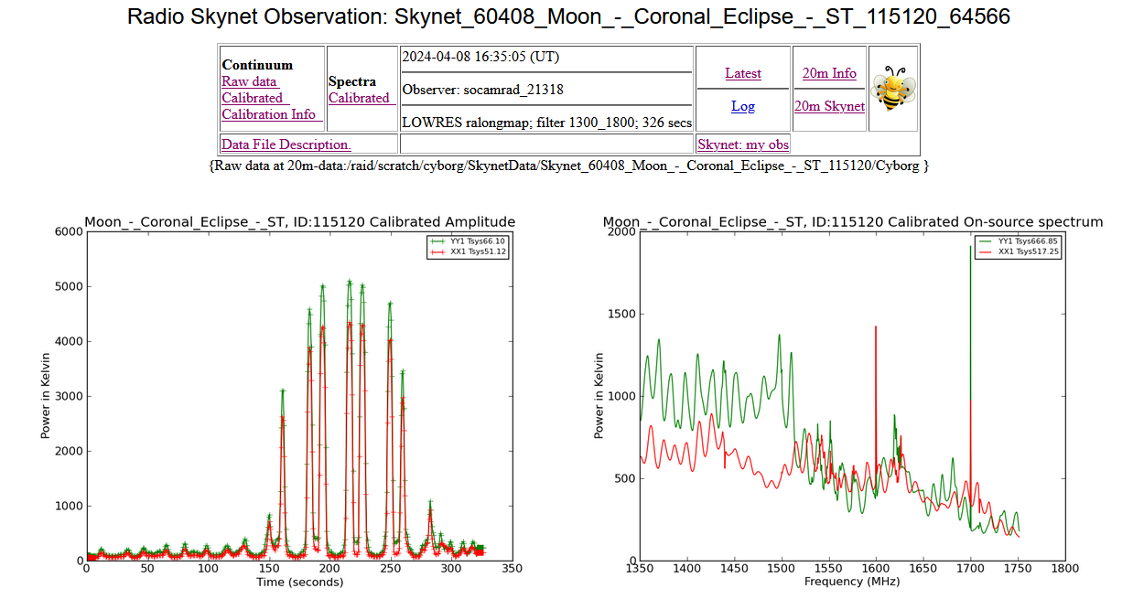
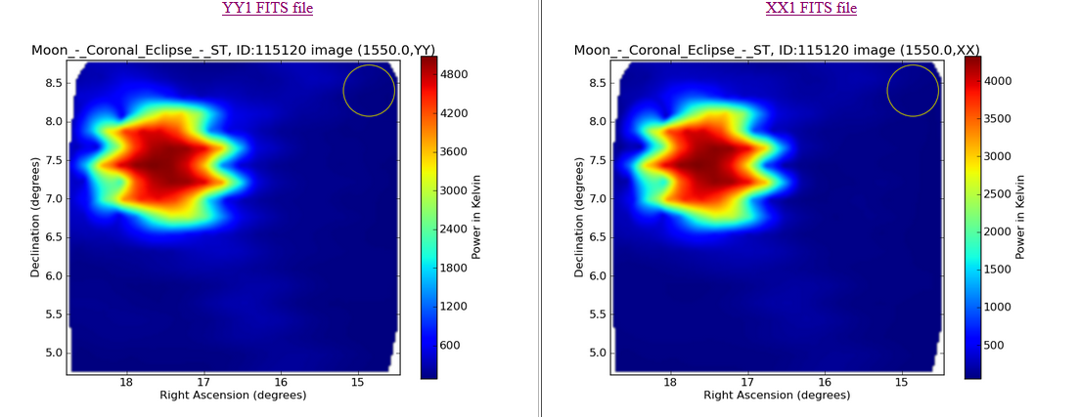
Solar Eclipses
12:35 PM On Moon
2024 4 08 Partial Solar Eclipse
20m data raster scan mode
Pre-Start centered on Moon
The April 8, 2024, solar eclipse was a partial eclipse in Green Bank, WV, with about 91% obscuration.
Details of the eclipse in Green Bank, WV:
Local view: Green Bank was not in the path of totality, but it experienced a significant partial eclipse, reaching approximately 91% obscuration.
Start time: The partial eclipse began at 1:59 pm EDT.
Maximum eclipse: The peak of the eclipse was at 3:16 pm EDT.
End Time: The partial eclipse concluded at 4:29 pm EDT.
Pre-Start: 2024-04-08, 16:35 (UT) = 12:35 Green Bank

Slide 14
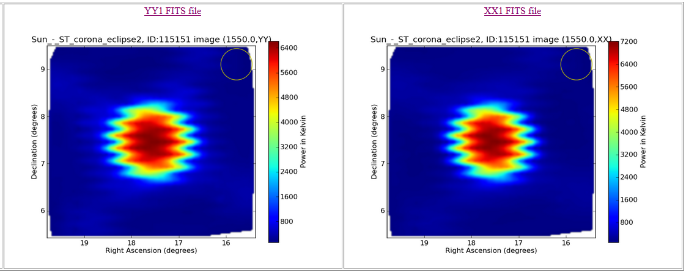
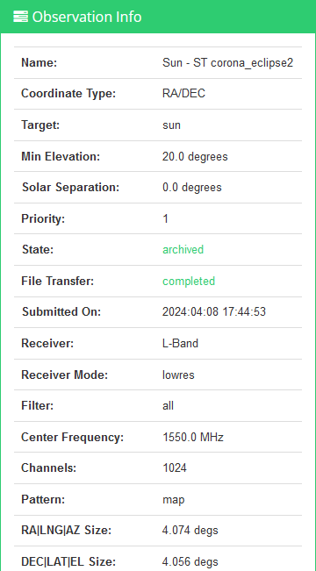
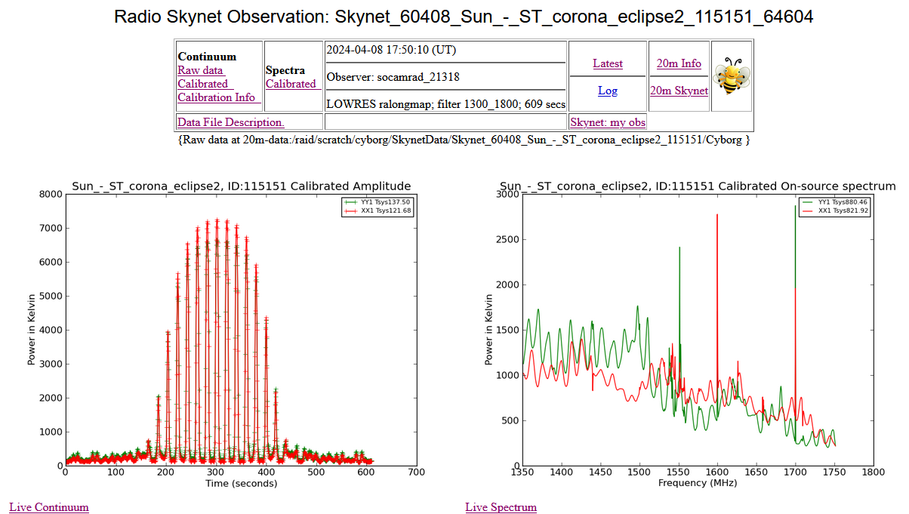
Solar Eclipses
1:50 PM On Sun
2024 4 08 Partial Solar Eclipse
20m data, raster scan mode
Pre-Start (centered on Sun)
The April 8, 2024, solar eclipse was a partial eclipse in Green Bank, WV, with about 91% obscuration.
Details of the eclipse in Green Bank, WV:
Local view: Green Bank was not in the path of totality, but it experienced a significant partial eclipse, reaching approximately 91% obscuration.
Start time: The partial eclipse began at 1:59 pm EDT.
Maximum eclipse: The peak of the eclipse was at 3:16 pm EDT.
End Time: The partial eclipse concluded at 4:29 pm EDT.
Pre-Start: 2024-04-08, 17:50 (UT) = 13:50 Green Bank

Slide 15
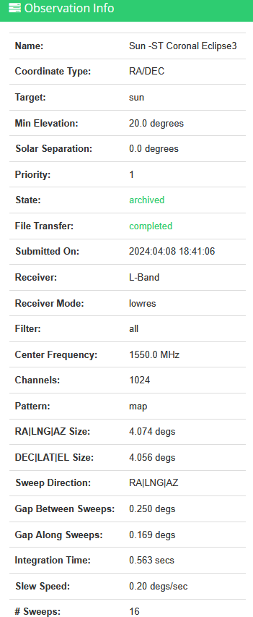
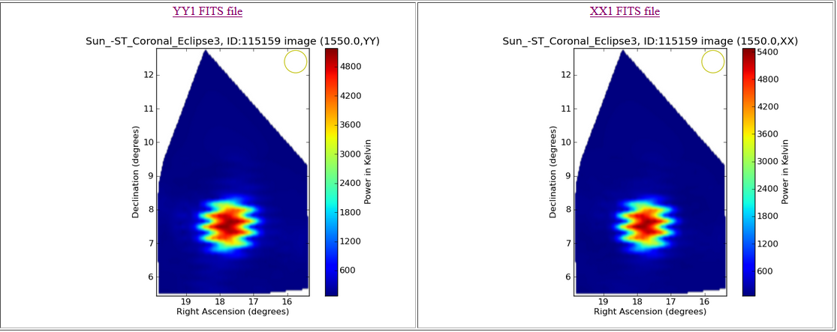
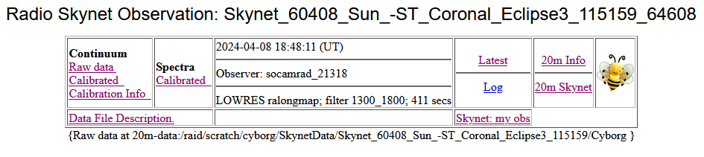
Solar Eclipses
2:48 PM on Sun
2024 4 08 Partial Solar Eclipse
20m data, raster scan mode
Centered on Sun
The April 8, 2024, solar eclipse was a partial eclipse in Green Bank, WV, with about 91% obscuration.
Details of the eclipse in Green Bank, WV:
Local view: Green Bank was not in the path of totality, but it experienced a significant partial eclipse, reaching approximately 91% obscuration.
Start time: The partial eclipse began at 1:59 pm EDT.
Maximum eclipse: The peak of the eclipse was at 3:16 pm EDT.
End Time: The partial eclipse concluded at 4:29 pm EDT.
Pre-Peak 2024-04-08, 18:48 (UT) = 14:48 Green Bank

Slide 16
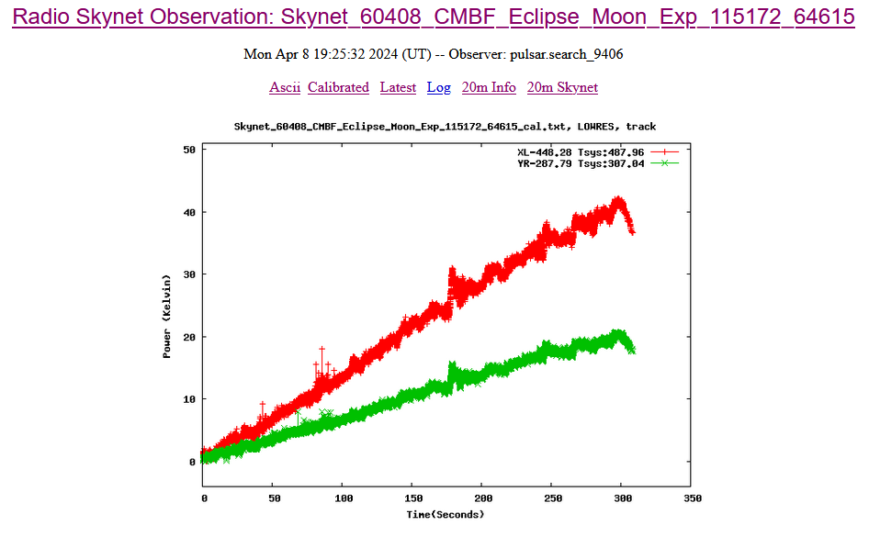
Solar Eclipses
3:25 PM On Moon
No “Skynet: My Obs”
2024 4 08 Partial Solar Eclipse
20m data, track mode
19:25 UT = 15:25 Green Bank
9 min. after peak eclipse centered on Moon Power Increasing as Expected
The April 8, 2024, solar eclipse was a partial eclipse in Green Bank, WV, with about 91% obscuration.
Details of the eclipse in Green Bank, WV:
Local view: Green Bank was not in the path of totality, but it experienced a significant partial eclipse, reaching approximately 91% obscuration.
Start time: The partial eclipse began at 1:59 pm EDT.
Maximum eclipse: The peak of the eclipse was at 3:16 pm EDT.
End Time: The partial eclipse concluded at 4:29 pm EDT.
Post-Peak: 2024-04-08, 19:25 (UT) = 15:25 Green Bank

Slide 17
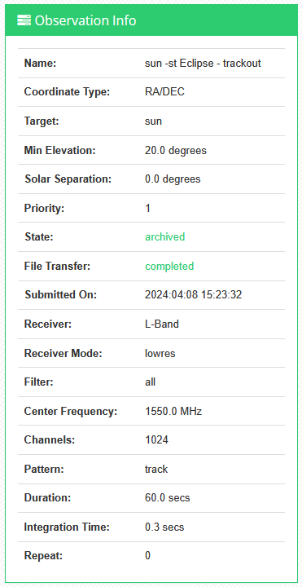
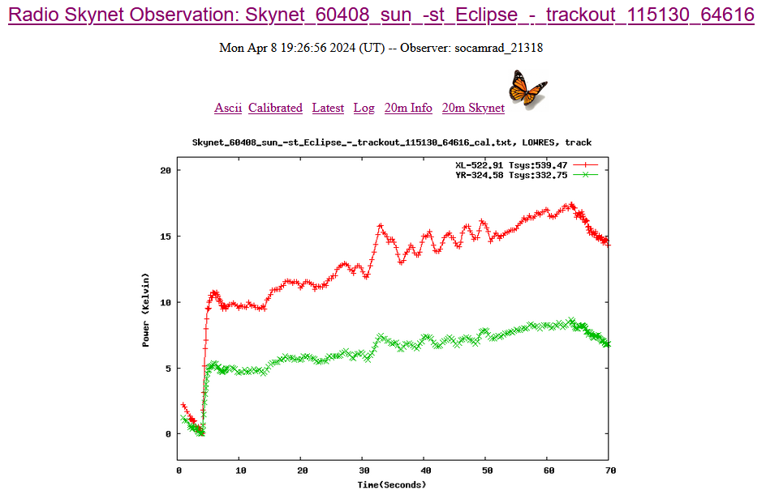
Solar Eclipses
3:26 PM On Sun
2024 4 08 Partial Solar Eclipse
20m data include raster scan mode
19:26 UT = 15:26 Green Bank
Post peak eclipse, Power Increasing as expected
Start time: The partial eclipse began at 1:59 pm EDT.
Maximum eclipse: The peak of the eclipse was at 3:16 pm EDT.
End Time: The partial eclipse concluded at 4:29 pm EDT.

Slide 18
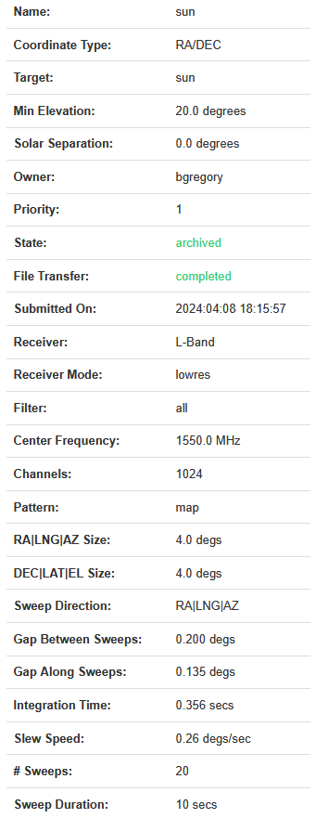
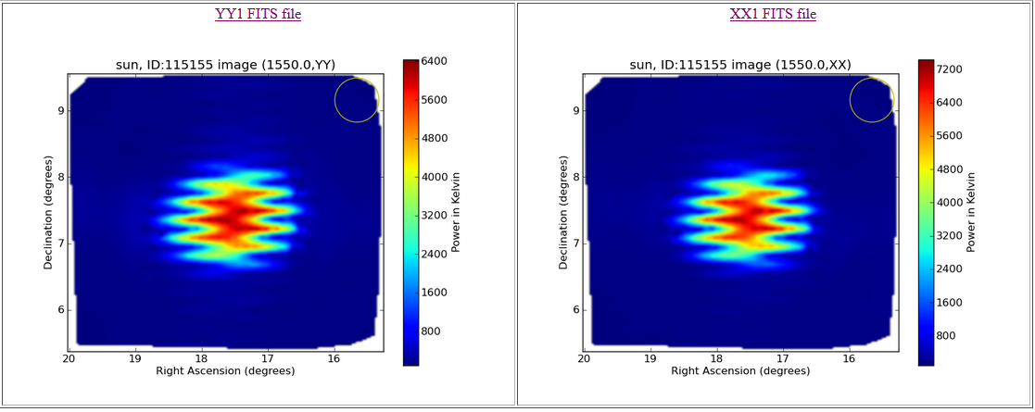
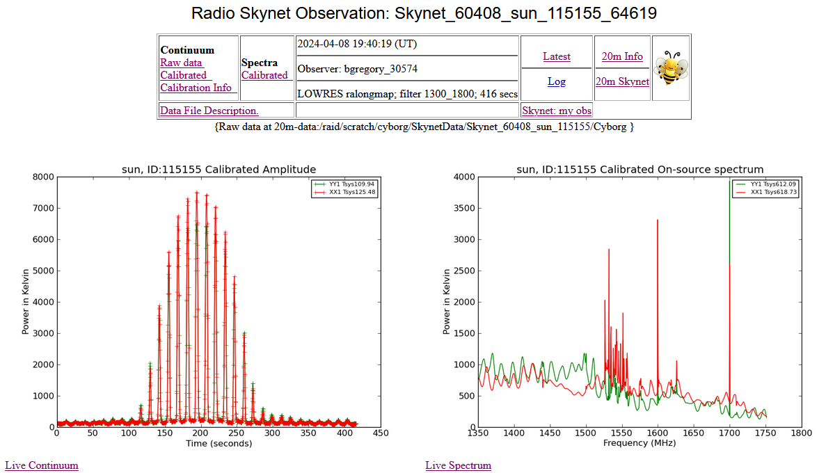
Solar Eclipses
3:40 PM On Sun
B. Gregory Observation
2024 4 08 Partial Solar Eclipse
20m data include raster scan mode
19:40 UT = 15:40 Green Bank
Post peak eclipse, centered on Sun
Start time: The partial eclipse began at 1:59 pm EDT.
Maximum eclipse: The peak of the eclipse was at 3:16 pm EDT.
End Time: The partial eclipse concluded at 4:29 pm EDT.

Slide 19

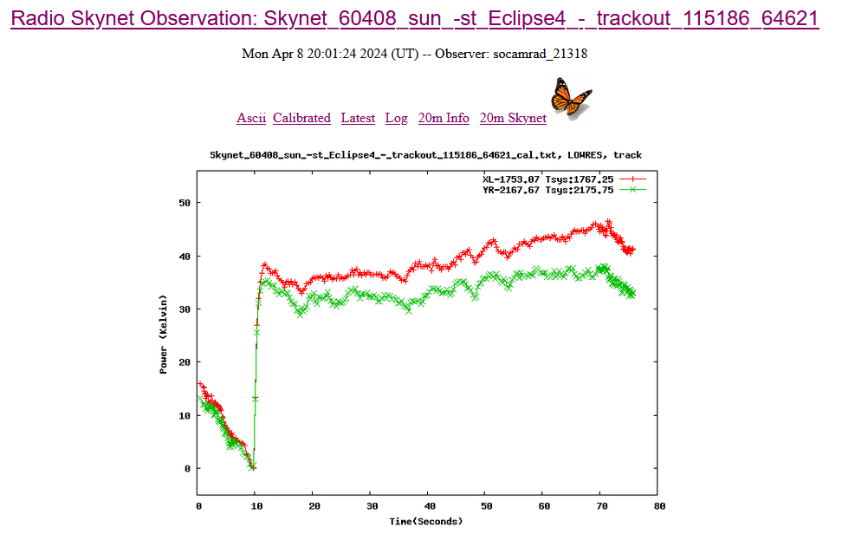
Solar Eclipses
4:01 PM on Sun
2024 4 08 Partial Solar Eclipse
20m data, raster scan mode
20:01 UT = 16:01 Green Bank
Post Peak, centered on Sun
Increasing power signal as expected

Slide 20
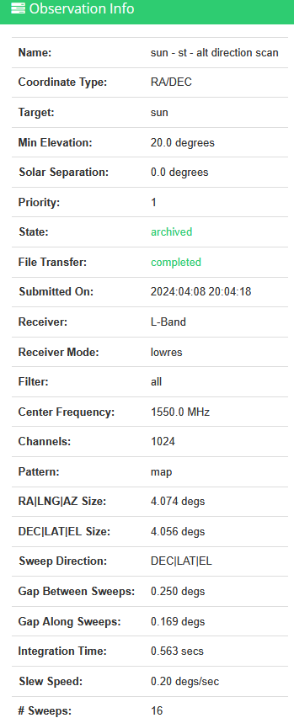
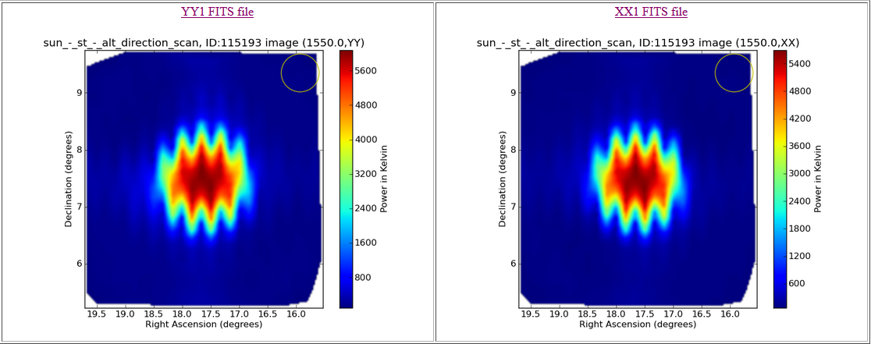
Solar Eclipses
4:04 PM on Sun
2024 4 08 Partial Solar Eclipse
20m data include raster scan mode
20:04 UT = 16:04 Green Bank
26 min. before end centered on Sun
Start time: The partial eclipse began at 1:59 pm EDT.
Maximum eclipse: The peak of the eclipse was at 3:16 pm EDT.
End Time: The partial eclipse concluded at 4:29 pm EDT.

Slide 21
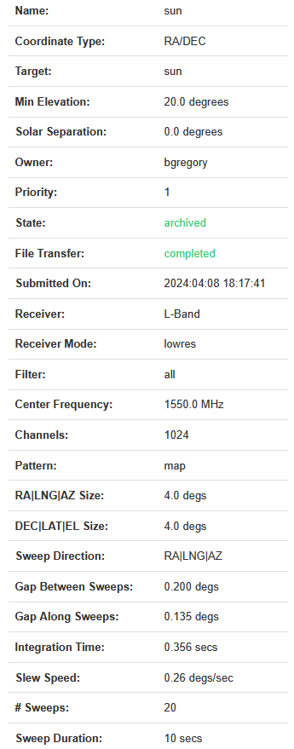

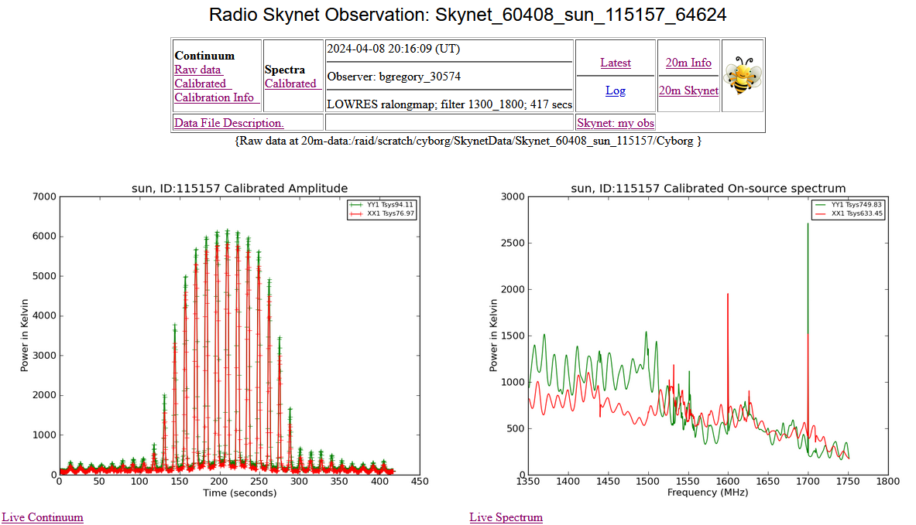
Solar Eclipses
4:16 PM on Sun
2024 4 08 Partial Solar Eclipse
20m data, raster scan mode
20:16 UT = 16:16 Green Bank
Post peak eclipse, centered on Sun
Start time: The partial eclipse began at 1:59 pm EDT.
Maximum eclipse: The peak of the eclipse was at 3:16 pm EDT.
End Time: The partial eclipse concluded at 4:29 pm EDT.

Slide 22
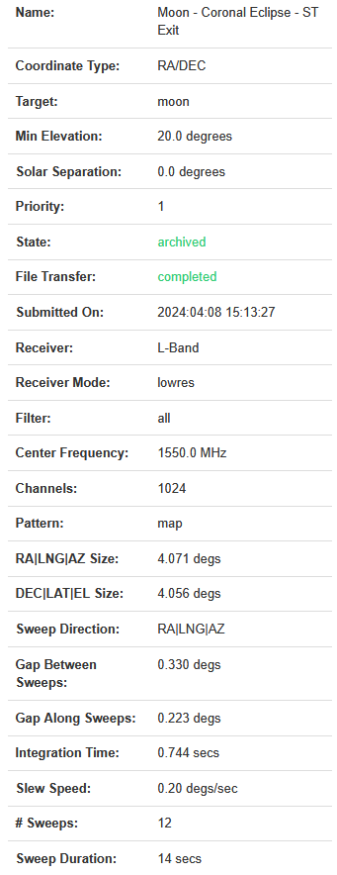
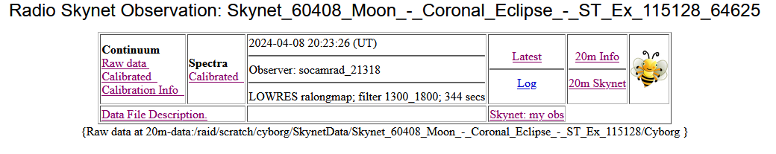
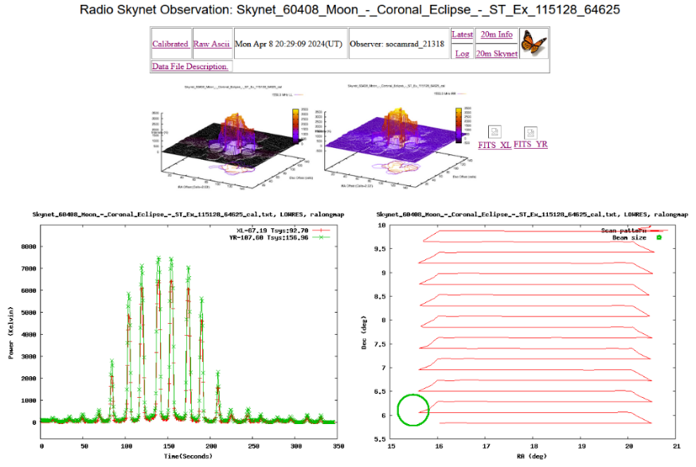
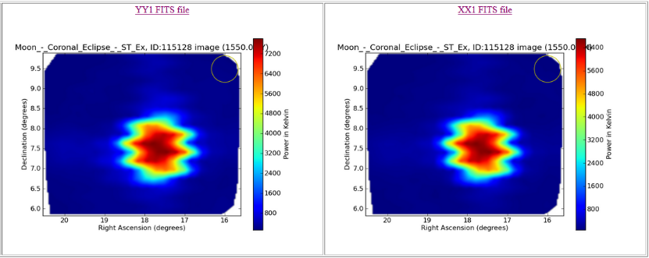
Solar Eclipses
4:23 PM On Moon
2024 4 08 Partial Solar Eclipse
20m data, raster scan/Contour mode
20:23 UT = 16:23 Green Bank
Centered on Moon
Start time: The partial eclipse began at 1:59 pm EDT.
Maximum eclipse: The peak of the eclipse was at 3:16 pm EDT.
End Time: The partial eclipse concluded at 4:29 pm EDT.

Slide 23
Solar Eclipses
Lessons Learned: Even with the 20m radio telescope centered on the Moon, the signal from the Moon is lost in the noise from the much more powerful signal from the Sun. But there is a way around this, and it was successfully employed on March 29, 2025.

Slide 24
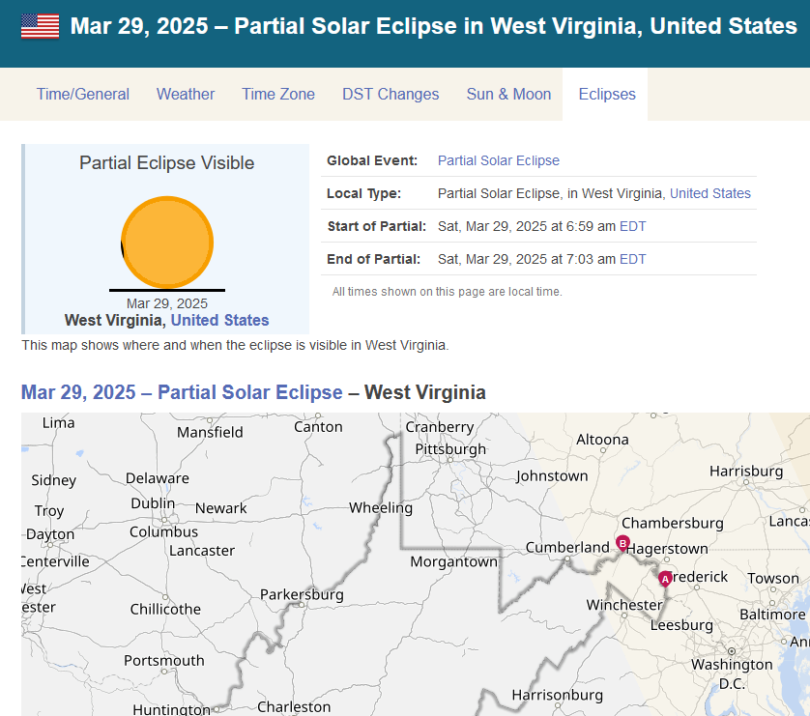
Solar Eclipses
2025 3 29 Eclipse
Corona Eclipse
This Time Prepared!

Slide 25
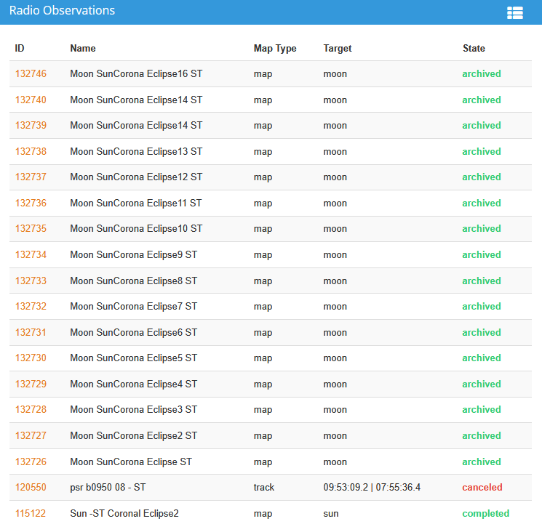
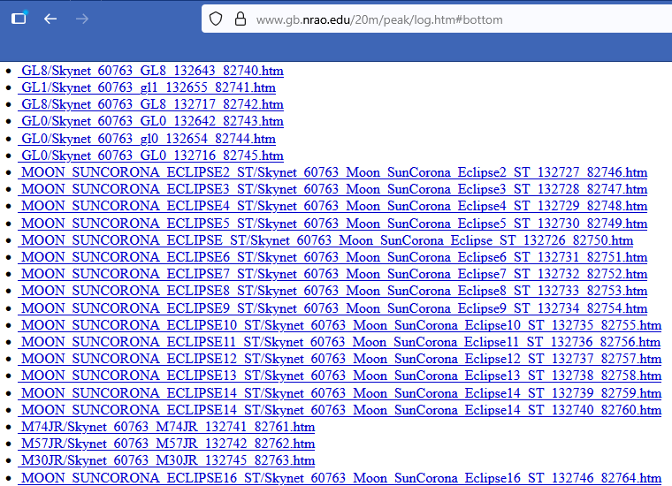
Solar Eclipses
2025 3 29 Eclipse

Slide 26
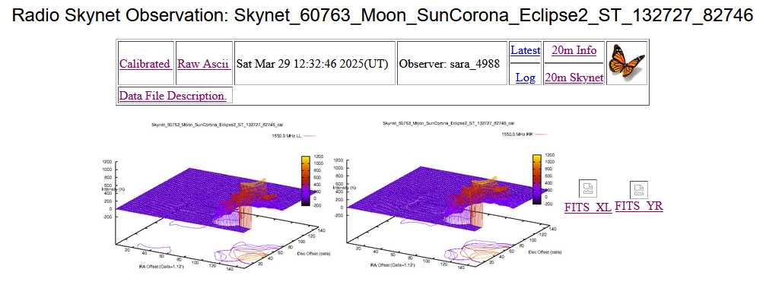
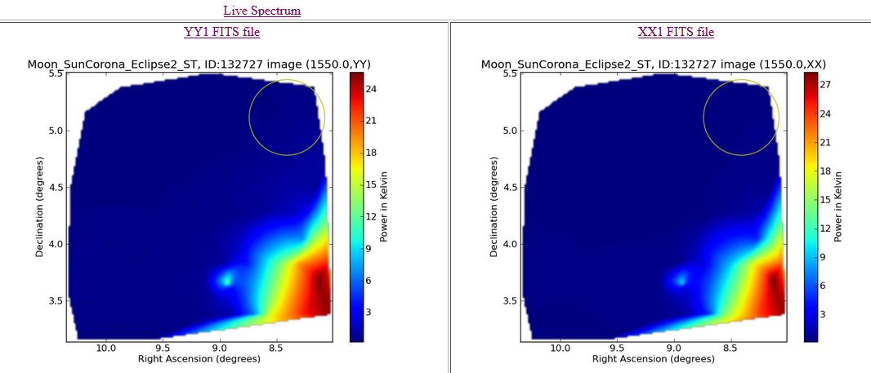
Solar Eclipses
2025 3 29 Eclipse
Clocks adjusted forward on March 9, 2025. UT is 4 hours ahead of WV time
Start of Eclipse = 6:59 AM = 12:59 UT
End of Eclipse = 7:03 AM = 13:03 UT
12:32 UT
Centered on Moon
Before start of eclipse

Slide 27
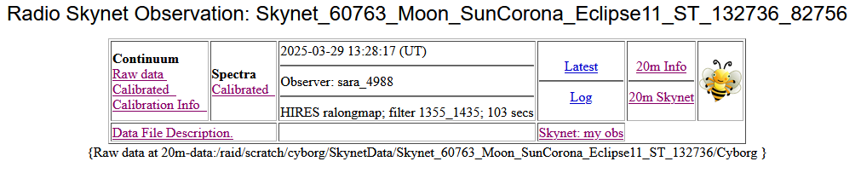
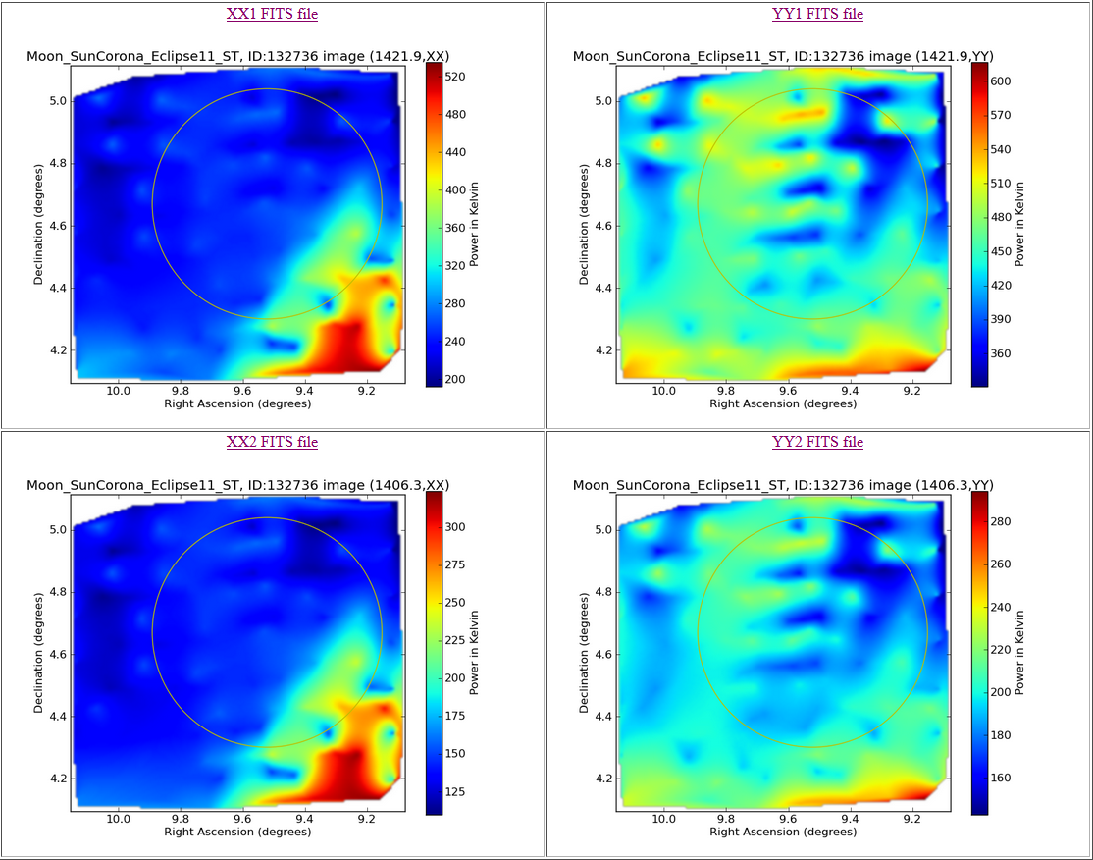
Solar Eclipses
2025 3 29 Eclipse
Clocks adjusted forward on March 9, 2025. UT is 4 hours ahead of WV time
Start of Eclipse = 6:59 AM = 12:59 UT
End of Eclipse = 7:03 AM = 13:03 UT
13:28 UT
Centered on Moon
After end of eclipse
Lunar/Corona signal starting to appear as Sun recedes further away

Slide 28
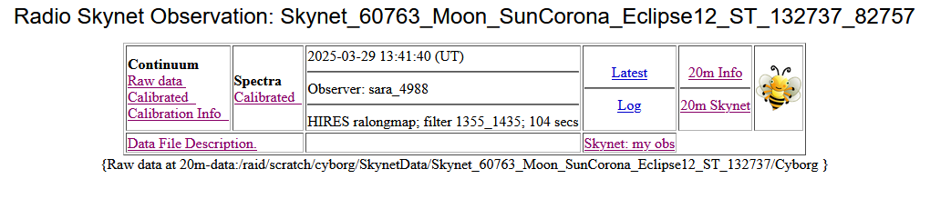
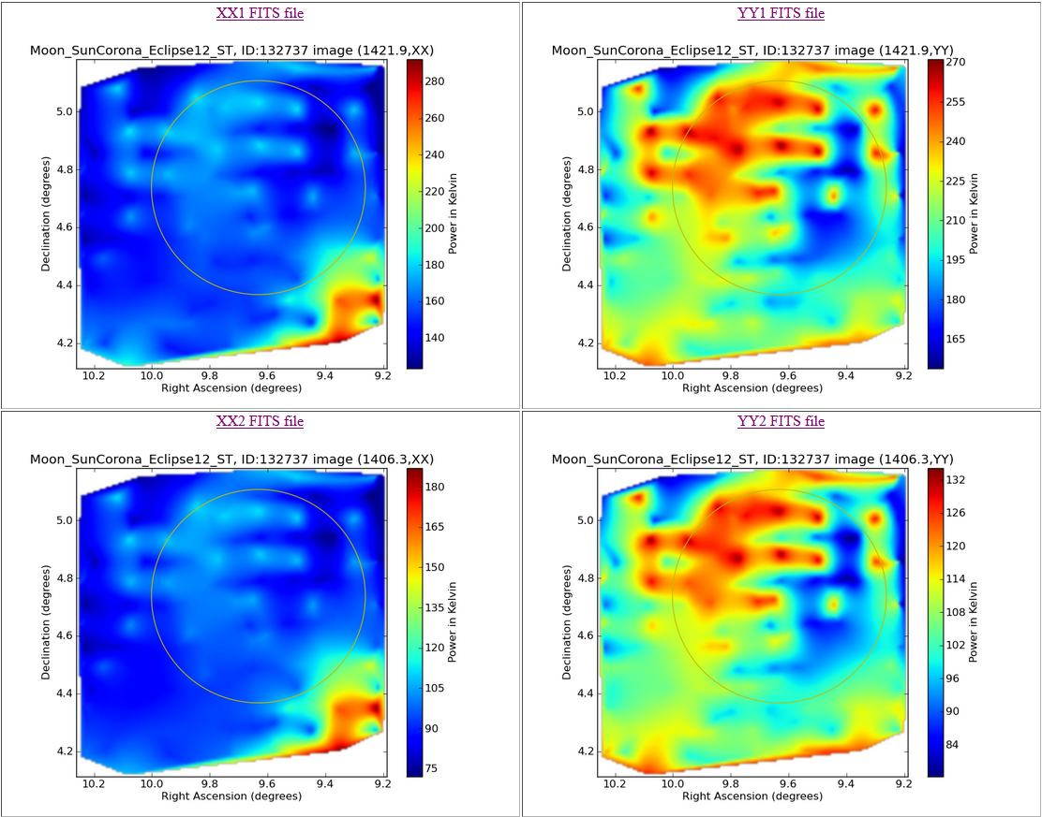
Solar Eclipses
2025 3 29 Eclipse
Clocks adjusted forward on March 9, 2025. UT is 4 hours ahead of WV time
Start of Eclipse = 6:59 AM = 12:59 UT
End of Eclipse = 7:03 AM = 13:03 UT
13:41 UT
Centered on Moon
After end of eclipse
Lunar/Corona signal even stronger as Sun recedes even further away

Slide 29
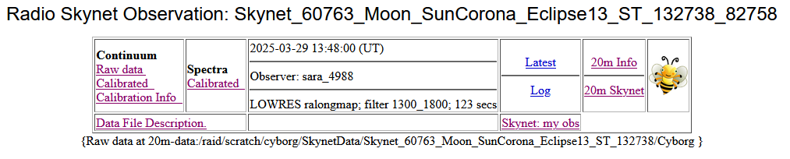
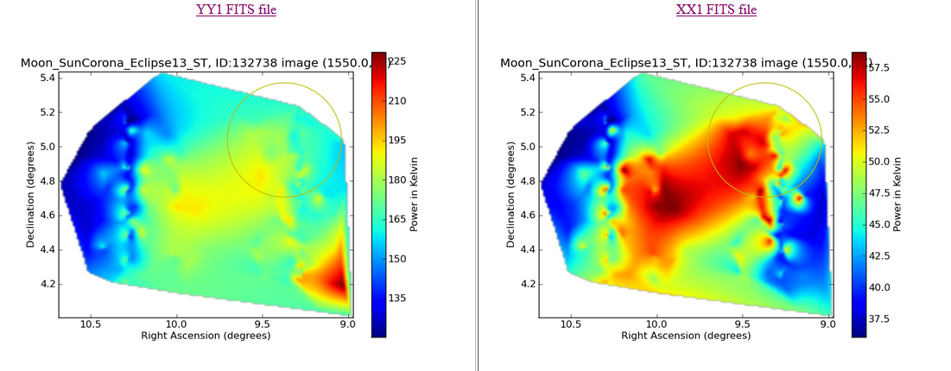
Solar Eclipses
2025 3 29 Eclipse
Clocks adjusted forward on March 9, 2025. UT is 4 hours ahead of WV time
Start of Eclipse = 6:59 AM = 12:59 UT
End of Eclipse = 7:03 AM = 13:03 UT
UT = 13:48
Centered on Moon
After end of eclipse
Lunar/Corona signal stronger still as Sun recedes even further.

Slide 30
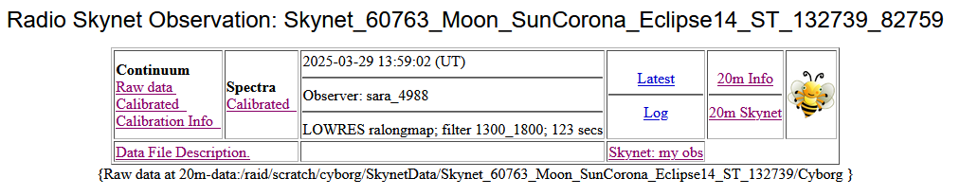
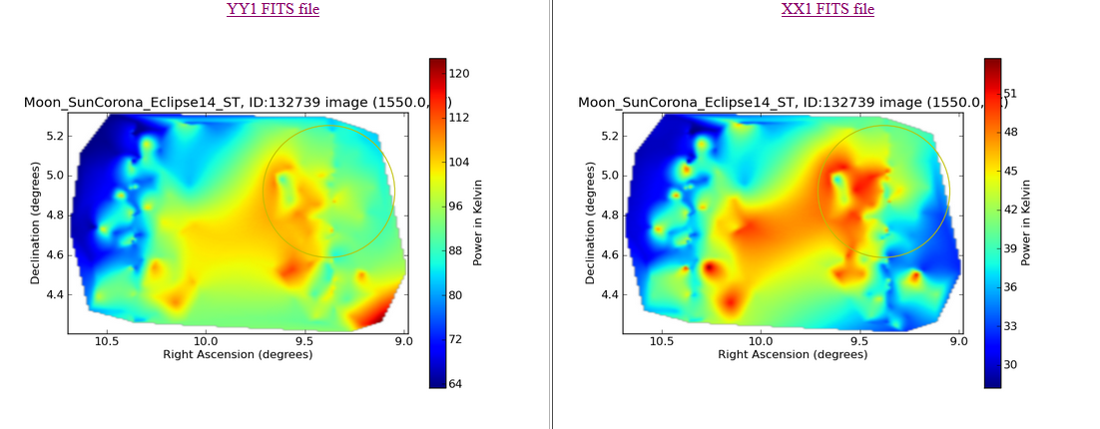
Solar Eclipses
2025 3 29 Eclipse
Clocks adjusted forward on March 9, 2025. UT is 4 hours ahead of WV time
Start of Eclipse = 6:59 AM = 12:59 UT
End of Eclipse = 7:03 AM = 13:03 UT
13:59 UT
Centered on Moon
After end of eclipse
Lunar/corona signal is similar. Eventually, the corona signal will fade, and the lunar signal will be a strong signal of a round disc as the Sun’s distance becomes great.

Slide 31


Solar Eclipses
2025 3 29 Eclipse
Clocks adjusted forward on March 9, 2025. UT is 4 hours ahead of WV time
Start of Eclipse = 6:59 AM = 12:59 UT
End of Eclipse = 7:03 AM = 13:03 UT
14:18 UT
Centered on Moon
After end of eclipse
Corona signal is fades. Eventually, the lunar signal will be a strong signal of a round disc as the Sun’s distance becomes great.

Slide 32

Solar Eclipses
2020 1 24 Corona Eclipse
On 1/24/2020 , UT is 5 hours ahead of WV time.
Sun and Moon are near each other at 11:13 AM Eastern time.
Credit: https://in-the-sky.org/skymap.php

Slide 33

Solar Eclipses
2020 1 24 Corona Eclipse
Frank Ghigo, an experienced radio astronomer at GBO, submits an observation centered on the Moon, in L-Band, and is Daisy mode.
The separation between the Sun and Moon is significantly larger than my observations, and the Daisy pattern offers considerable difference between the sweep pattern.
Is this a better strategy?
Let’s see.

Slide 34

Solar Eclipses
2020 1 24 Corona Eclipse
Here are the main observation page at 16:13:39 UT or 11:13 AM Local GBO time.
Let’s next observe the raster scan

Slide 35

Solar Eclipses
2020 1 24 Corona Eclipse
Wow! Sun, Moon, Corona.
I am a bit surprised that the Sun does not drown out the Moon.
My interpretation: The Sun is further from the Moon (center of observation) and the daisy pattern is not a full raster scan.

Slide 36

Solar Eclipses
2026 8 12
Next Coronal Eclipse

Slide 37

Solar Flares
Google AI Overview: October 2 , 2015 solar flare

Slide 38


Solar Flares
The Sun
Skynet_57983_sunmapSA_30059_30270.A.cal_LL0_img = 8/18/2017 (now broken link)
Skynet_57297_sun_X-Band_map_15701_16626.A.cal_RR0_img (solar flare) = 10/02/2015
While the Sun’s optical corona extends up to 12 solar radii from the Sun’s surface, the L-band corona is likely smaller.
Are we also seeing the Sun’s Corona?
Did someone correlate flares to 20m observing?
Date: 8/18/2017
Date: 10/02/2015

Slide 39



Solar Flares
Date = 10/02/2015
A closer data look
In X-Band

Slide 40


OJ 287 System “Flares”
Search Option Example
Frank Ghigo (GBO Scientist) and OJ 287 Target
Credit: https://skyandtelescope.org/astronomy-news/black-hole-duo-flares-right-on-time
The OJ 287 system “flares” when the smaller black hole plunges through a disk of gas around the larger one, an event that occurs twice during each 12-year orbit.

Slide 41


Occultations
Radio Occultation Guide: SARA Analytical Section

Slide 42

Occultations
https://www.youtube.com/watch?v=qKy-WCW0pdg

Slide 43
Summary and Open Forum
Summary:
Five different Sun-Moon partial eclipses and vicinity passes.
Why did the 20m dish observe as it did?
The radio telescope beam size needs to be considered.
The radio telescope sweep pattern and spacing needs to be considered.
The radio telescope receiver frequency needs to be considered.
Finding observations by experienced radio astronomers (Frank Ghigo) offers great insights.
The relative radio flux strength of the Sun and Moon and their separation angle needs to be considered.
Choose receiver settings (band width, center frequency, high/low resolution). Ensure proper data selected per polarization and frequency. i.e., xx1, yy1, xx2, or yy2, raw vs calibrated.
Confirm solar flares with NASA data.
Questions?

Slide 44
Contact
Email SARA Section Analytical Section Coordinator
Tzikas@alum.rpi.edu
stephentzikas@gmail.com

